Slide 1
Cabinets of curiosities:
https://www.youtube.com/watch?v=pj9Hp7Cxk_Y&ab_channel=anndilek

Slide 2
Ancient diver

Slide 3
Ancient Roman bikinis

Slide 4
Angelica Kauffman - Self portrait 1787

Slide 5
Eilliam Wordsworth- Il Preludio

Slide 6
Gavin Hamilton - The 8th Duke of Hamilton with dr. John Moore and Ensign Moore 1775

Slide 7
Goethe in the Campagna 1848

Slide 8
Jacob More – Self portrait 1783

Slide 9
Jakob Philipp Hackert - Lake Avernus 1800

Slide 10
Johan Zoffany - The Tribuna degli Uffizi 1772

Slide 11
Louis Ducros – The Grand Duke Paul and his Retinue in the forum Romanum, 1782

Slide 12
Pannini Giovanni Paolo - Views of Ancient Rome 1755

Slide 13
Pierre Volaire – The Eruption of Vesuvius from Atrio del Cavallo 1774

Slide 14
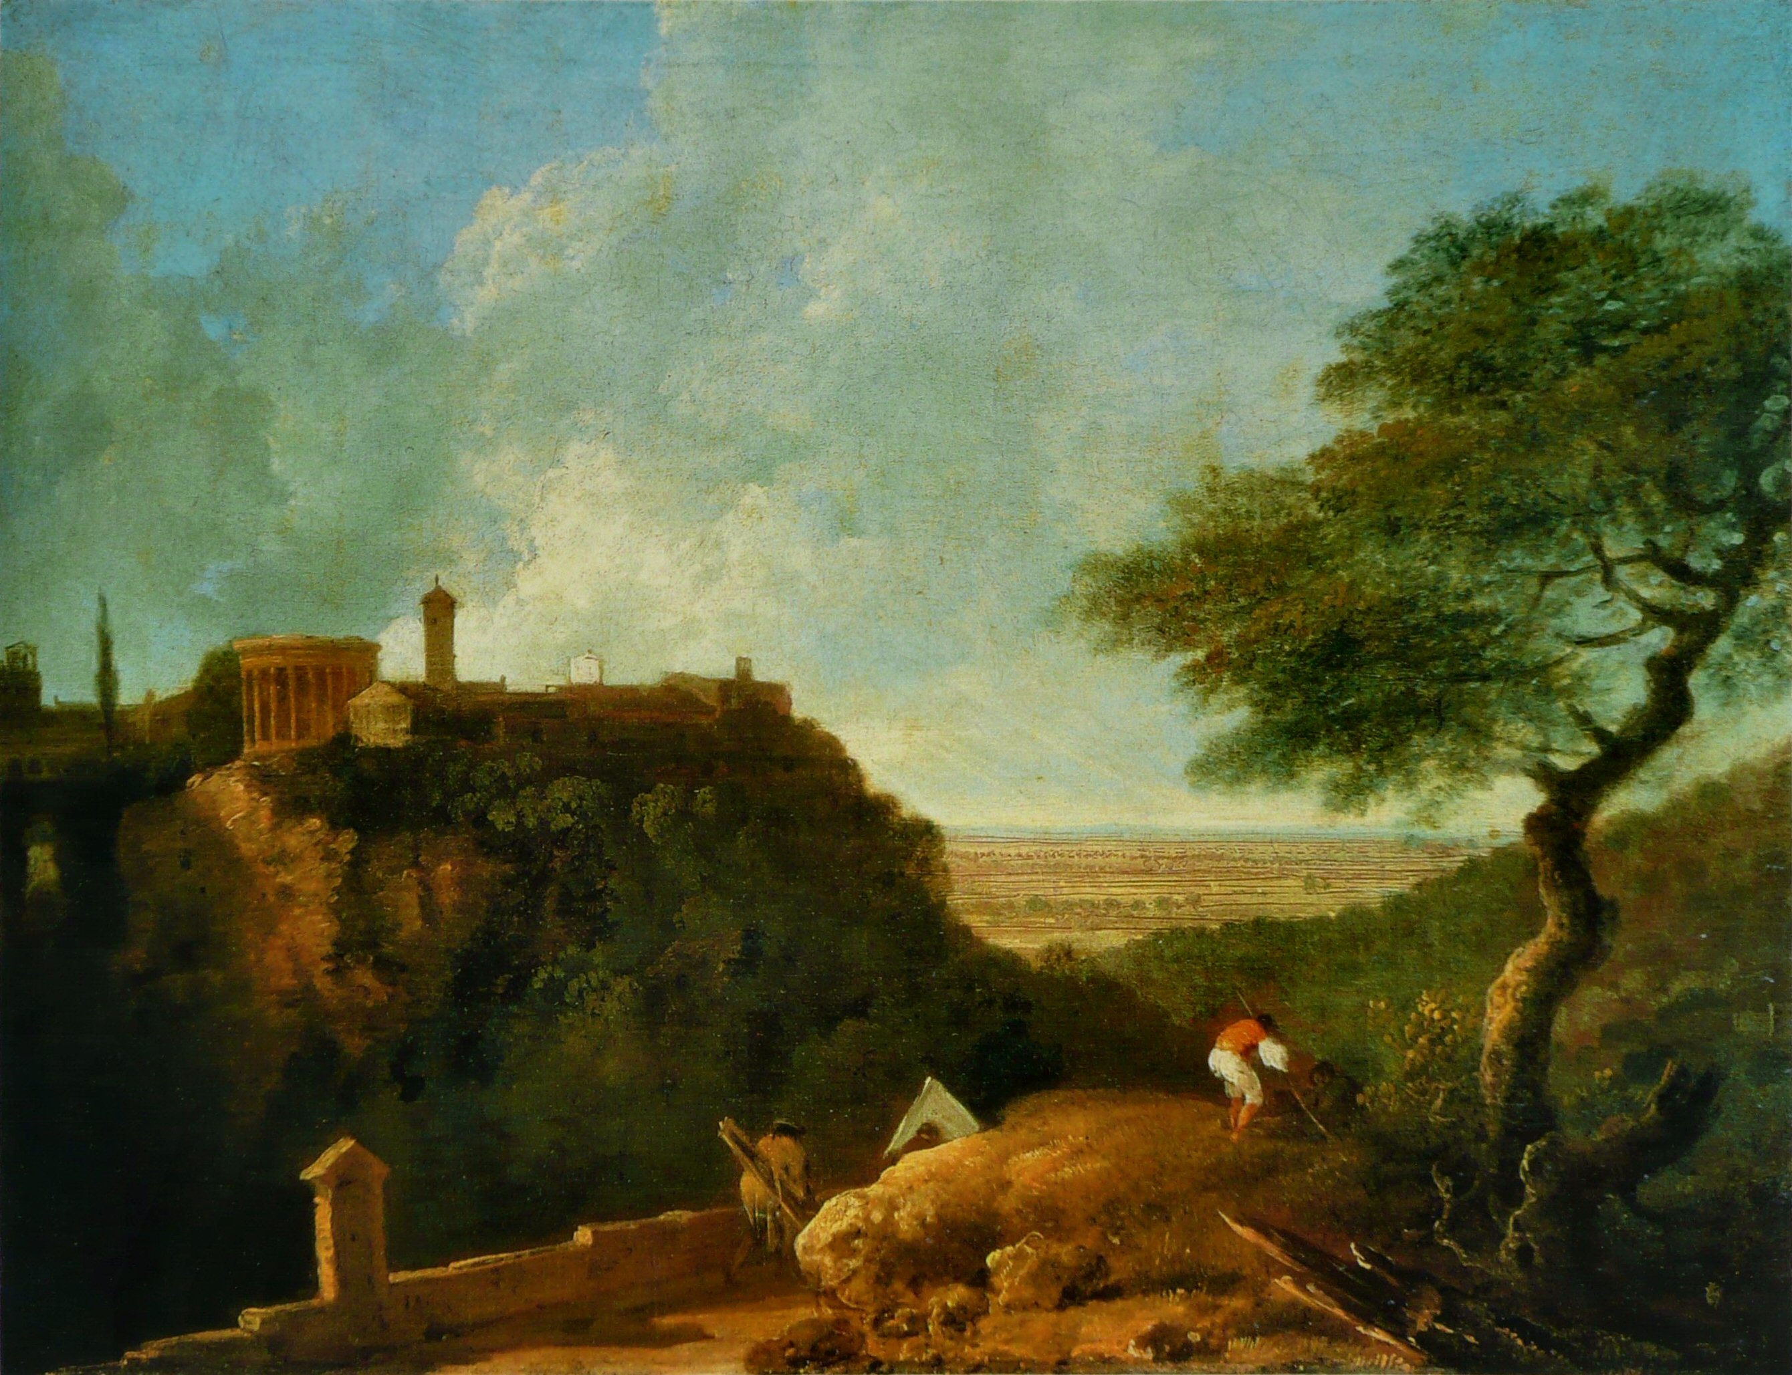
Richard Wilson – Tivoli The Temple of the Sibyl and Campagna 1752

Slide 15
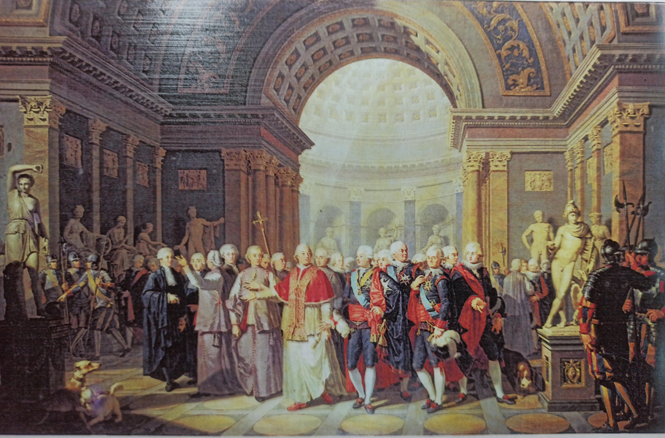
Pius VI Accompanying Gustav III of Sweden on a visit to the Museo Pio - Clementino, Benigne Gagnereaux 1786

Slide 16
Venice Regata in honour of Duke of York

Slide 18
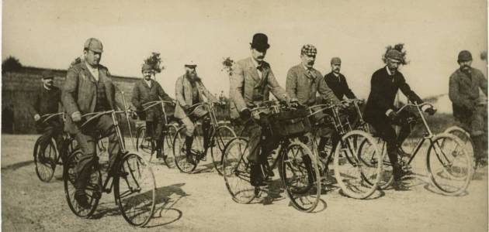
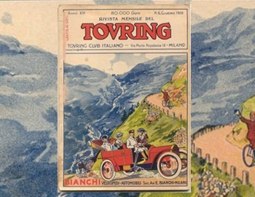
Touring Club Italiano

Slide 19
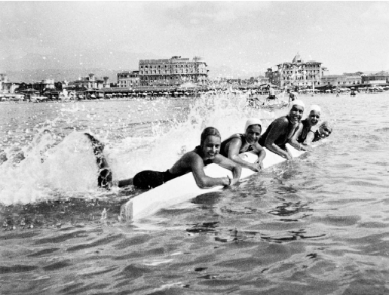
Women at the seaside, 1930s

Slide 21
1938

Slide 22
Fiat workers on excursion, 1962

Slide 23
Autostrada del Sole, 1969

Slide 24
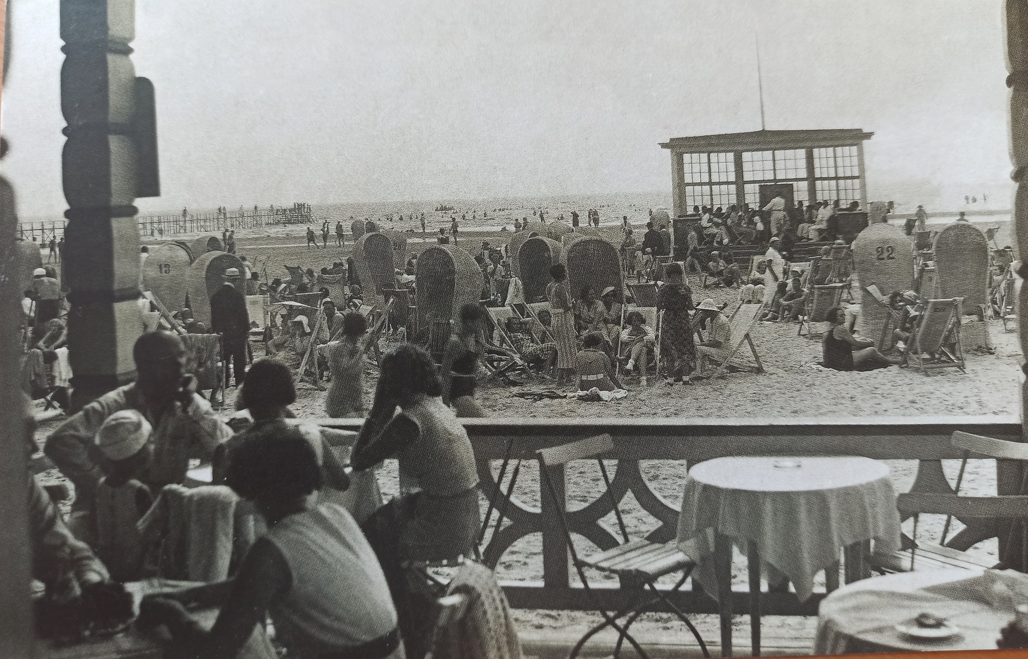

Slide 25
Venice in Las Vegas

Slide 26
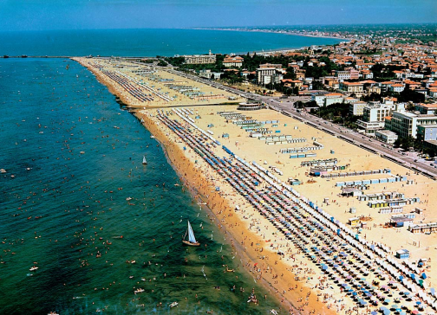

Slide 27
Timelapse of travel and motion
https://www.youtube.com/watch?v=83IVP1LxesU&ab_channel=Eyefortravel
A flight to nowhere:
https://edition.cnn.com/travel/article/flights-to-nowhere-qantas/index.html
Transport clashes in the globalized world:
Oil shock 1973:
https://www.businessinsider.com/1973-oil-crisis-photos-2013-10?IR=T#others-were-more-ominous-10
Covid 19, empty skies:
https://www.youtube.com/watch?v=7-Kis29TiTo&ab_channel=FRANCE24English

Slide 28
Dark Tourism
https://www.youtube.com/watch?v=8vV1xaLCONw&ab_channel=Netflix
https://www.youtube.com/watch?v=DFDECH8Y91U&ab_channel=CBCMoscow
https://www.youtube.com/watch?v=_KRDUNY5TO8&ab_channel=NowThisWorld

Slide 29
Terrorism and travel
https://www.gov.uk/guidance/reduce-your-risk-from-terrorism-while-abroad#history
https://travel.state.gov/content/travel/en/international-travel/emergencies/terrorism.html
https://www.youtube.com/watch?v=_KRDUNY5TO8&ab_channel=NowThisWorld

