Slide 1
Knowledge and Rationality – A.Y. 2024-2025
Ideals of
Rationality
Selene Arfini – selene.arfini@unipv.it

Slide 2
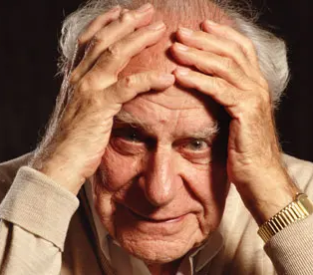
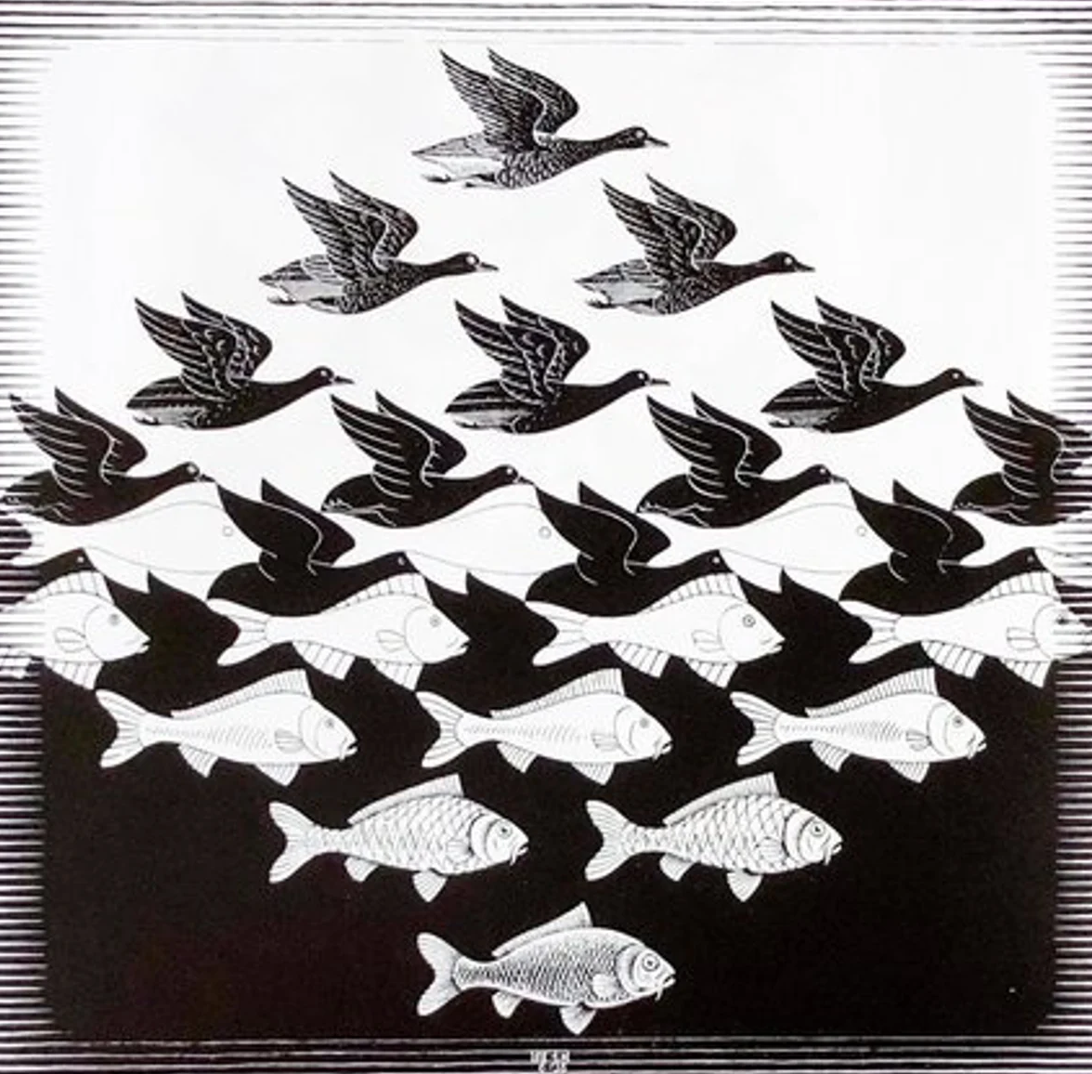
RATIONALITY
Un'ipotesi è falsificabile
se esiste almeno una proposizione osservativa logicamente possibile incompatibile con essa, ossia che, se vera,
la possa falsificare.
FALSIFICABILE
Karl Popper
(1902-1994)

Slide 3
LECT. 1
What are the rules of rationality?
And in which sense are they "rules"?
Reading on rationality and emotions
LECT. 2
Can we adjust either the idea of rationality or of human as a reasonable being?
Reading on if rationality can be universal
RATIONALITY
IRRATIONALITY
IRRATIONALITY

Slide 4
LECT. 1
What are the rules of rationality?
And in which sense are they "rules"?
Reading on: When are emotions rational?
LECT. 3
What is irrational? And ignorance and irrationality go hand in hand?
Reading what remains of irrationality
LECT. 2
Should we reconsider the idea of rationality? Can humans be rational?
Reading on: Can rationality can be universal?
LECT. 4
Is self-deception a form of self-defeating rationality (and so, by default irrational)?
Reading on self-deception and religion
RATIONALITY
RATIONALITY
IRRATIONALITY

Slide 5
LECT. 3
What is irrationality? And do ignorance and irrationality go hand in hand?
Reading on: what remains of irrationality?
LECT. 1
What are the rules of rationality?
And in which sense are they "rules"?
Reading on rationality and emotions
LECT. 5
How is the body involved in rational reasoning and behavior?
Reading on the consistency of 4E cognition
LECT. 2
Can we adjust either the idea of rationality or of man as a reasonable being?
Reading on if rationality can be universal
LECT. 4
Is self-deception a form of self-defeating rationality (and so, is it by default irrational)?
Reading on self-deception and religion
LECT. 6
How can the idea of rationality change if we consider the tenets of embodied cognition?
Reading on embodiment and naturalism
RATIONALITY
IRRATIONALITY
IRRATIONALITY

Slide 6
LECT. 5
How is the body involved in rational reasoning and behavior?
Reading on: the consistency of 4E cognition
LECT. 1
What are the
rules of rationality?
And in which sense
are they "rules"?
LECT. 6
How can the idea of rationality change if we consider the tenets of embodied cognition?
Reading on embodiment and naturalism
EMBODIED BOUNDED RATIONALITY
IRRATIONALITY

Slide 7
an interdisciplinary notion
Philosophy, psychology,
economics, mathematics,
statistics
LECT. 1
What are the
rules of rationality?
And in which sense
are they "rules"?
PHILOSOPHICAL
NATURALISM
BY DEFAULT
RATIONALITY

Slide 8
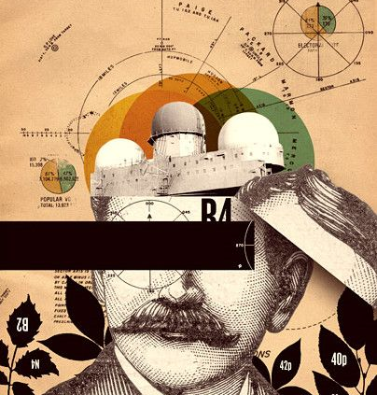
ONTOLOGICAL NATURALISM
METHODOLOGICAL NATURALISM
Sturm 2021, p. 79

Slide 9
ONTOLOGICAL NATURALISM
ONTOLOGICAL NATURALISM
"Reality consists only of natural objects, their properties, and relations: there are no unexplainable or irreducible supernatural entities or powers."
METHODOLOGICAL NATURALISM
Sturm 2021, p. 79

Slide 10
METHODOLOGICAL NATURALISM
ONTOLOGICAL NATURALISM
METHODOLOGICAL NATURALISM
"Philosophical questions can and should be answered by relying on the methods of the empirical sciences: there is no a priori philosophical knowledge and there are no special philosophical methods."
ONTOLOGICAL NATURALISM
"Reality consists only of natural objects, their properties, and relations: there are no unexplainable or irreducible supernatural entities or powers."
Sturm 2021, p. 79

Slide 11
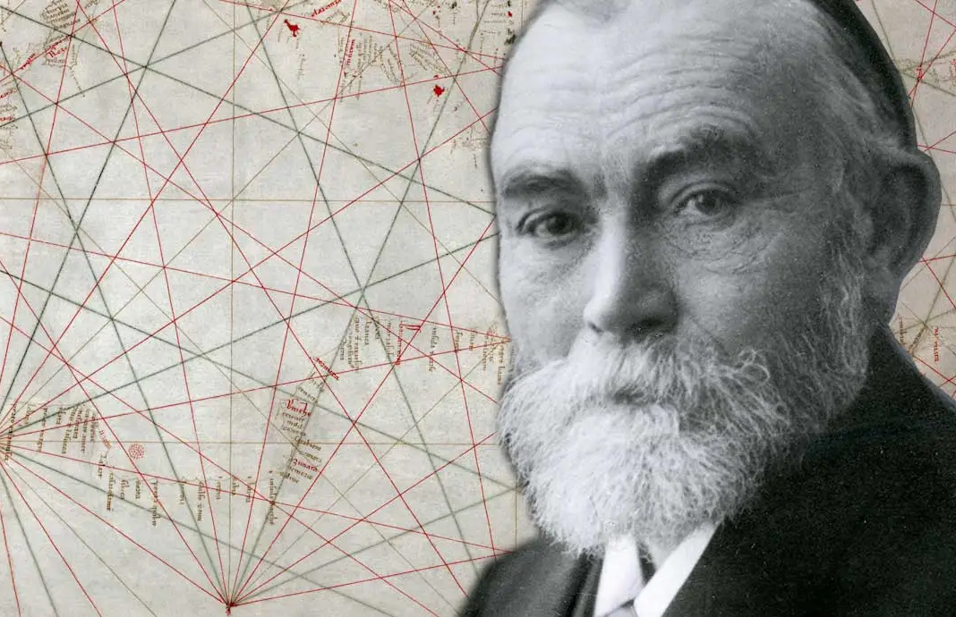
Edward Stein’s (1996)
"Standard Picture"
of Rationality
an interdisciplinary notion
Philosophy, psychology,
economics, mathematics,
statistics
Deductive Logics
PHILOSOPHICAL
NATURALISM
BY DEFAULT
Probability
Decision theory
RATIONALITY

Slide 12
Edward Stein’s (1996)
"Standard Picture"
of Rationality
an interdisciplinary notion
Philosophy, psychology,
economics, mathematics,
statistics
Logical rules determine whether reasoning from premises to conclusions is truth-preserving.
In valid inferences, if the premises are true, then the conclusion will also be true
Deductive Logics
PHILOSOPHICAL
NATURALISM
BY DEFAULT
Gottlob Frege’s
Logicism and anti-psychologicism
RATIONALITY
Probability
Decision theory

Slide 13
If Adam tests positive for covid
Then he must have a fever
Adam has a fever,
Adam tests positive for covid
FALLACY: Abduction or
affirming of the consequent
Edward Stein’s (1996)
"Standard Picture"
of Rationality
an interdisciplinary notion
Philosophy, psychology,
economics, mathematics,
statistics
If Ben is at home
Then he must be sick
Ben is not sick,
Ben is not at home
Deductive Logics
All French people drink wine
Some wine drinkers are snob
Some French people are snob
PHILOSOPHICAL
NATURALISM
BY DEFAULT
RATIONALITY
Logical rules determine whether reasoning from premises to conclusions is truth-preserving.
In valid inferences, if the premises are true, then the conclusion will also be true.
Probability
Decision theory
Gottlob Frege’s (1996)
Logicism and anti-psychologicism

Slide 14
If Adam tests positive for covid
Then he must have a fever
Adam has a fever,
Adam tests positive for covid
FALLACY: Abduction or
affirming of the consequent
Edward Stein’s (1996)
"Standard Picture"
of Rationality
an interdisciplinary notion
Philosophy, psychology,
economics, mathematics,
statistics
If Ben is at home
Then he must be sick
Ben is not sick,
Ben is not at home
Deductive Logics
All French people drink wine
Some wine drinkers are snob
Some French people are snob
PHILOSOPHICAL
NATURALISM
BY DEFAULT
RATIONALITY
Logical rules determine whether reasoning from premises to conclusions is truth-preserving.
In valid inferences, if the premises are true, then the conclusion will also be true.
Probability
Decision theory
Gottlob Frege’s (1996)
Logicism and anti-psychologicism

Slide 15
If Adam tests positive for covid
Then he must have a fever
Adam has a fever,
Adam tests positive for covid
FALLACY: Abduction or
affirming of the consequent
Edward Stein’s (1996)
"Standard Picture"
of Rationality
an interdisciplinary notion
Philosophy, psychology,
economics, mathematics,
statistics
If Ben is at home
Then he must be sick
Ben is not sick,
Ben is not at home
Deductive Logics
All French people drink wine
Some wine drinkers are snob
Some French people are snob
PHILOSOPHICAL
NATURALISM
BY DEFAULT
FALLACY: belief bias effect
RATIONALITY
Logical rules determine whether reasoning from premises to conclusions is truth-preserving.
In valid inferences, if the premises are true, then the conclusion will also be true.
Probability
Decision theory
Gottlob Frege’s (1996)
Logicism and anti-psychologicism

Slide 16
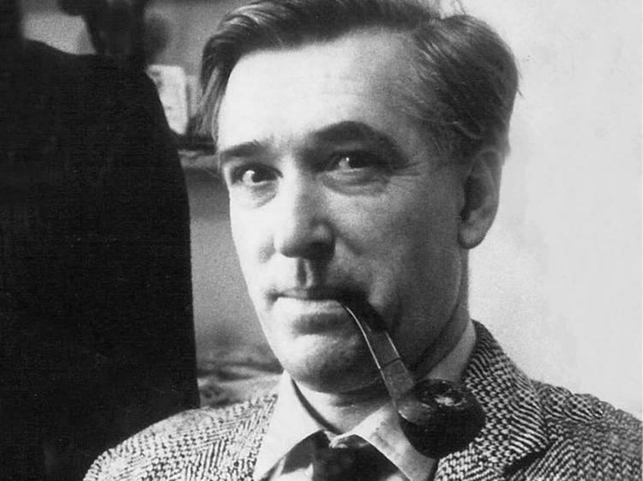
If Adam tests positive for covid
Then he must have a fever
Adam has a fever,
Adam tests positive for covid
FALLACY: Abduction or
affirming of the consequent
Peter Wason’s (1956)
Selection Task
Edward Stein’s (1996)
"Standard Picture"
of Rationality
an interdisciplinary notion
Philosophy, psychology,
economics, mathematics,
statistics
If Ben is at home
Then he must be sick
Ben is not sick,
Ben is not at home
Which card(s) must you turn over in order to test that if a card shows a vocal on one face, then its opposite face is an even number?
VALID INFERENCE:
modus tollens
Deductive Logics
All French people drink wine
Some wine drinkers are snob
Some French people are snob
PHILOSOPHICAL
NATURALISM
BY DEFAULT
FALLACY: belief bias effect
A
B
2
5
RATIONALITY
Logical rules determine whether reasoning from premises to conclusions is truth-preserving.
In valid inferences, if the premises are true, then the conclusion will also be true.
Probability
Decision theory
Gottlob Frege’s (1996)
Logicism and anti-psychologicism

Slide 17
Peter Wason’s (1956)
Selection Task
Edward Stein’s (1996)
"Standard Picture"
of Rationality
an interdisciplinary notion
Philosophy, psychology,
economics, mathematics,
statistics
Which card(s) must you turn over to test if this sentence is true: if a card shows a vocal on one face, then its opposite face is an even number?
Deductive Logics
PHILOSOPHICAL
NATURALISM
BY DEFAULT
A
B
2
5
RATIONALITY
FALLACY: Abduction or
affirming of the consequent
Logical rules determine whether reasoning from premises to conclusions is truth-preserving.
In valid inferences, if the premises are true, then the conclusion will also be true.
Probability
VALID INFERENCE:
modus tollens
Decision theory
Gottlob Frege’s (1996)
Logicism and anti-psychologicism
FALLACY: belief bias effect

Slide 18
Peter Wason’s (1956)
Selection Task
Edward Stein’s (1996)
"Standard Picture"
of Rationality
an interdisciplinary notion
Philosophy, psychology,
economics, mathematics,
statistics
Which person’s ID or drink should you check to ensure that if a person drinks alcohol, they are of the legal age to do so?
Deductive Logics
PHILOSOPHICAL
NATURALISM
BY DEFAULT
beer
coke
40yo
15yo
RATIONALITY
FALLACY: Abduction or
affirming of the consequent
Logical rules determine whether reasoning from premises to conclusions is truth-preserving.
In valid inferences, if the premises are true, then the conclusion will also be true.
Probability
VALID INFERENCE:
modus tollens
Decision theory
Gottlob Frege’s (1996)
Logicism and anti-psychologicism
FALLACY: belief bias effect

Slide 19
Peter Wason’s (1956)
Selection Task
Edward Stein’s (1996)
"Standard Picture"
of Rationality
an interdisciplinary notion
Philosophy, psychology,
economics, mathematics,
statistics
Which card(s) must you turn over in order to test that if a card shows a vocal on one face, then its opposite face is an even number?
Deductive Logics
PHILOSOPHICAL
NATURALISM
BY DEFAULT
Probability
A
B
2
5
Decision theory
RATIONALITY

Slide 20
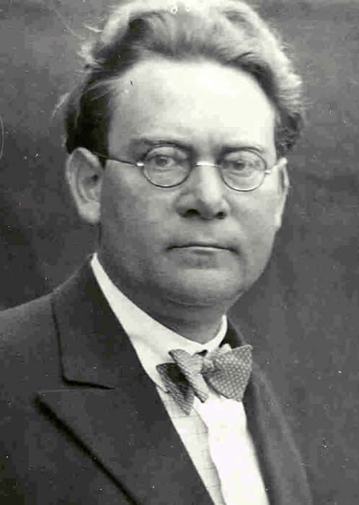
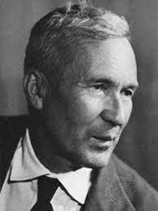
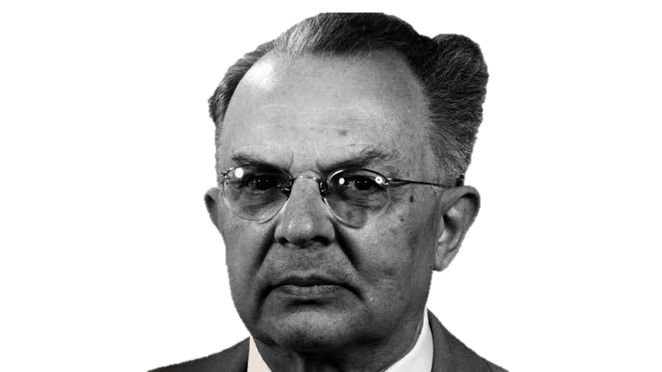
Daniel Kahneman and Amos Tversky’s (1982)
Linda’s problem
Edward Stein’s (1996)
"Standard Picture"
of Rationality
an interdisciplinary notion
Philosophy, psychology,
economics, mathematics,
statistics
Whether it refers to subjective degrees of confidence or to the frequencies of events in the world, theories of probability rely on anti-psychologism
Linda is 31 years old, single, outspoken, and very bright.
She majored in philosophy.
As a student, she was deeply concerned with issues of discrimination and social justice, and also participated in anti-nuclear demonstrations.
Probability
PHILOSOPHICAL
NATURALISM
BY DEFAULT
Which is more probable?
(1) Linda is a bank teller.
(2) Linda is a bank teller and is active in the feminist movement.
Rudolf Carnap, Hans Reichenbach, Andrej Kolmogorov’s
theories of probability
RATIONALITY
Deductive Logics
Decision theory

Slide 21
Daniel Kahneman and Amos Tversky’s (1982)
Linda’s problem
Edward Stein’s (1996)
"Standard Picture"
of Rationality
an interdisciplinary notion
Philosophy, psychology,
economics, mathematics,
statistics
Linda is 31 years old, single, outspoken, and very bright.
She majored in philosophy.
As a student, she was deeply concerned with issues of discrimination and social justice, and also participated in anti-nuclear demonstrations.
Probability
PHILOSOPHICAL
NATURALISM
BY DEFAULT
Which is more probable?
(1) Linda is a bank teller.
(2) Linda is a bank teller and is active in the feminist movement.
RATIONALITY
Deductive Logics
Decision theory

Slide 22
Daniel Kahneman and Amos Tversky’s (1982)
Linda’s problem
Edward Stein’s (1996)
"Standard Picture"
of Rationality
an interdisciplinary notion
Philosophy, psychology,
economics, mathematics,
statistics
Linda is 31 years old, single, outspoken, and very bright.
She majored in philosophy.
As a student, she was deeply concerned with issues of discrimination and social justice, and also participated in anti-nuclear demonstrations.
Deductive Logics
PHILOSOPHICAL
NATURALISM
BY DEFAULT
Probability
Which is more probable?
(1) Linda is a bank teller.
(2) Linda is a bank teller and is active in the feminist movement.
Decision theory
RATIONALITY

Slide 23
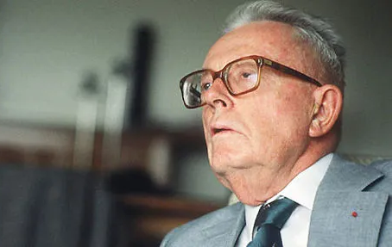
Edward Stein’s (1996)
"Standard Picture"
of Rationality
an interdisciplinary notion
Philosophy, psychology,
economics, mathematics,
statistics
If you are a rational agent, you ought to maximize your (expected) advantage, given what you believe the probability of certain outcomes to be
Maurice Allais’s (1953)
Paradox
You can choose between 2 boxes:
Decision theory
PHILOSOPHICAL
NATURALISM
BY DEFAULT
1° box: it contains 100 milions
2° box: ther is 1% of chance that it contains nothing; 89% of chance that it contains 100 milions, 10% of chance that it contains 500 milions
John Von Newman and Oscar Morgenstern’s Theory of Games and Economic Behavior
RATIONALITY
Probability
Deductive Logics

Slide 24
Edward Stein’s (1996)
"Standard Picture"
of Rationality
an interdisciplinary notion
Philosophy, psychology,
economics, mathematics,
statistics
Is it
descriptive or prescriptive?
Maurice Allais’s (1953)
Paradox
You can choose between 2 boxes:
Decision theory
PHILOSOPHICAL
NATURALISM
BY DEFAULT
1° box: expected utility: 100 milions
2° box:
expected utility: (0.01×0)+(0.89×100)+(0.10×500) = 0+89+50 = 139 millions
1° box: it contains 100 milions
2° box: there is 1% of chance that it contains nothing; 89% of chance that it contains 100 milions, 10% of chance that it contains 500 milions
RATIONALITY
Deductive Logics
Probability
Deductive Logics
Probability

Slide 25
Edward Stein’s (1996)
"Standard Picture"
of Rationality
an interdisciplinary notion
Philosophy, psychology,
economics, mathematics,
statistics
Is it
descriptive or prescriptive?
Maurice Allais’s (1953)
Paradox
You can choose between 2 boxes:
Decision theory
PHILOSOPHICAL
NATURALISM
BY DEFAULT
1° box: it contains 100 milions
2° box: there is 1% of chance that it contains nothing; 89% of chance that it contains 100 milions, 10% of chance that it contains 500 milions
1° box: expected utility: 100 milions
2° box:
expected utility: (0.01×0)+(0.89×100)+(0.10×500) = 0+89+50 = 139 millions
RATIONALITY
Deductive Logics
Probability
Deductive Logics
Probability

Slide 26
Edward Stein’s (1996)
"Standard Picture"
of Rationality
an interdisciplinary notion
Philosophy, psychology,
economics, mathematics,
statistics
Maurice Allais’s (1953)
Paradox
Is it
descriptive or prescriptive?
You can choose between 2 boxes:
Deductive Logics
PHILOSOPHICAL
NATURALISM
BY DEFAULT
1° box: it contains 100 milions
2° box: ther is 1% of chance that it contains nothing; 89% of chance that it contains 100 milions, 10% of chance that it contains 500 milions
Probability
Decision theory
RATIONALITY

Slide 27
Edward Stein’s (1996)
"Standard Picture"
of Rationality
an interdisciplinary notion
Philosophy, psychology,
economics, mathematics,
statistics
Maurice Allais’s (1953)
Paradox
Is it
descriptive or prescriptive?
You can choose between 2 boxes:
Deductive Logics
PHILOSOPHICAL
NATURALISM
BY DEFAULT
1° box: it contains 100 milions
2° box: ther is 1% of chance that it contains nothing; 89% of chance that it contains 100 milions, 10% of chance that it contains 500 milions
Probability
Decision theory
RATIONALITY

Slide 28
Edward Stein’s (1996)
"Standard Picture"
of Rationality
Is it
descriptive or prescriptive?
empirical counterexamples
Deductive Logics
ideal reasoner
Probability
computational intractability
Consider finding the shortest optimal route between 50 cities traveling to each location only once.
Decision theory
RATIONALITY
It requires considering three hundred quindecillion routes
(300,000,000,000,000,000,000,000,000,000,000,000,000,000,000,000,000,000,00 0,000,000 routes)

Slide 29
Edward Stein’s (1996)
"Standard Picture"
of Rationality
an interdisciplinary notion
Philosophy, psychology,
economics, mathematics,
statistics
Is it
descriptive or prescriptive?
empirical counterexamples
Deductive Logics
PHILOSOPHICAL
NATURALISM
BY DEFAULT
ideal reasoner
Probability
computational intractability
It requires considering three hundred quindecillion routes
(300,000,000,000,000,000,000,000,000,000,000,000,000,000,000,000,000,000,00 0,000,000 routes)
Decision theory
RATIONALITY
Consider finding the shortest optimal route between 50 cities traveling to each location only once.

Slide 30
Edward Stein’s (1996)
"Standard Picture"
of Rationality
an interdisciplinary notion
Philosophy, psychology,
economics, mathematics,
statistics
Is it
descriptive or prescriptive?
empirical counterexamples
Deductive Logics
PHILOSOPHICAL
NATURALISM
BY DEFAULT
ideal reasoner
Probability
computational intractability
Decision theory
RATIONALITY
ought implies can
It requires considering three hundred quindecillion routes
(300,000,000,000,000,000,000,000,000,000,000,000,000,000,000,000,000,000,00 0,000,000 routes)

Slide 31
Edward Stein’s (1996)
"Standard Picture"
of Rationality
an interdisciplinary notion
Philosophy, psychology,
economics, mathematics,
statistics
Deductive Logics
PHILOSOPHICAL
NATURALISM
BY DEFAULT
Probability
Decision theory
RATIONALITY

Slide 32
Should we reconsider the idea of rationality?
Can humans be rational?

Slide 33
HOW TO PREPARE
FOR THE FINAL EXAM
What do you have to do?
Two short essays (3-4k words),
or a long one (6-8k words) delivered in advance.
On what?
On two topics one for the first part of the course, and another for the second one.
When should you submit them?
At least ten days before the exam date
June 18; July 02 and 16; September 3 and 17
2 p.m. via Zoom

Slide 34
HOW TO PREPARE
FOR THE FINAL EXAM
What essays are suitable?
Those that pass a plagiarism check
Those that have a wordcount between 3/4k (two essays) 6/8k (one essay) words
Those that contain in-text and final bibliography
Those that include at least three texts from each of the course two-part bibliographies
What do you have to do?
Two written essays, delivered in advance.
On what?
On two topics one for the first part of the course, and another for the second one.
When should you submit them?
At least ten days before the exam date

Slide 35
HOW TO PREPARE
FOR THE FINAL EXAM
What will be evaluated?
The form and style of writing (Grammar and syntactic correctness, layout, division into paragraphs and sections, how you set up the bibliography)
The content of the essay (clarity, introduction and conclusion, clarity of titles, abstract and sections, depth of the philosophical analysis, originality and relevance)
What essays are suitable?
Those that pass a plagiarism check
Those that have a wordcount between 3000/4000 words
Those that contain in-text and final bibliography
Those that include at least three texts from each of the course two-part bibliographies

Slide 36
HOW TO PREPARE
FOR THE FINAL EXAM
What will determine an insufficient result?
Frequent grammatical and sintactical errors, which seriously undermine the readability of the text
One or both essays will be a summary of a course lecture
What will be evaluated?
The form and style of writing (Grammar and syntactic correctness, layout, division into paragraphs and sections, how you set up the bibliography)
The content of the essay (clarity, introduction and conclusion, clarity of titles, abstract and sections depth of the philosophical analysis, originality and relevance)

Slide 37
IF YOU HAVE QUESTIONS:
Check KIRO and
UNIBG elearning webpage of the course for:
Slides of the lectures
The exam’s guide
Check Leganto for:
The two-part bibliography
How to get the texts
Ask us anything else:
Tommaso Piazza: tommaso.piazza@unipv.it
Selene Arfini: selene.arfini@unipv.it
HOW TO PREPARE
FOR THE FINAL EXAM
What will determine an insufficient result?
Frequent grammatical and sintactical errors, which seriously undermine the readability of the text
One or both essays will be a summary of a course lecture

Slide 38
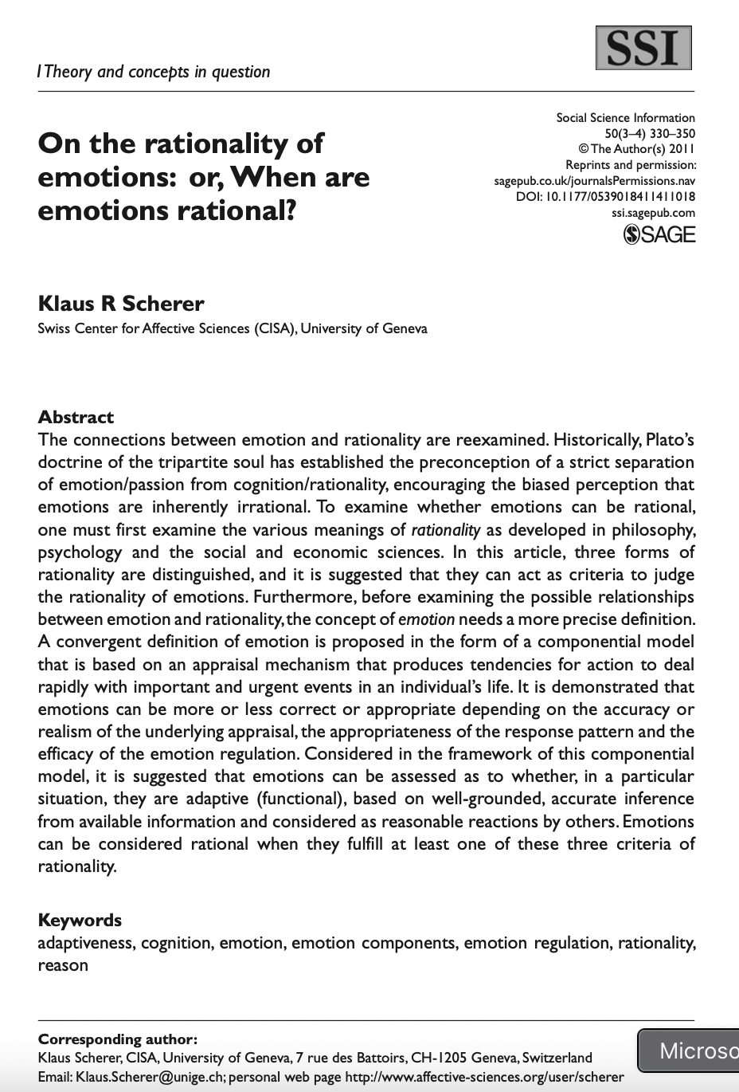

Slide 39
Next time: From ideal to ecological rationality
Scherer, Klaus R. 2011. ‘On the Rationality of Emotions: Or, When Are Emotions Rational?’ Social Science Information 50 (3–4): 330–50.
Sturm, Thomas. 2021. ‘Towards a Critical Naturalism about Bounded Rationality’. In Routledge Handbook of Bounded Rationality, edited by Riccardo Viale, 73–89. Abingdon, Oxon ; New York, NY: Routledge.

