Slide 1
Knowledge and Rationality – A.Y. 2024-2025
From ideal to
ecological rationality
Selene Arfini – selene.arfini@unipv.it

Slide 2
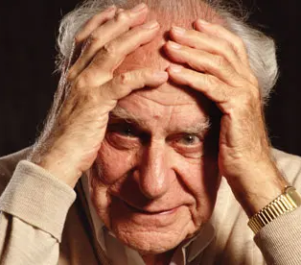
Should we adjust the idea of rationality or the idea of humans as rational beings?
Un'ipotesi è falsificabile
se esiste almeno una proposizione osservativa logicamente possibile incompatibile con essa, ossia che, se vera,
la possa falsificare.
FALSIFICABILE
Karl Popper
(1902-1994)

Slide 3
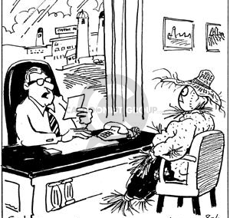
The problem of prescription
So you think you
can scare crows?
competence and performance

Slide 4
The problem of prescription
So you think you
can scare crows?
competence and performance

Slide 5
The problem of prescription
language
(Chomsky, 1965)
Drinks beer
Drinks coca cola
He’s 36 years-old
She’s 15 years-old
Competence
Performance
So you think you
can scare crows?
Of which people do you need further information about to determine if a person is drinking beer, then he or she is of legal age to drink alcoholic beverages?
competence and performance

Slide 6
The problem of prescription
Drinks beer
Drinks coca cola
He’s 36 years-old
She’s 15 years-old
So you think you
can scare crows?
Of which people do you need further information about to determine that:
if a person is drinking beer, then he or she is of legal age to drink alcoholic beverages?
competence and performance
Griggs & Cox 1982
language
(Chomsky, 1965)
Competence
Performance

Slide 7
The problem of prescription
How instructions are formulated is crucial for activating the rational principle
A
B
2
5
So you think you
can scare crows?
Which card(s) must you turn over in order to test that if a card shows a vocal on one face, then its opposite face is an even number?
competence and performance
heuristics e biases
Griggs & Cox 1982
language
(Chomsky, 1965)
Competence
Performance

Slide 8
The problem of prescription
So you think you
can scare crows?
competence and performance
heuristics e biases
How instructions are formulated is crucial for activating the rational principle
A
B
2
5
Which card(s) must you turn over in order to test that if a card shows a vocal on one face, then its opposite face is an even number?

Slide 9
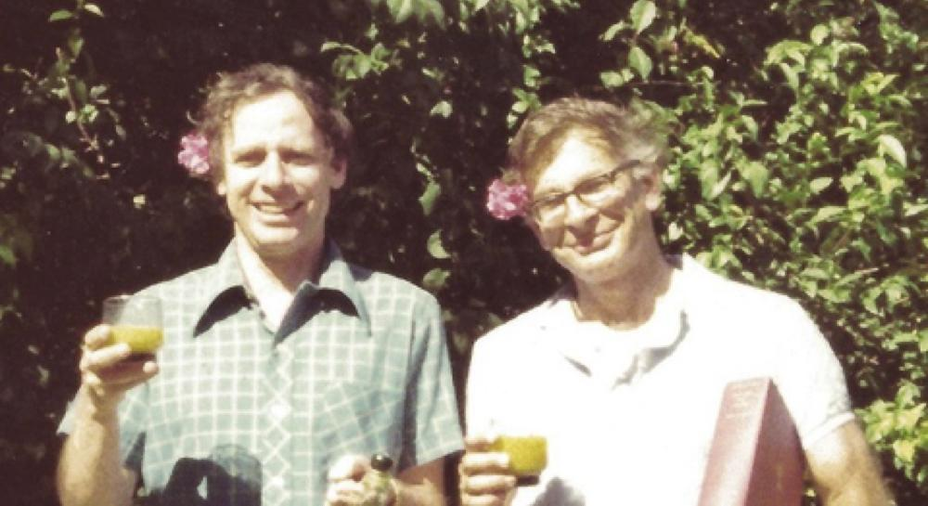
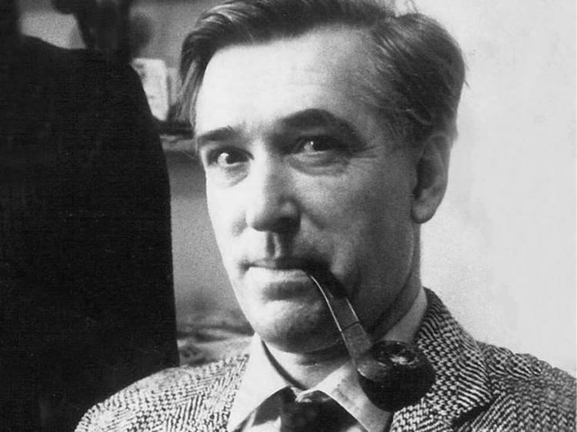
Heuristics require fewer
cognitive resources
(time, information, and
computational capability)
The problem of prescription
Limited applicability
Mostly irrational
So you think you
can scare crows?
knowledge and competence
heuristics e biases
Twersky & Kahneman
on heuristics
Wason
on bias

Slide 10
Heuristics require fewer
cognitive resources
(time, information, and
computational capability)
The problem of prescription
Limited applicability
Mostly irrational
So you think you
can scare crows?
knowledge and competence
heuristics e biases
Wason
on bias
Twersky & Kahneman
on heuristics
Bias

Slide 11
Heuristics require fewer
cognitive resources
(time, information, and
computational capability)
The problem of prescription
Limited applicability
Mostly irrational
So you think you
can scare crows?
knowledge and competence
heuristics e biases
Wason
on bias
Twersky & Kahneman
on heuristics

Slide 12
The problem of prescription
the problem of
description
So you think you
can scare crows?
Am I warm?
knowledge and competence
heuristics e biases
bounded rationality

Slide 13
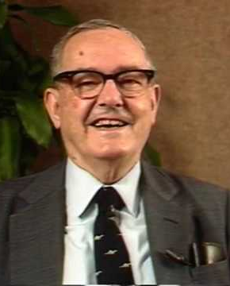
The problem of prescription
Simon studied the behavior and decision-making processes used by business managers
the problem of
description
‘‘The behavior of individuals is determined by irrational and non-rational elements that circumscribe the area of rationality. The area of rationality is that of ADAPTABILITY to these non-rational elements’’
They did not conform to the norms of rational decision theory but arrived at efficient results
achieving optimal results by retrieving all useful information is costly in terms of time and resources
So you think you
can scare crows?
Am I warm?
Herbert Simon
The myth of rationality
knowledge and competence
heuristics e biases
bounded rationality

Slide 14
Simon studied the behavior and decision-making processes used by business managers
They did not conform to the norms of rational decision theory but arrived at efficient results
achieving optimal results by retrieving all useful information is costly in terms of time and resources
The problem of prescription
the problem of
description
‘‘The behavior of individuals is determined by irrational and non-rational elements that circumscribe the area of rationality. The area of rationality is that of ADAPTABILITY to these non-rational elements’’
So you think you
can scare crows?
Am I warm?
Herbert Simon
The myth of rationality
knowledge and competence
heuristics e biases
bounded rationality

Slide 15
‘‘The behavior of individuals is determined by irrational and non-rational elements that circumscribe the area of rationality. The area of rationality is that of ADAPTABILITY to these non-rational elements’’
The problem of prescription
the problem of
description
The myth of rationality
Herbert Simon
So you think you
can scare crows?
Am I warm?
idealized agents’
computational capacity
idealized how much
information they have
knowledge and competence
heuristics e biases
bounded rationality

Slide 16
‘‘The behavior of individuals is determined by irrational and non-rational elements that circumscribe the area of rationality. The area of rationality is that of ADAPTABILITY to these non-rational elements’’
The myth of rationality
idealized agents’
computational capacity
Idealized how much
Information they have
The problem of prescription
the problem of
description
Herbert Simon
So you think you
can scare crows?
Am I warm?
Then the agents
are bound to fail
knowledge and competence
heuristics e biases
bounded rationality

Slide 17
‘‘The behavior of individuals is determined by irrational and non-rational elements that circumscribe the area of rationality. The area of rationality is that of ADAPTABILITY to these non-rational elements’’
The myth of rationality
idealized agents’
computational capacity
Idealized how much
Information they have
The problem of prescription
the problem of
description
What decision-making mechanisms are used in a particular task environment?
What are their outcomes?
What are their practical limits?
rational action
So you think you
can scare crows?
Am I warm?
Then the agents
are bound to fail
Herbert Simon
knowledge and competence
heuristics e biases
bounded rationality

Slide 18
‘‘The behavior of individuals is determined by irrational and non-rational elements that circumscribe the area of rationality. The area of rationality is that of ADAPTABILITY to these non-rational elements’’
The myth of rationality
He rethought rationality considering...
idealized agents’
computational capacity
Idealized how much
Information they have
The problem of prescription
the problem of
description
the cognitive agent’s
limited resources
rational action
So you think you
can scare crows?
Am I warm?
Then the agents or the setting
are bound to fail
complexity and opacity
of the environment
knowledge and competence
heuristics e biases
bounded rationality
Herbert Simon
What decision-making mechanisms are used in a particular task environment?
What are their outcomes?
What are their practical limits?

Slide 19
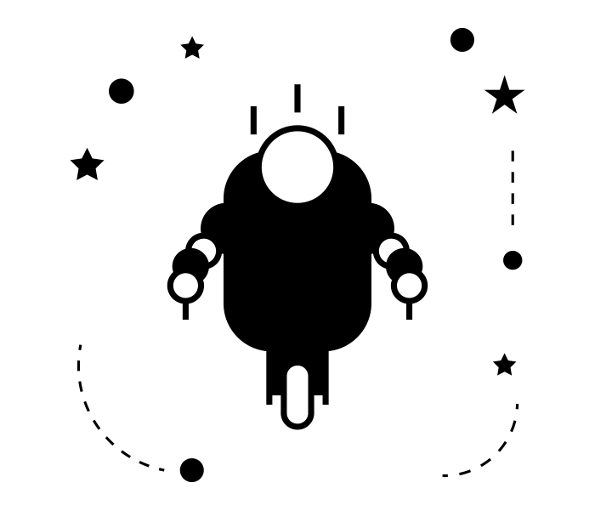
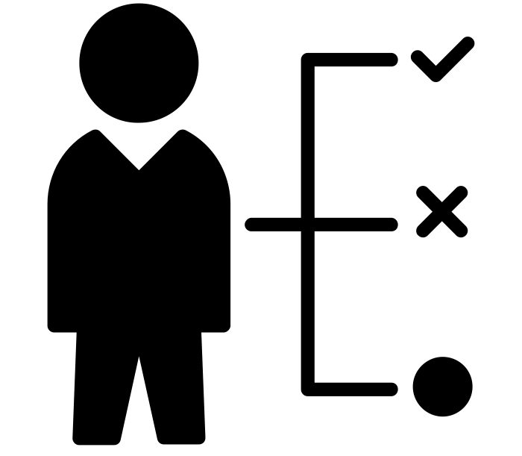
He rethought rationality considering...
the problem of
description
the cognitive agent’s
limited resources
‘‘The behavior of individuals is determined by irrational and non-rational elements that circumscribe the area of rationality. The area of rationality is that of ADAPTABILITY to these non-rational elements’’
rational action
Am I warm?
complexity and opacity
of the environment
bounded rationality
The myth of rationality
traditional
decision theory
satisficing
decision theory
idealized agents’
computational capacity
Idealized how much
Information they have
The problem of prescription
decision-makers
simultaneously
consider all alternatives
to decide the optimal option
decison-makers consider
alternatives sequentially
and choose the one
closest to their needs
So you think you
can scare crows?
Then the agents or the setting
are bound to fail
Herbert Simon
knowledge and competence
heuristics e biases
What decision-making mechanisms are used in a particular task environment?
What are their outcomes?
What are their practical limits?

Slide 20
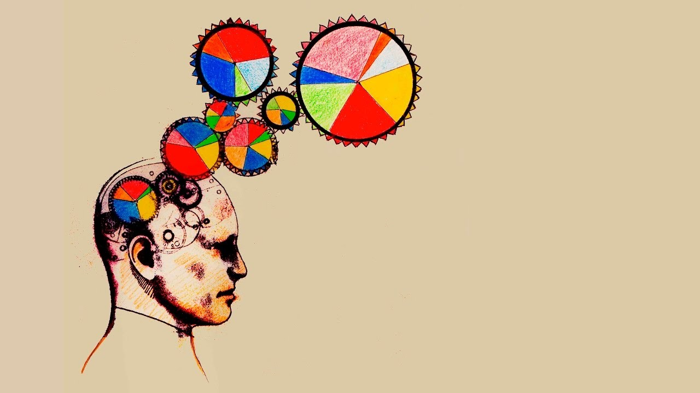
"Bounded rationality is essentially concerned with mechanistic answers to proximate questions about problem solving and decision making"
(Nordli and Todd, p. 314)
It describes what a rational action is...
but does it also explain why we use it?

Slide 21
"Bounded rationality is essentially concerned with mechanistic answers to proximate questions about problem solving and decision making"
(Nordli and Todd, p. 314)
It describes what a rational action is...
but does it also explain why we use it?

Slide 22
"Bounded rationality is essentially concerned with mechanistic answers to proximate questions about problem solving and decision making"
(Nordli and Todd, p. 314)
It describes what a rational action is...
but does it also explain why we use it?

Slide 23
"Bounded rationality is essentially concerned with mechanistic answers to proximate questions about problem solving and decision making"
(Nordli and Todd, p. 314)
It describes what a rational action is...
but does it also explain why we use it?

Slide 24
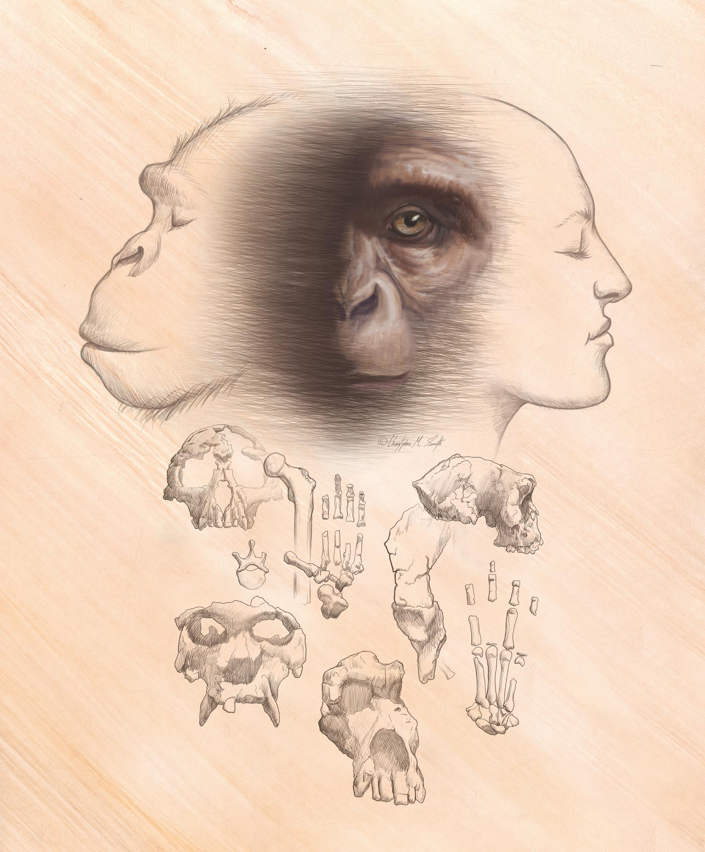
Asking the why-questions regarding rationality means to ask:
When an agent’s decision-making works well in a given context, how has it evolved to fit within the environment structure?
When the decision-making runs contrary to what might be expected how has it evolved to occur in that context?

Slide 25
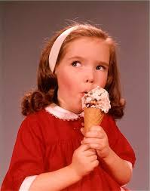
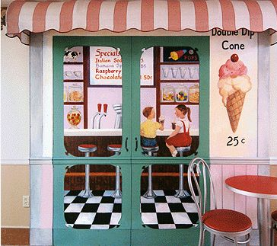
ANY DECISION IS
The selection
of a behavior
In service
of a goal
The application
of a behavior
In a given
environment

Slide 26
ANY DECISION IS
In service
of a goal
The selection
of a behavior
Can we repete
a past behavior?
Habit formation is a mechanism through which procedurally learned patterns of behavior come to mimic the cue-driven efficiency and efficacy of evolved behavioral sequences
(Nordli & Todd, 2017).
YES
EXPLOITATION
HABIT
The application
of a behavior
In a given
environment

Slide 27
ANY DECISION IS
In service
of a goal
The selection
of a behavior
Can we repete
a past behavior?
Habit formation is a mechanism through which procedurally learned patterns of behavior come to mimic the cue-driven efficiency and efficacy of evolved behavioral sequences
(Nordli & Todd, 2017).
YES
EXPLOITATION
HABIT
The application
of a behavior
In a given
environment

Slide 28
ANY DECISION IS
In service
of a goal
The selection
of a behavior
Can we repete
a past behavior?
Habit formation is a mechanism through which procedurally learned patterns of behavior come to mimic the cue-driven efficiency and efficacy of evolved behavioral sequences
(Nordli & Todd, 2017).
YES
EXPLOITATION
HABIT
The application
of a behavior
In a given
environment

Slide 29
ANY DECISION IS
In service
of a goal
The selection
of a behavior
Can we repete
a past behavior?
Habit formation is a mechanism through which procedurally learned patterns of behavior come to mimic the cue-driven efficiency and efficacy of evolved behavioral sequences
(Nordli & Todd, 2017).
YES
EXPLOITATION
HABIT
The application
of a behavior
In a given
environment

Slide 30
ANY DECISION IS
A heuristic is a strategy that ignores part of the information, with the goal of making decisions more quickly, frugally, and/or accurately than more complex methods
The selection
of a behavior
Can we repete
a past behavior?
NO
EXPLORATION
HEURISTICS
Which city is more populous?
YES
EXPLOITATION
HABIT
San Antonio
Philadelphia
Habit formation is a mechanism through which procedurally learned patterns of behavior come to mimic the cue-driven efficiency and efficacy of evolved behavioral sequences
(Nordli & Todd, 2017).

Slide 31
ANY DECISION IS
A heuristic is a strategy that ignores part of the information, with the goal of making decisions more quickly, frugally, and/or accurately than more complex methods
The selection
of a behavior
Can we repete
a past behavior?
NO
EXPLORATION
HEURISTICS
Which city is more populous?
YES
EXPLOITATION
HABIT
San Antonio
Philadelphia
Habit formation is a mechanism through which procedurally learned patterns of behavior come to mimic the cue-driven efficiency and efficacy of evolved behavioral sequences
(Nordli & Todd, 2017).

Slide 32
ANY DECISION IS
A heuristic is a strategy that ignores part of the information, with the goal of making decisions more quickly, frugally, and/or accurately than more complex methods
The selection
of a behavior
Can we repete
a past behavior?
NO
EXPLORATION
HEURISTICS
Which city is more populous?
YES
EXPLOITATION
HABIT
San Antonio
Philadelphia
Habit formation is a mechanism through which procedurally learned patterns of behavior come to mimic the cue-driven efficiency and efficacy of evolved behavioral sequences
(Nordli & Todd, 2017).

Slide 33
ANY DECISION IS
A heuristic is a strategy that ignores part of the information, with the goal of making decisions more quickly, frugally, and/or accurately than more complex methods
The selection
of a behavior
Can we repete
a past behavior?
NO
EXPLORATION
HEURISTICS
Which city is more populous?
YES
EXPLOITATION
HABIT
San Antonio
Philadelphia
Habit formation is a mechanism through which procedurally learned patterns of behavior come to mimic the cue-driven efficiency and efficacy of evolved behavioral sequences
(Nordli & Todd, 2017).

Slide 34
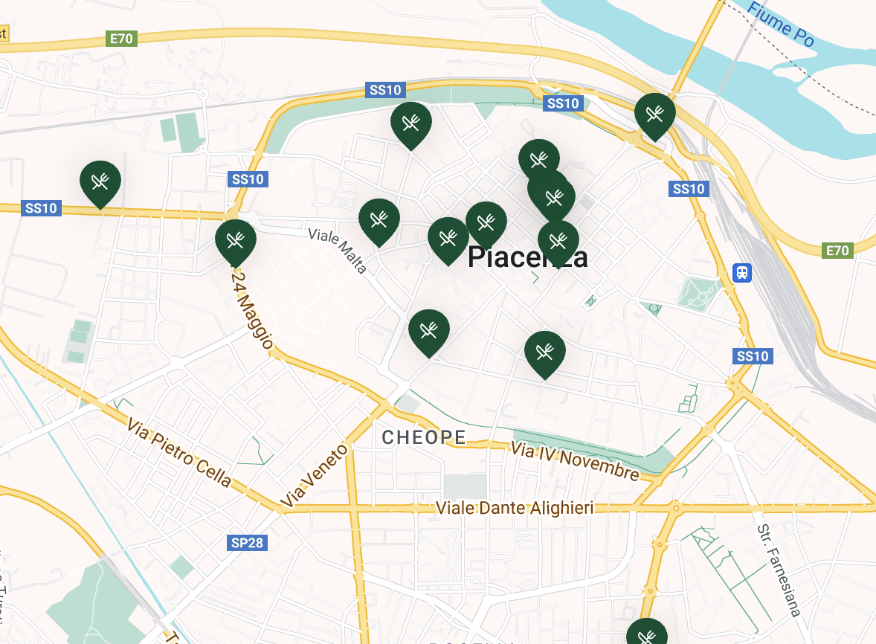
ANY DECISION IS
The selection
of a behavior
One-decision heuristic
Multiple-cue decision heuristic
DECISION RULE
STOPPING RULE
SEARCH RULE
Es: minimalistic heuristic
Es: elimination by aspects
The application
of a behavior
A heuristic is a strategy that ignores part of the information, with the goal of making decisions more quickly, frugally, and/or accurately than more complex methods
Can we repete
a past behavior?
NO
EXPLORATION
HEURISTICS
Which city is more populous?
YES
EXPLOITATION
HABIT
San Antonio
San Diego

Slide 35
ANY DECISION IS
The selection
of a behavior
Multiple-cue decision heuristic
One-decision heuristic
Sequential search heuristic
DECISION RULE
STOPPING RULE
SEARCH RULE
Es: elimination by aspects
Es: minimalistic heuristic
Es: satisficing strategy
The application
of a behavior

Slide 36
ANY DECISION IS
The selection
of a behavior
In service
of a goal
Sequential search heuristic
Multiple-cue decision heuristic
DECISION RULE
STOPPING RULE
SEARCH RULE
Es: satisficing strategy
Es: elimination by aspects
The application
of a behavior
In a given
environment

Slide 37
ANY DECISION IS
The selection
of a behavior
In service
of a goal
The application
of a behavior
In a given
environment
Sequential search heuristic
Es: satisficing strategy

Slide 38
Asking the why-questions regarding rationality again:
When an agent’s decision-making works well in a given context, how has it evolved to fit within the environment structure?
When the decision-making runs contrary to what might be expected how has it evolved to occur in that context?
Ecological rationality can be conceptualized as the study of how individuals and species are adapted to identify and take advantage of opportunities in which past behavior can be exploited to achieve their goals in present contexts, including cases in which the exploited behavior is a strategic approach to exploration.

Slide 39
Asking the why-questions regarding rationality again:
When an agent’s decision-making works well in a given context, how has it evolved to fit within the environment structure?
When the decision-making runs contrary to what might be expected how has it evolved to occur in that context?
Ecological rationality can be conceptualized as the study of how individuals and species are adapted to identify and take advantage of opportunities in which past behavior can be exploited to achieve their goals in present contexts, including cases in which the exploited behavior is a strategic approach to exploration.

Slide 40
Asking the why-questions regarding rationality again:
When an agent’s decision-making works well in a given context, how has it evolved to fit within the environment structure?
When the decision-making runs contrary to what might be expected how has it evolved to occur in that context?
Ecological rationality can be conceptualized as the study of how individuals and species are adapted to identify and take advantage of opportunities in which past behavior can be exploited to achieve their goals in present contexts, including cases in which the exploited behavior is a strategic approach to exploration.

Slide 41
Asking the why-questions regarding rationality again:
When an agent’s decision-making works well in a given context, how has it evolved to fit within the environment structure?
When the decision-making runs contrary to what might be expected how has it evolved to occur in that context?
Ecological rationality can be conceptualized as the study of how individuals and species are adapted to identify and take advantage of opportunities in which past behavior can be exploited to achieve their goals in present contexts, including cases in which the exploited behavior is a strategic approach to exploration.

Slide 42
Asking the why-questions regarding rationality again:
When an agent’s decision-making works well in a given context, how has it evolved to fit within the environment structure?
When the decision-making runs contrary to what might be expected how has it evolved to occur in that context?
Ecological rationality can be conceptualized as the study of how individuals and species are adapted to identify and take advantage of opportunities in which past behavior can be exploited to achieve their goals in present contexts, including cases in which the exploited behavior is a strategic approach to exploration.

Slide 43
Asking the why-questions regarding rationality again:
When an agent’s decision-making works well in a given context, how has it evolved to fit within the environment structure?
When the decision-making runs contrary to what might be expected how has it evolved to occur in that context?
Ecological rationality can be conceptualized as the study of how individuals and species are adapted to identify and take advantage of opportunities in which past behavior can be exploited to achieve their goals in present contexts, including cases in which the exploited behavior is a strategic approach to exploration.

Slide 44
Asking the why-questions regarding rationality again:
When an agent’s decision-making works well in a given context, how has it evolved to fit within the environment structure?
When the decision-making runs contrary to what might be expected how has it evolved to occur in that context?
Ecological rationality can be conceptualized as the study of how individuals and species are adapted to identify and take advantage of opportunities in which past behavior can be exploited to achieve their goals in present contexts, including cases in which the exploited behavior is a strategic approach to exploration.

Slide 45
Asking the why-questions regarding rationality again:
When an agent’s decision-making works well in a given context, how has it evolved to fit within the environment structure?
When the decision-making runs contrary to what might be expected how has it evolved to occur in that context?
THE STRATEGY SELECTION PROBLEM
& ERROR TENDENCIES
Ecological rationality can be conceptualized as the study of how individuals and species are adapted to identify and take advantage of opportunities in which past behavior can be exploited to achieve their goals in present contexts, including cases in which the exploited behavior is a strategic approach to exploration.

Slide 46
Asking the why-questions regarding rationality again:
When an agent’s decision-making works well in a given context, how has it evolved to fit within the environment structure?
When the decision-making runs contrary to what might be expected how has it evolved to occur in that context?
THE STRATEGY SELECTION PROBLEM
& ERROR TENDENCIES
Sour grapes
(underestimating the value of a positive-but-unlikely scenario)
Fear-driven inferences
(overstimating the probability of an unlikely-but-costly scenario)
Ecological rationality can be conceptualized as the study of how individuals and species are adapted to identify and take advantage of opportunities in which past behavior can be exploited to achieve their goals in present contexts, including cases in which the exploited behavior is a strategic approach to exploration.

Slide 47
Ecological rationality can be conceptualized as the study of how individuals and species are adapted to identify and take advantage of opportunities in which past behavior can be exploited to achieve their goals in present contexts, including cases in which the exploited behavior is a strategic approach to exploration.
But... what remains of irrationality?
THE STRATEGY SELECTION PROBLEM
& ERROR TENDENCIES
Sour grapes
(underestimating the value of a positive-but-unlikely scenario)
Fear-driven inferences
(overstimating the probability of an unlikely-but-costly scenario)

Slide 48
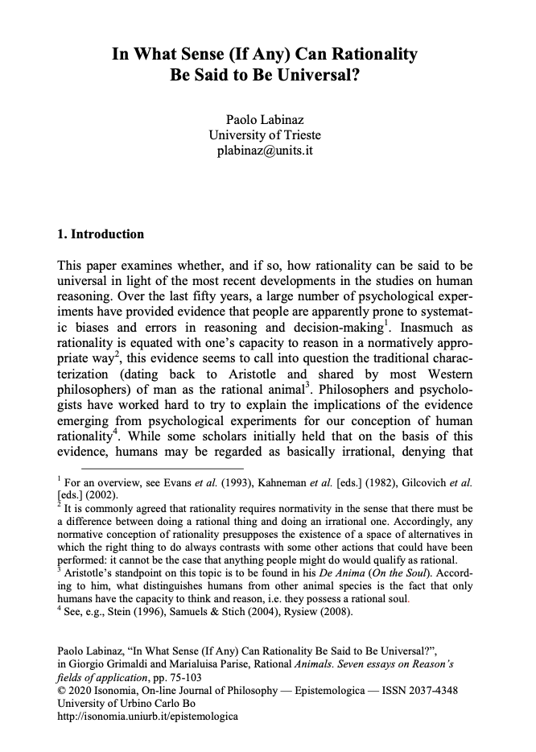

Slide 49
Next time: Irrationality and ignorance
Labinaz, Paolo. 2020. ‘In What Sense (If Any) Can Rationality Be Said to Be Universal?’ In Rational Animals. Seven Essays on Reason’s Field of Application, edited by G. Grimaldi and M. Parise, 75–104. Urbino: Isonomia Epistemologica.
Nordli, Samuel A., and Peter M. Todd. 2021. ‘Ecological Rationality: Bounded Rationality in an Evolutionary Light’. In Routledge Handbook of Bounded Rationality, edited by R. Viale, 313–23. Abingdon, Oxon ; New York, NY: Routledge.

