Slide 1
History of Philosophical Thought and Aesthetics
Nature, Ecology, and the Environment in Early Modernity
Module A
Part 1: Keywords
Cecilia Muratori
cecilia.muratori@unipv.it

Slide 2
Module A Menu
6 episodes, 5 main concepts:
* Introduction
UTOPIA
DOMINION
ANIMALS
POLLUTION
METAPHYSICS OF NATURE

Slide 3
Main questions:
What do we talk about when we talk about nature, ecology, and the environment in the early modern period?
Is it legitimate to ask questions such as: was there concern for the environment in early modernity? Does ‘nature’ mean the same thing in early modernity as it does for us? Is there any relationship between present-day ecological debates and early modern ones?
→ Find a contact point between early modern philosophical texts and contemporary environmental humanities

Slide 4
How this course (module A) is structured
Selection of primary texts from early modernity
Selection of critical texts from contemporary debates (→ presentations)
Aims:
An alternative overview of early modern philosophy
An introduction to contemporary philosophical debates on nature and the environment

Slide 5
Methodological Questions:
What does it mean to study the history of philosophy today?
What is the ‘application’ of the history of philosophy?
Should the history of philosophy be useful?

Slide 6
An Anachronistic History of Philosophy and the Environment
“The problem is to define exactly the series of precautions to be taken, the prescriptions to be observed to avoid the sin of sins, the sin that cannot be forgiven: anachronism.” Lucien Febvre, Le Problème de l’incroyance au XVIe siècle. La religion de Rabelais (1968), 15
Examples of potentially anachronistic questions
- Can we read early modern texts from the perspective of the environmental humanities, or are the environmental humanities linked to the contemporary world?
- Can we use terms like ‘sustainability’ when we talk about early modern philosophies?

Slide 7
An Anachronistic History of Philosophy and the Environment
“No assertion of continuity (‘If you want to understand the origins of the present, you have to be interested in the Middle Ages’) and no insinuation of alterity (‘Dear reader, let us tell you about a distant, better world and then draw your own conclusions from it’) carries this book, but rather the historian’s confidence in drawing knowledge precisely from anachronisms: from the controlled application of present-day concepts, questions and problems to distant times and the tentative transfer of past constellations back into the modern age. The past that becomes visible in this procedure, I believe, can be plausible even if it was not perceived in this way by any of the historical witnesses. And the present, in which the procedure takes place, gains a better insight if not into its past history, then into the space of possibility in which it moves itself.”
Frank Rexroth, Fröhliche Scholastik: Die Wissenschaftsrevolution des Mittelalters (2018), 17-18
→ Anachronisms as a tool for seeing something new

Slide 8
An Anachronistic History of Philosophy and the Environment
“What can the historian of Antiquity do about the present? And what does she have to say to her contemporaries, who are now more convinced of the irony of history or of its violence; of its accelerating movements than of the evidence of its meaning? […] But just asking these questions has already raised the formidable problem of anachronism in history. Anachronism is the historian's bête noire, the cardinal sin of the method, whose very name is enough to constitute an infamous accusation, the accusation - after all - of not being a historian because you handle time and times in the wrong way. For this reason, historians generally take great care not to import concepts that the period in question is supposed to have been unfamiliar with, and even more to make comparisons - which are in principle unwarranted - between two periods that are centuries apart. The extent to which the fear of anachronism is a blocking factor cannot be overstated: because we are vested with the intellectual - and almost moral - duty of interpreting a fact of society or an event only within the well-established framework of the ‘contemporary concepts’ and attitudes of the time, does not every new proposal run the risk of being accused of methodological imprudence?” Nicole Loraux, ‘Éloge de l’anachronisme en histoire’, in Espaces Temps 87-88 (2005), 127-138, here 127
→ Anachronisms are what makes history ‘interesting’

Slide 9
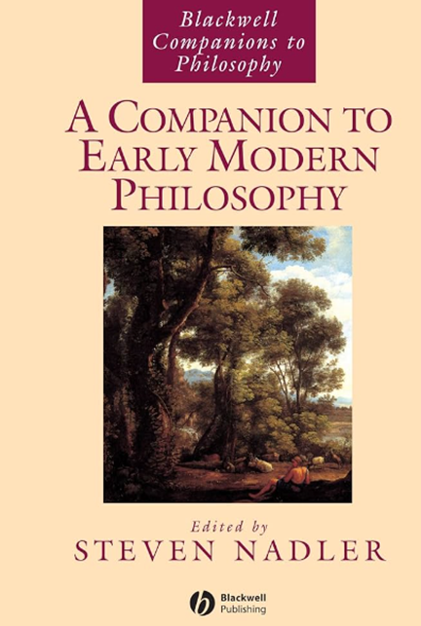
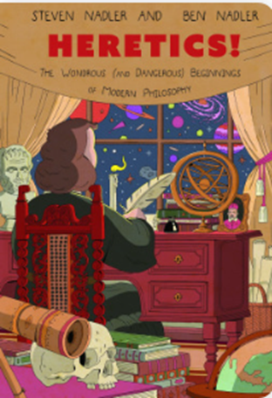
Early modern philosophy: what is ‘modern’ about it?
«The seventeenth and eighteenth centuries represent an extraordinary rich period for philosophy in Western Europe. This is due not only to the fortuitous appearance of individuals of great natural genius – Descartes, Leibniz, Newton, et. al. – but also, in no small part, to a confluence of various historical, intellectual, spiritual and even material factors: the rise of the new modern science, with its devotion to clear and fruitful mechanistic explanations of natural phenomena, along with the development of sophisticated conceptions of experiment and theory and consequent reformulations of the canons of knowledge; the radical rethinking of the cosmos entailed by new developments and discoveries in particular sciences, especially physics and astronomy; the culture-shock generated by the relatively recent confrontation by the West with theretofore unknown civilizations half a world away; the proliferation of centers of learning and channels of communication; and, not the least, the Protestant Reformation of the previous century, combined with the reactionary forces of the counter-Reformation» (Introduction)
The standard portrait of the history of early modern philosophy:
A few big names (generally men)
A change of scenery after the Renaissance?
Emphasis on method, measurement → a new view of nature

Slide 10
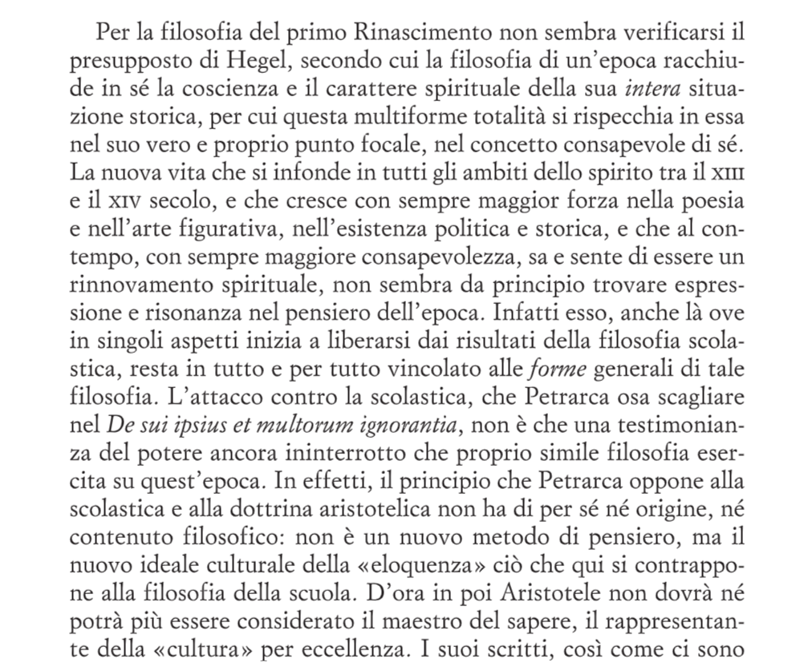
Renaissance, renewal
Ernst Cassirer, Individuo e cosmo nella filosofia del Rinascimento [Individuum und Kosmos in der Philosophie der Renaissance] (Bollati Boringhieri 2012)
Plurality of views
Critique of Aristotelianism

Slide 11
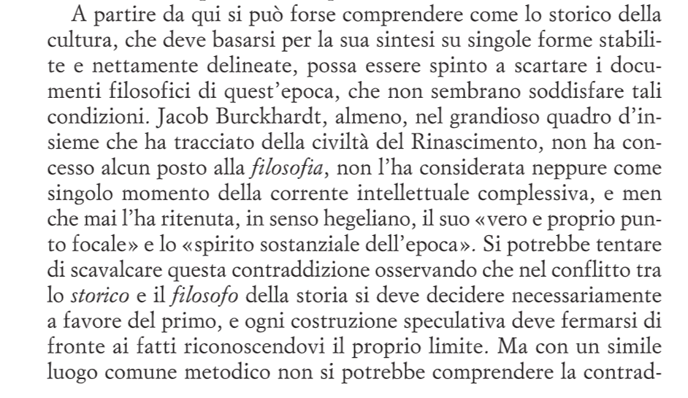
Renaissance, renewal
Ernst Cassirer, Individuo e cosmo nella filosofia del Rinascimento [Individuum und Kosmos in der Philosophie der Renaissance] (Bollati Boringhieri 2012)
→ Is there a philosophy of the Renaissance?

Slide 12
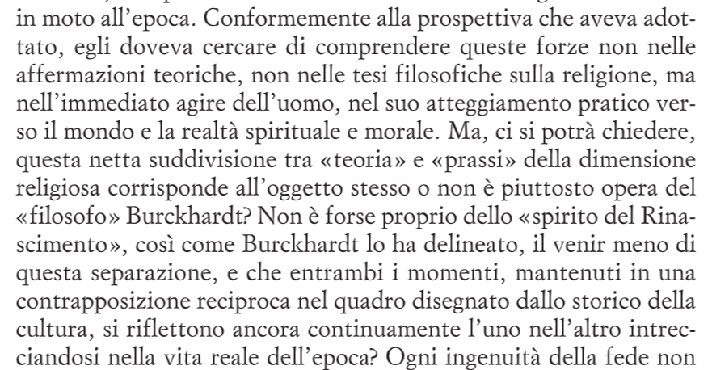
Renaissance, renewal
Ernst Cassirer, Individuo e cosmo nella filosofia del Rinascimento [Individuum und Kosmos in der Philosophie der Renaissance] (Bollati Boringhieri 2012)
Theory and practice
Individuum and cosmos
→ What does this mean in terms of the human relation to nature in early modernity?

Slide 13
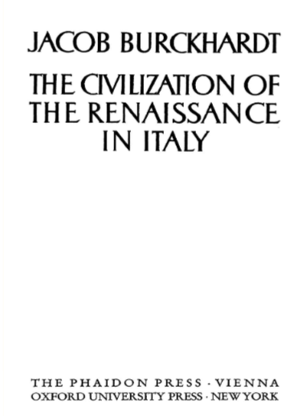
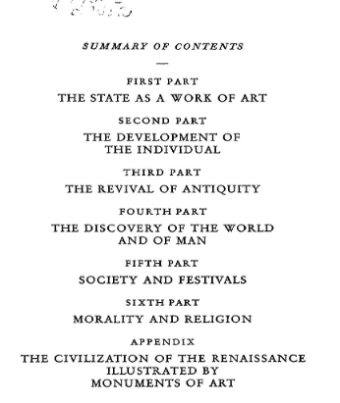
Renaissance, renewal
Jacob Burckhgardt, Die Cultur der Renaissance in Italien (1860)
The rediscovery of antiquity
New political and social orders
The importance of the geographic discoveries
→ Was there a Renaissance philosophy?

Slide 14
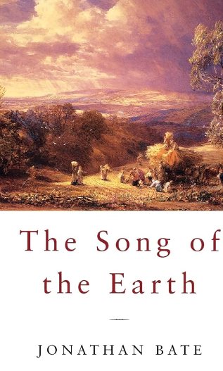
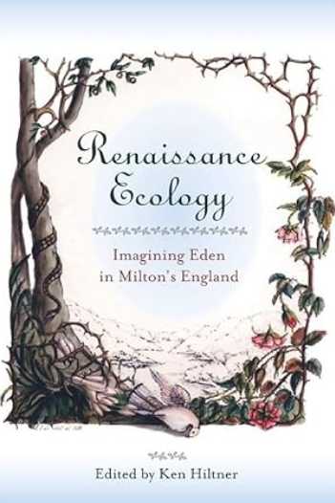
Environmental Humanities
→ Centrality of the Renaissance (but not necessarily of Renaissance philosophy)

Slide 15
Goals for the module:
To reflect on philosophical conceptions of nature and ecology from the 16th to the 18th centuries
To delineate the philosophical history of concepts such as exploitation, sustainability, animal protection etc.
To use the methodologies of the history of philosophy for an application of philosophical knowledge to contemporary concern

Slide 16
Introductory Keywords
Nature
Ecology
Environment/Milieu/Surroundings

Slide 17
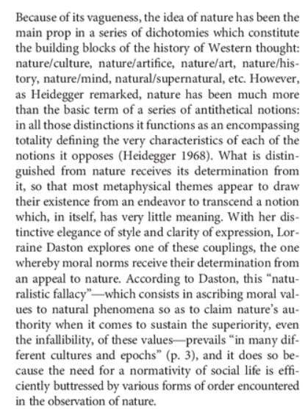
Introductory Keywords
Nature: an ancient term (not an anachronism: widely used in early modernity). BUT: a contested concept in contemporary philosophical discussions
https://www.youtube.com/watch?v=i9FlWiBAmJY
Lorraine Daston: Nature as a layer cake
Philippe Descola on Daston’s Against Nature

Slide 18
Introductory Keywords
Nature: an ancient term (not an anachronism: widely used in early modernity)
https://www.youtube.com/watch?v=i9FlWiBAmJY
Lorraine Daston: Nature as a layer cake
Philippe Descola on Daston’s Against Nature

Slide 19
Introductory Keywords
Nature: a Eurocentric concept
https://www.youtube.com/watch?v=YSs7E4zRnhE&list=TLPQMjUwNDIwMjSQi8YlRsH9MQ&index=1

Slide 20
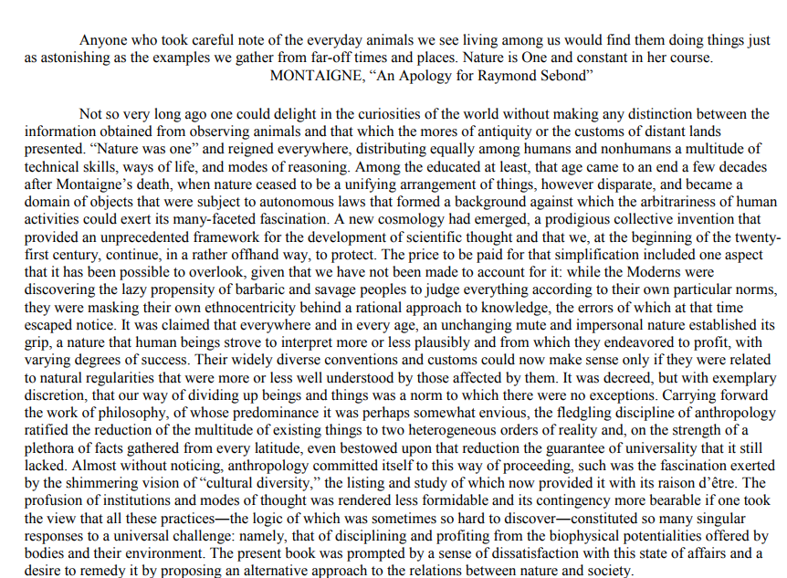
Introductory Keywords
Nature:
Not an efficient concept;
A concept which underwent a crisis, but we keep using it
We need new concepts (philosophy and anthropology working together)
Is ‘nature’ an anachronism after all?
How do we interpret ‘nature’ in early modern texts?

Slide 21
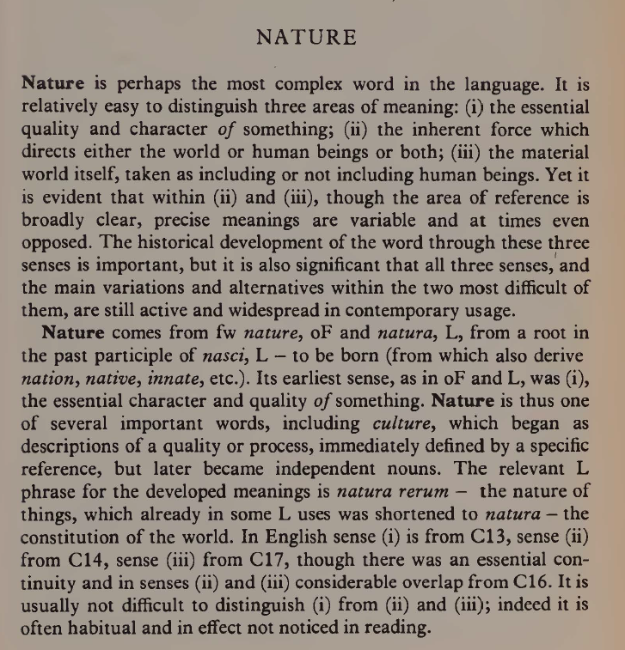
Introductory Keywords: Nature
Raymond Williams, Keywords (1976)
(Marxist perspective)
At least three meanings of ‘nature’

Slide 22
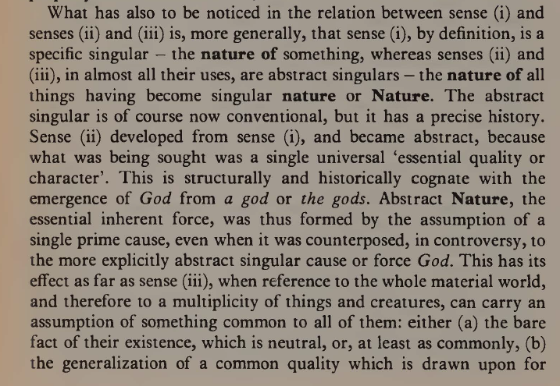
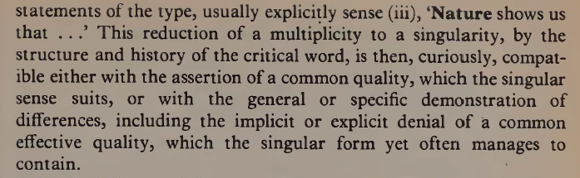
Introductory Keywords: Nature
Raymond Williams, Keywords (1976)
(Marxist perspective)
From nature to Nature

Slide 23
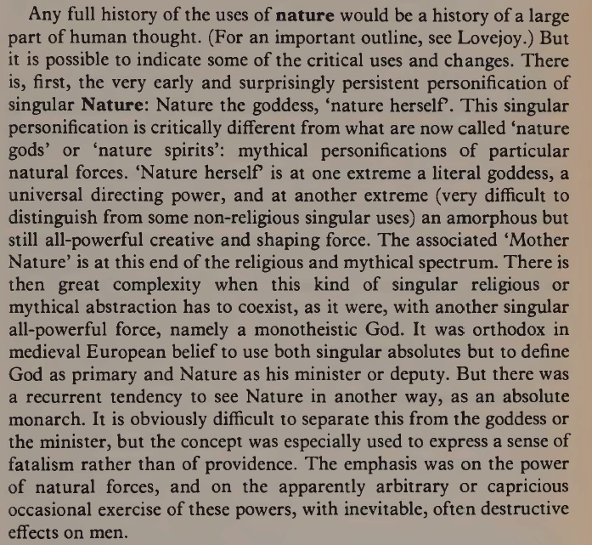
Introductory Keywords: Nature
Raymond Williams, Keywords (1976)
(Marxist perspective)
From nature to Nature

Slide 24
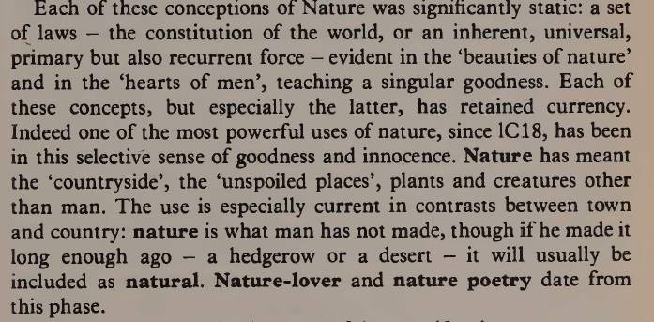
Introductory Keywords: Nature
Raymond Williams, Keywords (1976)
(Marxist perspective)
A fallacy at the heart of the conception of Nature (this is what Daston talks about)

Slide 25
Introductory Keywords: Nature
Raymond Williams, Keywords (1976)
(Marxist perspective)
A fallacy at the heart of the conception of Nature (this is what Daston talks about)

Slide 26
Introductory Keywords
Raymond Williams, Keywords (1976)
(Marxist perspective)
A fallacy at the heart of the conception of Nature (this is what Daston talks about)

Slide 27
Introductory Keywords: Environment
Environment/Milieu/Surroundings
https://www.youtube.com/watch?v=dwPOwLpZSFg
Etienne Benson on ‘THE environment’

Slide 28
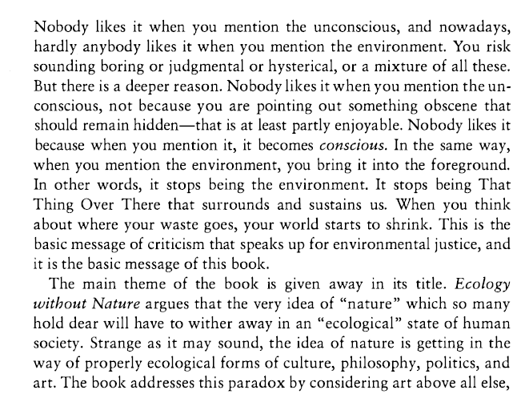
Introductory Keywords: Environment
A critique of nature and the concept of environment
T. Morton, Ecology Without Nature (2007)

Slide 29
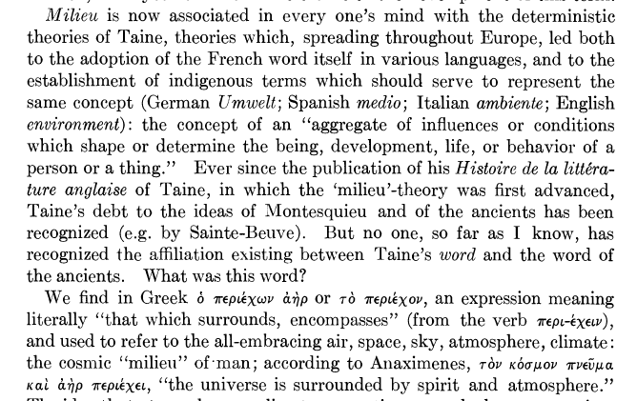
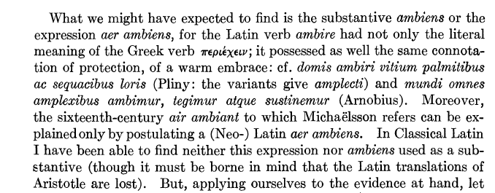
Introductory Keywords: Environment
Milieu, ambiens aer, environment

Slide 30
Introductory Keywords: Environment
→ When does a specific term start to be used? And in which language? (NB: the story of the word is not the story of the concept!)
“In einem solchen Element bei solcher Umgebung, bei Liebhabereien und Studien dieser Art…”
Goethe, Aus meinem Leben. Dichtung und Wahrheit, Part III, Tübingen 1814, p. 332
Translation by Thomas Carlyle in his review of Goethe, Sämmtliche Werke (1827), The Foreign Review, 2, September 1828, p. 98: “In such an element, with such an environment of circumstances, with studies and tastes of this sort…”

Slide 31
Introductory Keywords: Environment
→ When does a specific term start to be used? And in which language? (NB: the story of the word is not the story of the concept!)
“In einem solchen Element bei solcher Umgebung, bei Liebhabereien und Studien dieser Art…”
Goethe, Aus meinem Leben. Dichtung und Wahrheit, Part III, Tübingen 1814, p. 332
Translation by Thomas Carlyle in his review of Goethe, Sämmtliche Werke (1827), The Foreign Review, 2, September 1828, p. 98: “In such an element, with such an environment of circumstances, with studies and tastes of this sort…”

Slide 32
Introductory Keywords: Environment
→’Environment’ in early modernity? The influence of the surrounding ‘air’
Giovanni Pontano, De fortuna (ed. Francesco Tateo), III.1: “Putat [Aristoteles] igitur motus eos extrinsecus ab ambiente suscitari. […] Recte igitur qui dixerunt aera receptaculum esse et tanquam penu eorum omnium, quae e terra atque aquis exhalant, evaporant, aspirant”.
Fortunio Liceti, De spontaneo viventium ortu (1618), chap. 122: “a calore in ambiente vigente viventia sponte nascentia immediate oriri confitentur”.
Girolamo Cardano, De subtilitate (OO, vol. 3), lib. 2: “Ambiens aër est causa corruptionis”.

Slide 33
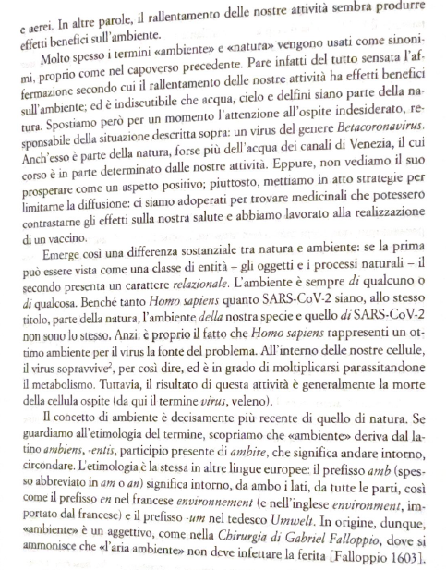
Introductory Keywords: Environment
→Environment/ambiente vs nature/natura
E. Casetta, Filosofia dell’ambiente (Il Mulino, 2023)

Slide 34
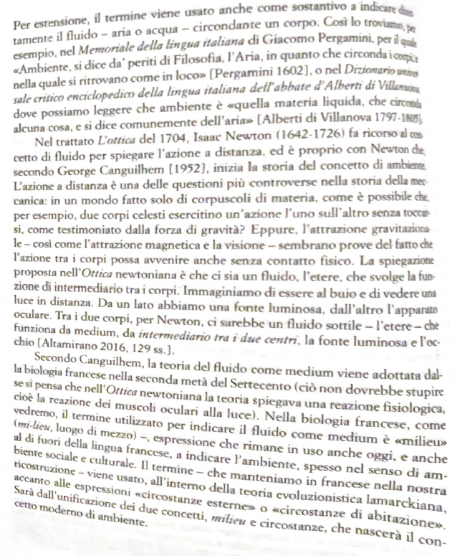
Introductory Keywords: Environment
→Environment/ambiente vs nature/natura
E. Casetta, Filosofia dell’ambiente (Il Mulino, 2023)

Slide 35
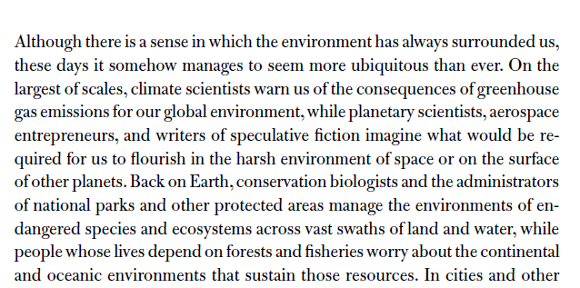
Introductory Keywords: From Environment to environmentalism
E. Benson, Surroundings (2020)

Slide 36
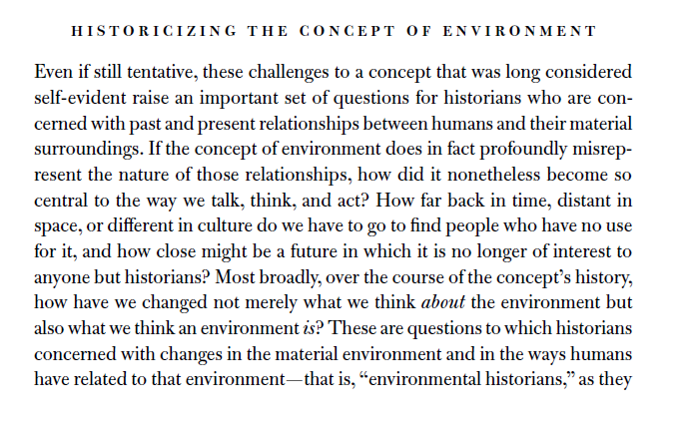
Introductory Keywords: From Environment to environmentalism
→ What about philosophers/historians of philosophy?
E. Benson, Surroundings (2020)

Slide 37
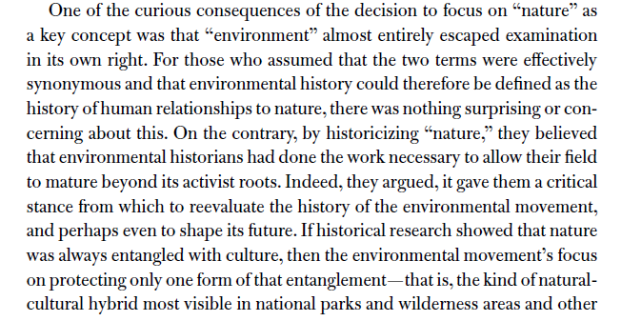
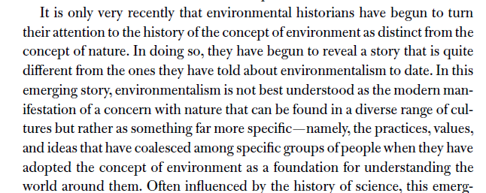
Introductory Keywords: From Environment to environmentalism
→ A (philosophical) history of nature, versus a (philosophical) environmental history
E. Benson, Surroundings (2020)

Slide 38
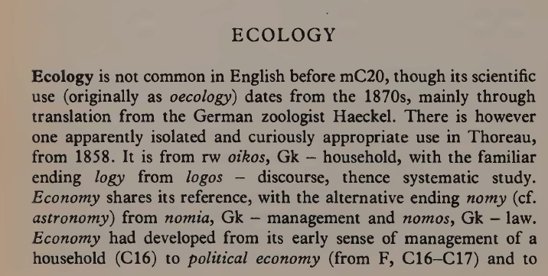
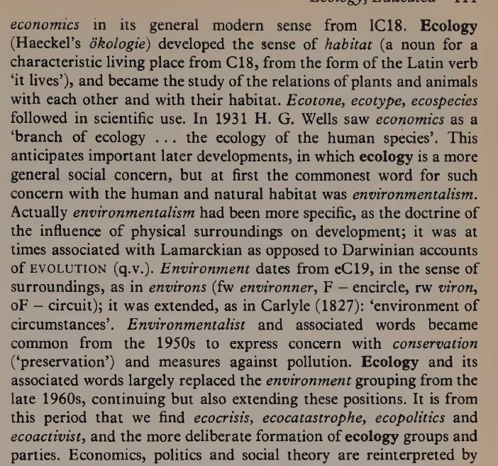
Introductory Keywords: Ecology – an anachronism if applied to early modernity?
Williams, Keywords

Slide 39
Nature, the Environment, and Ecology in Early Modernity
Many of the philosophers/positions we will also consider (but some are also notably absent – Campanella for example)
Emphasis on ‘science’

Slide 40
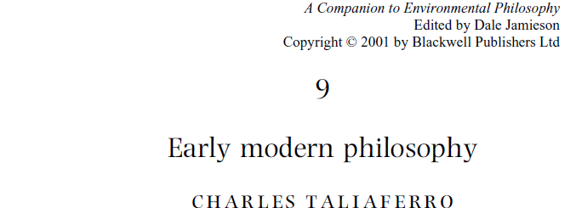
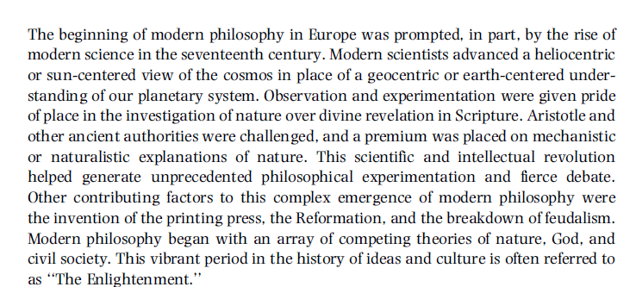
Nature, the Environment, and Ecology in Early Modernity
Does ‘environmental philosophy’ imply a certain, ‘scientific’ approach to nature?

Slide 41
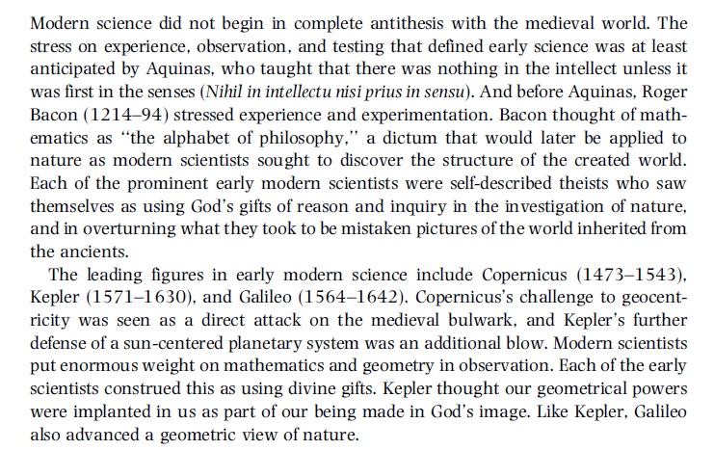
Nature, the Environment, and Ecology in Early Modernity
Do you agree with Taliaferro’s emphasis?

Slide 42
Cornelis Snellinck (1605-1669)
Landscape with figures passing by a cottage and a pond

