Slide 1
History of North America
Prof. Benedetta Calandra
AUDIO VISUAL MATERIAL+SEMINARS - WEEK BY WEEK

Slide 2
Week one- class 2 The beginning of “the American century”: the Cuban-Spanish- American war of 1898.
Crucible of Empires. The Spanish-American War https://www.youtube.com/watch?v=8g8NpQsmxj4

Slide 3
The Spanish-American War- Synopsis
Examines the colorful characters and historic events surrounding this war and its relevance to the twentieth century.
When a declining Spain fell to American expansionism, the United States inherited her colonies and suddenly emerged as a world power.
The experience and questions that the Spanish-American War raised about foreign intervention echo throughout the 20th century.

Slide 4
The Spanish-American War- Synopsis
In the process:
debuted the media in its role as catalyst of U.S. intervention;
built up the navy and inspired a re-evaluation of the army
and vastly broadened the powers of the president in wartime and foreign affairs.
Clearly, the Spanish-American War was the war that launched the American century.

Slide 5
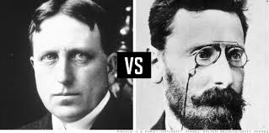
The Spanish-American War- Synopsis
The Spanish-American War was the first "media war." (min. 14…)
The film explores the role sensationalist journalism played in the war and pays particular attention
to William Randolph Hearst
and Joseph Pulitzer.
With the sinking of the U.S.S. Maine in Havana harbor in 1898, Hearst had the perfect pretext for war. The Hearst press saw to it that Spain shouldered the blame and a reluctant President McKinley capitulated.

Slide 6
The U.S. went to war with Spain, winning in a matter of weeks.
The new territory promised markets, military bases, and influence overseas.
The Spanish-American War would spur U.S. policy-makers to reinterpret the Monroe Doctrine and reassess American leadership as it extended from the Western Hemisphere to the world.

Slide 7
The Spanish-American War- Sources
Using period photographs, newspaper headlines, more than a dozen popular songs from the 1890s, and interviews with some of America's most prominent historians, CRUCIBLE OF EMPIRE tells how issues of
race, economy, technology, yellow journalism, and public opinion propelled America into this war.
https://www.youtube.com/watch?v=8g8NpQsmxj4

Slide 8
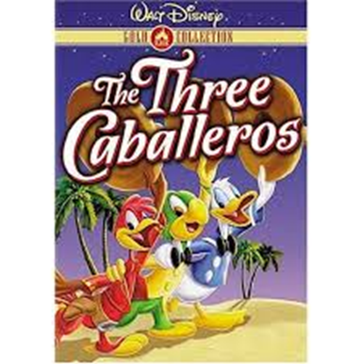
Week 2 – class 4 American imperialism, The Great Depression and the Politics of Good Neighbour (1904-1933)
The three caballeros (1943, Walt Disney production)

Slide 9
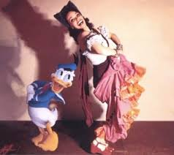
The Three Caballeros (1944)
The film premiered in Mexico City on December 21, 1944
It was another good will movie towards the South American countries
The film combines animation and live action
Several Latin American stars of the period appear, including singers Aurora Miranda
and dancer Carmen Molina

Slide 10
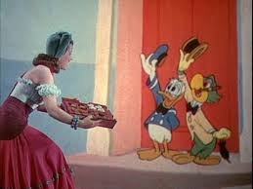
The Three Caballeros (1944)
The film star Is Donald Duck, who in the course of the film is joined by old friend José Carioca, the cigar-smoking parrot representing Brazil.
Many Brazilians embrace Jose Carioca because he is an accurate portrayal of a upperclass Brazilian ladies man

Slide 11
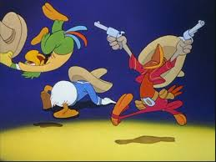
The Three Caballeros (1944)
Donald later makes a new friend in the pistol-packing rooster
Panchito Pistoles, a native of Mexico.
Panchito is the typical Mexican bandito, which you could argue is Disney stereotyping Mexicans as being gun happy

Slide 12
Week 2 – class 4 American imperialism, The Great Depression and the Politics of Good Neighbour
The three caballeros (1943, Walt Disney production)
https://nortonsafe.search.ask.com/search?q=the+three+caballeros+walt+disney+video&page=1&ctype=videos&doi=2022-10-03&cmpgn=medici&o=APN12174&p2=%5EEQ%5Emedici%5E&browser=Chrome&prod=DS&installSource=other&darkMode=false&sameTabLaunch=false&annot=false&ueid=d69b8684-7d45-42cb-8cc6-49051802f3a3

Slide 13
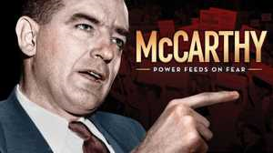
Week 3- class 6, March 6, The ‘read scare’: Mc Carthyism, Guatemalan revolution and Operation Success (1950 s)
The rise and fall of Joseph McCarthy, the Wisconsin senator whose zealous anti-communist crusade would test the limits of American decency and democracy.
and fall The rise and fall of Joseph McCarthy, the Wisconsin senator whose zealous anti-communist
https://www.pbs.org/wgbh/americanexperience/features/mccarthy-extended-trailer/ (min. 1.60)
https://www.pbs.org/wgbh/americanexperience/features/mccarthy-chapter-1/ (min 8.50)

Slide 14
Week 3- class 6, March 6, The ‘read scare’: Mc Carthyism, Guatemalan revolution and Operation Success
Some archival sources…
Ngo National Security Archive,
The Guatemala Project
The National Security Archive launched the Guatemala Documentation Project in 1994, after peace negotiators seeking to end Guatemala’s 36-year armed conflict agreed to establish a truth commission. The project's first objective was to support the human rights investigations of the UN-sponsored Historical Clarification Commission by forcing the declassification and release of secret U.S. government files on decades of repression and state violence in Guatemala.
https://nsarchive.gwu.edu/project/guatemala-project
The Guatemala Project
The Guatemala Project

Slide 15
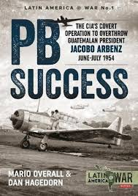
Week 3- class 6, March 6 The ‘read scare’: Mc Carthyism, Guatemalan revolution and Operation Success
Operation PBSuccess – YouTube
https://www.youtube.com/watch?v=qGpFIefUTlk
(10 minutes)
(excerpts from History Channel)

Slide 16
Week 3- class 6 - March 11, The 1960s: the Peace Corps, social movements and the Counterculture.
Peace Corps:
Kennedy Speaks On The American Peace Corps (1961), British Pathè, Reuters historical collection
https://www.youtube.com/watch?v=o_jPrHipF_c (5 minutes)

Slide 17
Week 4- class 6 - March 11, The 1960s: the Peace Corps, social movements and the Counterculture.
Woodstock
In August, 1969, half a million people from all walks of life and every corner of the country converged on a small dairy farm in upstate New York. They came to hear the concert of their lives, but most experienced something far more profound. What happened over the next three days,, was far more than a concert: a moment that would change them and the country forever, define a cultural revolution and mark the end of one of the most turbulent decades in modern history.
https://www.youtube.com/watch?v=asDTFjApJ2c (2 min.)

Slide 18
Week 3- class 6 - March 11, The 1960s: the Peace Corps, the social movements and the Counterculture
Woodstock
Woodstock 1969: What was original festival really like?
Memories from who was there…
https://www.youtube.com/watch?v=SPY7sEpTtNs /(10 min)

Slide 19
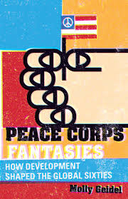
Week 4- class 7, March 4 invited lecture
Women’s Sterilizations in Bolivia and the case of the Peace Corps,
prof. Molly Geidel,
Dartmouth College.

Slide 20
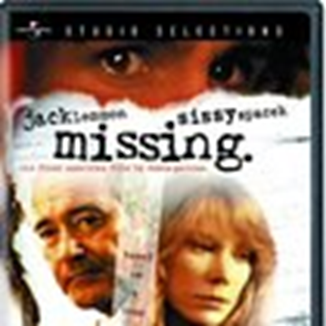
Week 4 – class 8. March 13, National Security Doctrine and the Condor Operation: the case of Chile
Missing (1982, Joaquin Costa-Gavras)

Slide 21
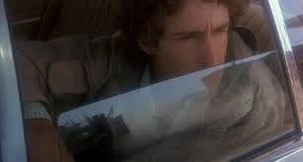
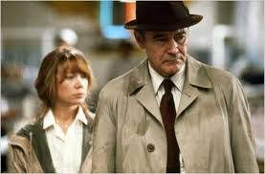
Missing- Synopsis
In 1973, U.S. businessman Ed Horman (Jack Lemmon) arrives in Chile to look for his son, Charles (John Shea), a Charles Horman, a young, Harvard-educated, counterculture, politically left-leaning journalist who disappeared during a military coup.

Slide 22
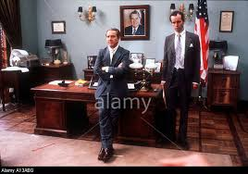
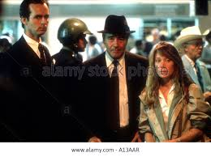
Missing- Synopsis
Charles' wife, Beth (Sissy Spacek), has been looking for some time, but her requests for help from the U.S. consulate have thus far produced few results.
As Ed and Beth try to figure out what really happened to Charles, Ed realizes that the American officials may know more than they're telling.

Slide 23
Missing- Synopsis
Ed and Beth's search for Charles involves a succession of chilling encounters with politely patronizing United States embassy and consular officials, as well as with members of the Chilean Government.
Missing documents, in a most moving way, the raising of the political consciousness of Ed Horman who has, until this devastating experience, always believed in the sanctity of his government and accepted its actions and policies without question.

Slide 24
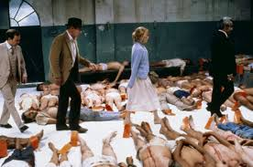
Missing- Synopsis
Ed and his daughter-in-law have never seen eye to eye politically, and he refuses to entertain the notion that his son's disappearance might be part of a larger conspiracy or cover-up.
But as the days grow into weeks, Ed comes to the shattering conclusion that he and his family have been betrayed by the American government, on behalf of the "friendly" South American dictator who holds his people in a grip of iron.

Slide 25
Missing (1982, Joaquin Costa-Gavras)
Official trailer (min 2,50)
https://www.youtube.com/watch?v=chLXsiIldCI
Missing, main theme, Vangelis sound track (min. 4,15)
https://www.youtube.com/watch?v=u_NRgcZcNRI

Slide 26
Interview with with Joyce Horman
Interview with Joyce Horman, Charles’ widow
Joyce Horman on the Chilean Military Coup of 1973 | Bob Herbert's Op-Ed.TV
https://www.youtube.com/watch?v=C4-7-WqtN24 (26 min.)

Slide 27
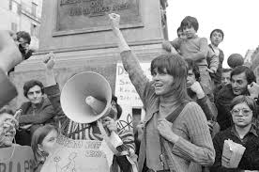
Week 5- class 9, Invited lecture
Between Hollywood and Capitol Hill:
Jane Fonda’s activism in the late seventies,
Doc. Marta Gara, Catholic University of Sacred Heart, Milan

