Slide 1
History of Philosophical Thought and Aesthetics
Nature, Ecology, and the Environment in Early Modernity
Part A
Part 2: Utopia – A Renaissance (ecological) concept
cecilia.Muratori@unipv.it

Slide 2
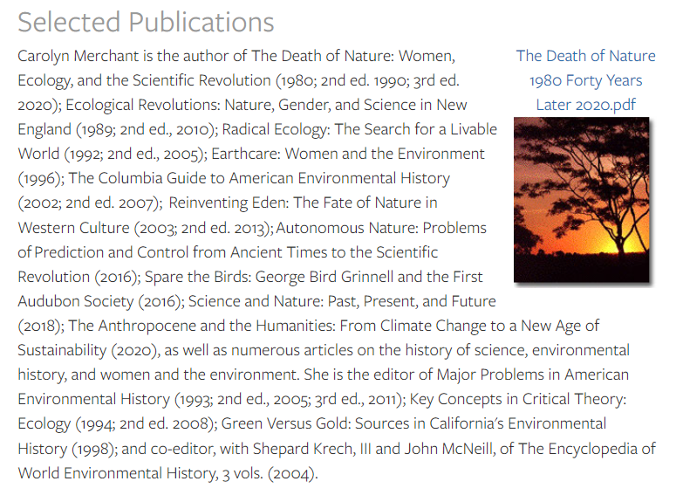
Carolyn Merchant, American ecofeminist philosopher

Slide 3
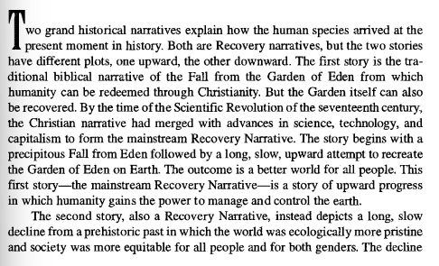
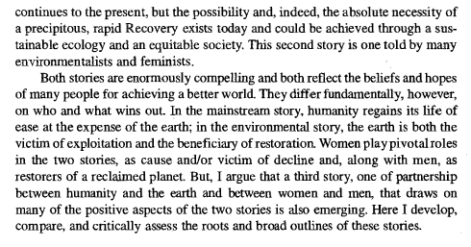
From Ecology to Utopia
Carolyn Merchant, Reinventing Eden

Slide 4
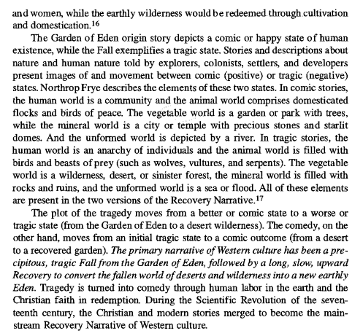
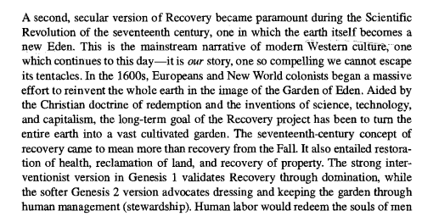
From Ecology to Utopia

Slide 5
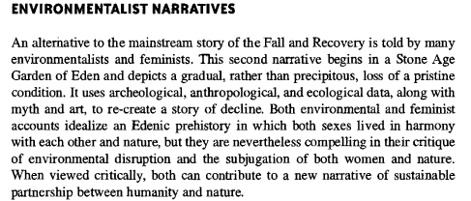
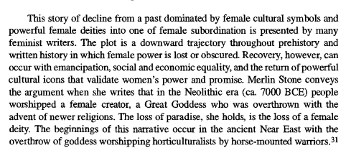
From Ecology to Utopia
Why is early modernity central in one of these narratives?
What would be the role of utopias in these narratives?
In what sense can a utopian narrative be ecological?

Slide 6
Talking About Utopia today
https://www.youtube.com/watch?si=nVD922Z_NxSyE_o3&v=Zto299cA8nM&feature=youtu.be
Miriam Eliav-Feldon, Realistic Utopias (1982): utopias are «an invitation to perceive the distance between things as they are and things as they should be».
Ou-topia/Eu-topia
(Dystopia: an alternative scenario in which everything is negative, distorted, worse than the present condition. Probably first used by John Stuart Mill (1806-1873) in a speech in the British House of Commons)

Slide 7
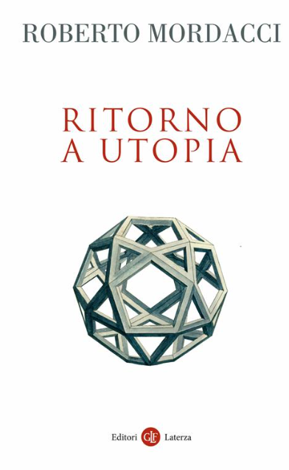
Nostalgia for Utopia
«L’utopia ha inizio da un nome. Originariamente, infatti, Utopia non è un concetto. È solo una parola evocativa, frutto di una brillante quanto semplice invenzione linguistica: è un luogo (-topia) chiamato non-luogo (ou-topia), che è, a un tempo, un buon-luogo (eu-topia). La parola originaria dà il nome all’isola dove Sir Thomas More, nel 1516, immagina la sua repubblica ideale, contro-specchio critico della sua Inghilterra e proiezione del sogno umanistico di una società giusta e armonica. Si sa che un luogo simile non esiste, ma è proprio per questo che esso è un’insuperabile obiezione contro l’ingiustizia, il sopruso, l’inimicizia e l’odio. Nessuno immagina la società ideale come una comunità in perenne conflitto, ostile, iniqua e infelice. Quest’ultima è piuttosto la triste realtà che ci si presenta ogni giorno nell’esperienza, mentre l’altra immagine, quella di armonia e felicità, è viva solo nella fantasia».

Slide 8
Nostalgia for Utopia
Points for discussion:
‘Utopia’ seems to mean imaginary, fictitious, dream-like
Is Mordacci really talking about Renaissance utopias, or about a present-day nostalgia for an ideal society that differs substantially from the one in which we live?
Mordacci does not refer to key aspects of Renaissance utopias: irony, the presence of violence and less than desirable traits in these ‘ideal’ societies, the idea of change and development in these utopias (they are not static)

Slide 9
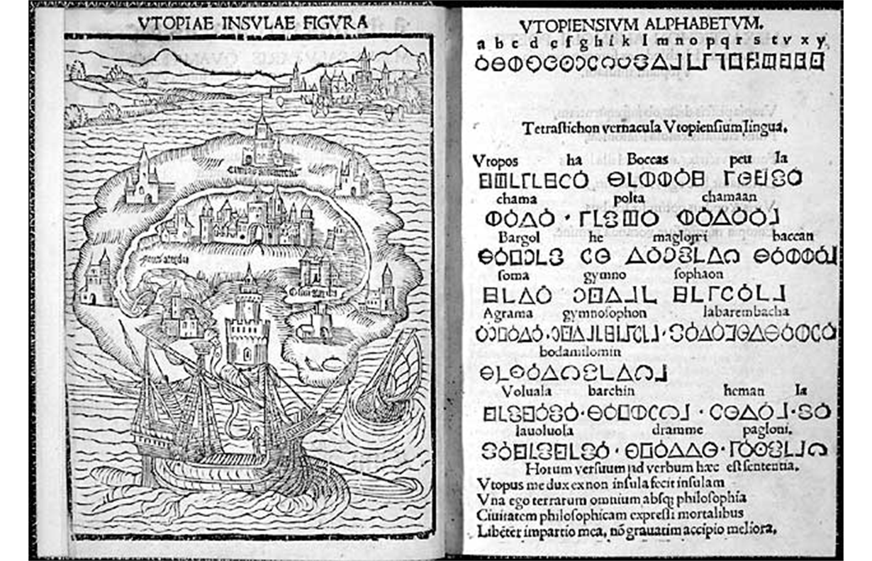
Thomas More, Utopia (Louvain 1516)

Slide 10
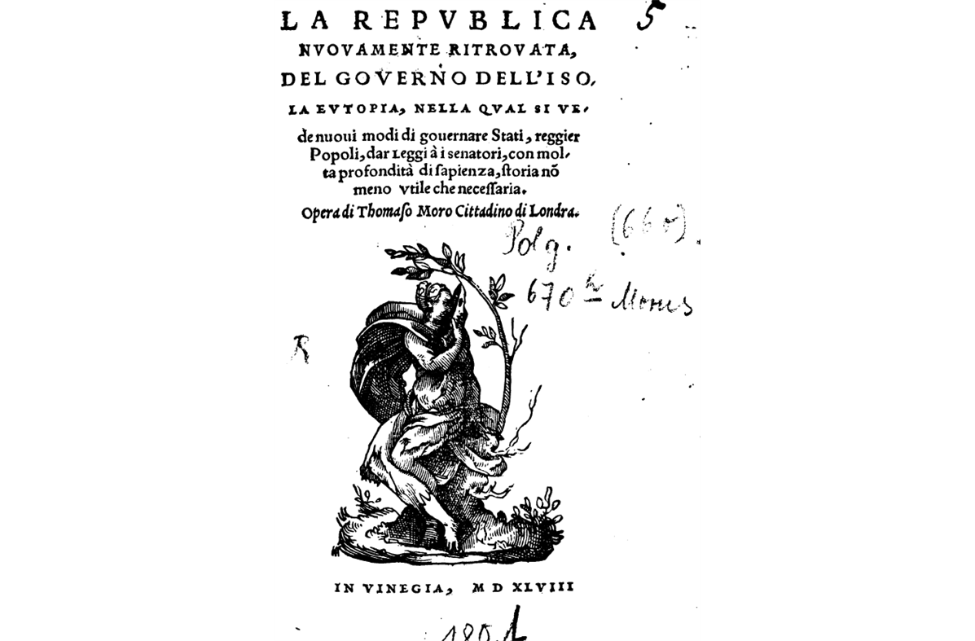
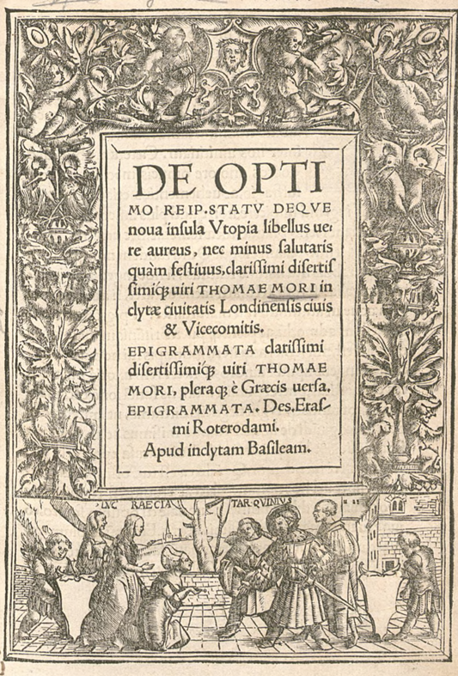
Utopia, Nusquama, Eutopia

Slide 11
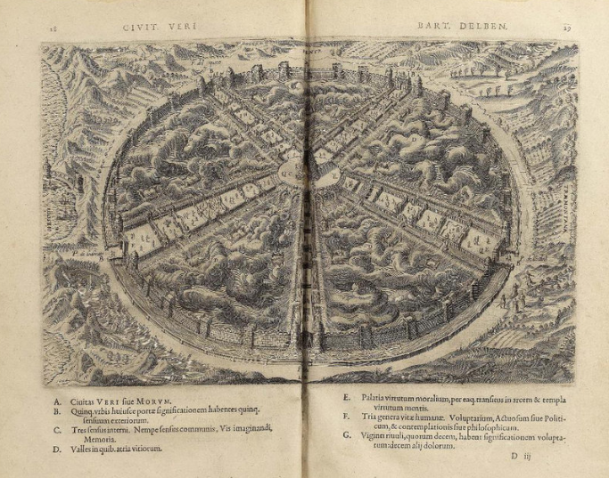
Utopia, an idea between architecture, literature, philosophy
Bartolomeo Del Bene (born 1514), Civitas Veri
An allegory based on Aristotle’s Nicomachean Ethics, about the progressive elevation of the philosopher to virtue. The aim is reaching philosophical wisdom (subdivision in 30 days or allegorical panels)

Slide 12
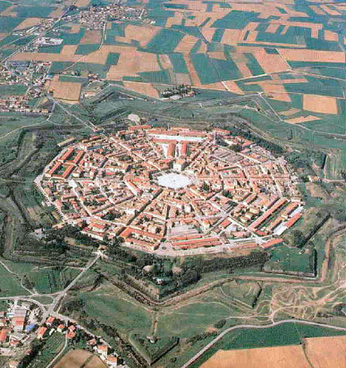
Utopia, an idea between architecture, literature, philosophy
La città ideale, Galleria nazionale delle Marche, Urbino (end of the 15th century)
Palmanova (end of the 16th century)

Slide 13
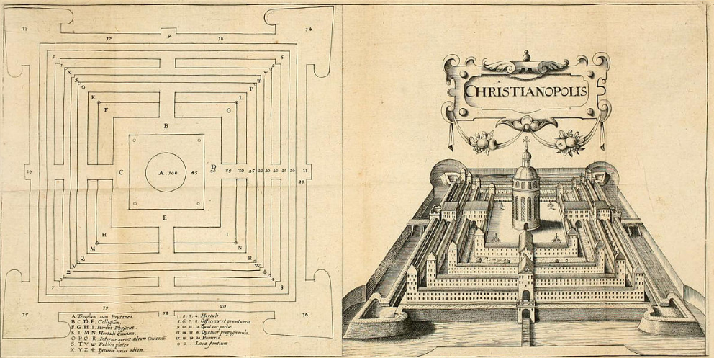
Utopia, an idea between architecture, literature, philosophy
Johann Valentin Andreae,
Christianopolis (1619)

Slide 14
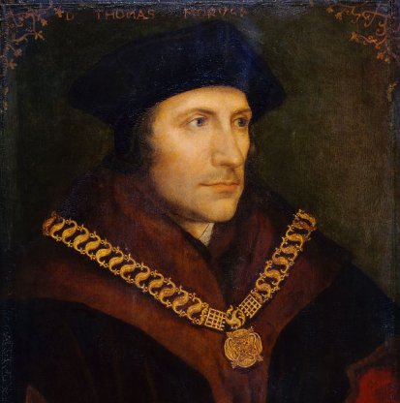
Thomas More (1478-1535)
1517: civil servant to Henry VIII (secretary, diplomat)
1535: executed for refusing to accept the annulation of Henry’s marriage to Catherine of Aragon and severing from Rome
1534: Act of supremacy (Henry VIII head of the Church of England)
Historical context for Utopia
Reformation still to happen (1517/18)
First french edition 1550; English edition 1551
Of the early Latin editions (De optimo rei publicae statu deque nova insula Utopia) none were published in England
1548: Italian edition (La republica nuovamente ritrovata)
1550: French edition (Description de l’Isle d’Utopie)
Gargantua & Pantagruel (use of the term Utopia): 1534

Slide 15
Utopia: sources of inspiration
- Lucian, True History (2 century). First ‘science fiction’. Parody of travel writing. The heroes travel beyond the Pillars of Hercules. Satire on what is true and what is fiction. Lucian is an author loved by Erasmus and Thomas More (they translate Lucian in 1505, publication in 1506). The aim is to entertain and to provide interesting material (same for Utopia?). The protagonist of True History arrives on the island of the Blessed where he encounters many great figures from the past, apart from Plato, who is allegedly living in his imaginary, ideal city.
- Vespucci’s travels (basis for the imaginary journey are real journeys): Mundus novus, 1504 (in the form of a letter to Pierfrancesco de’ Medici)
1492: first voyage
1493 Bull by Pope Alexander VI dividing in two hemispheres: time of negotiations between maritime powers
Bible
Plato

Slide 16
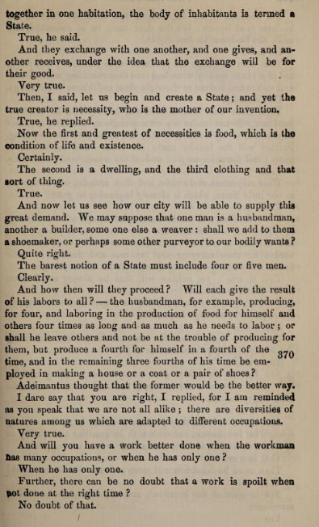
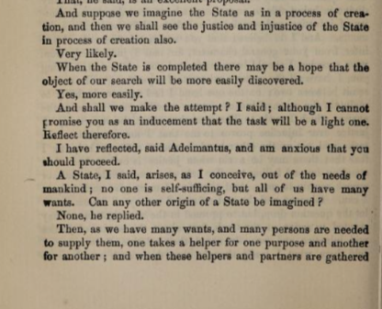
The ideal state as thought experiment:
Plato, Republic 369-373 (tr. B. Jowett)

Slide 17
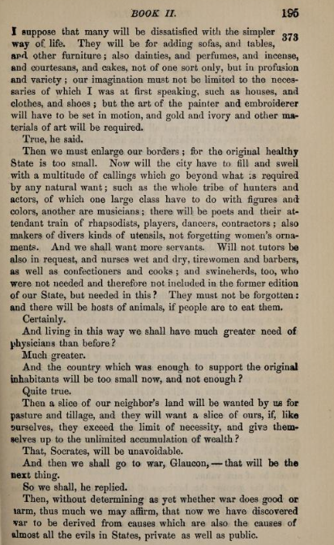
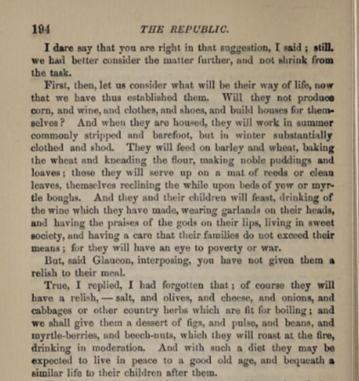
The ideal state as thought experiment:
Plato, Republic 369-373

Slide 18
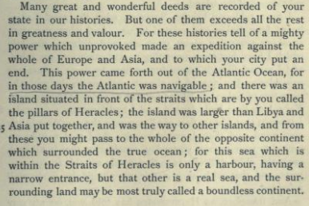
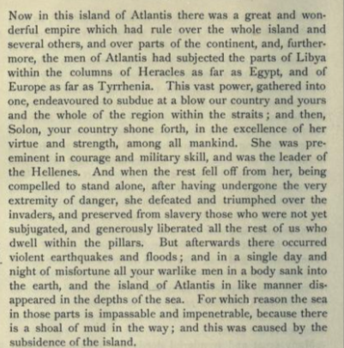
Plato, the myth of Atlantis
Timaeus, 24-25

Slide 19
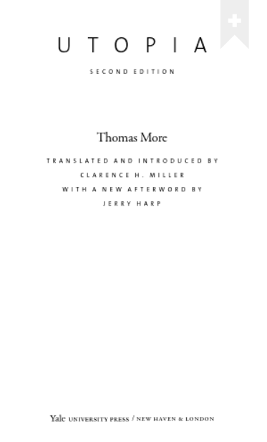
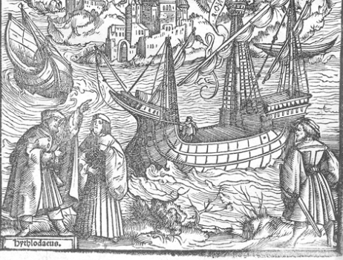
More’s Utopia: the setting
Peter Giles, real person
Raphael Hythlodaeus (Rafael, ‘divine’ guide; Hythlodaeus: dispenser of nonsense)
Thomas More
“as my business required, I made my way to Antwerp. [...] One day, after I had heard mass at the church of St. Mary, which is remarkable for its beautiful architecture and its large congregation, when the service was over and I was getting ready to return to my lodgings, I happened to see Giles conversing with a stranger who was getting up in years. His face was sunburned, his beard untrimmed, his cloak hanging carelessly from his shoulder; from his face and bearing I thought he looked like a sea captain.”

Slide 20
More to Raphael: «Then too, since your friend Plato thinks that commonwealths will be happy only when philosophers become kings or kings become philosophers, how far will be from happiness if philosophers will not even deign to impart their advice to kings. […] But undoubtedly Plato clearly foresaw that unless kings became philosophers, they would never give the advice of philosophers, because since childhood they have been thoroughly imbued and infected with misguided notions».
How would philosophers design a city?
How would philosophers manage resources?
How would philosophers handle nature?

Slide 21
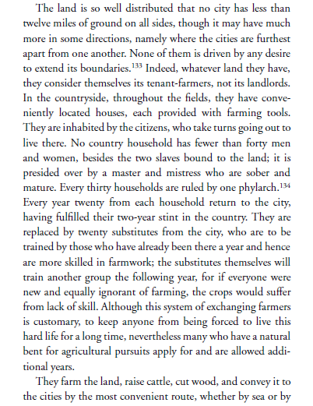
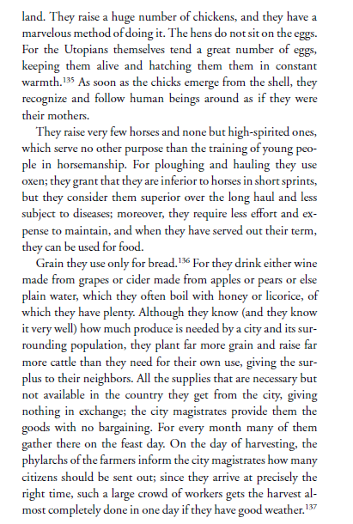
Managing
the
Land

Slide 22
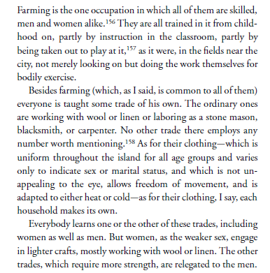
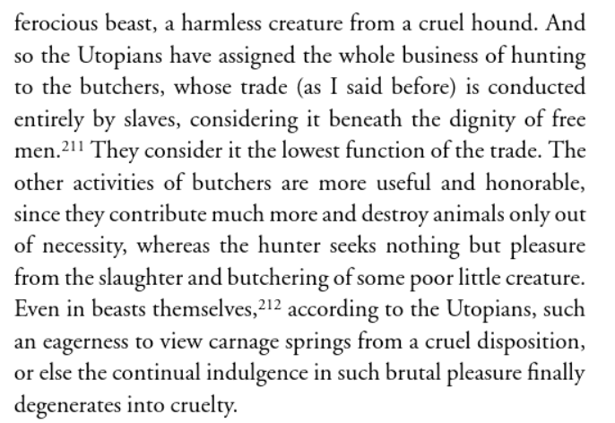
Farming
and
butchering

Slide 23
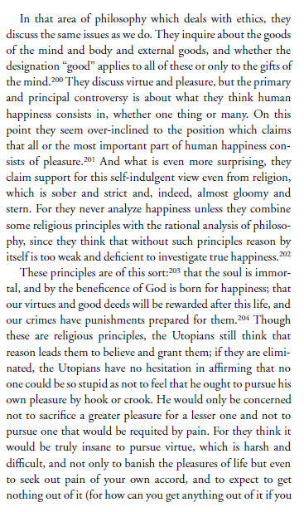
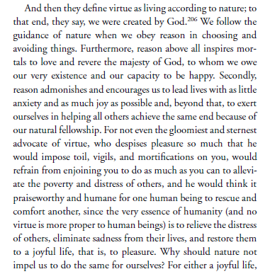
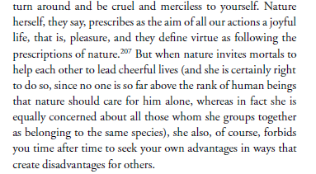
The philosophy of the Utopians: following Nature

Slide 24
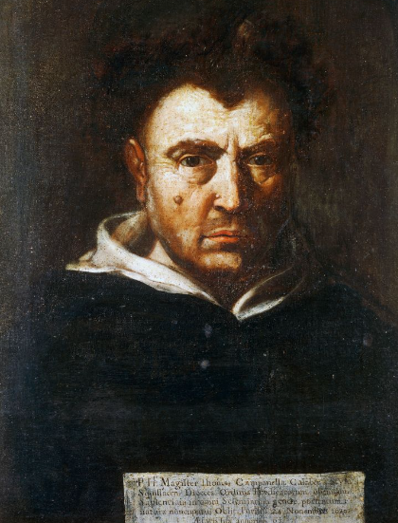
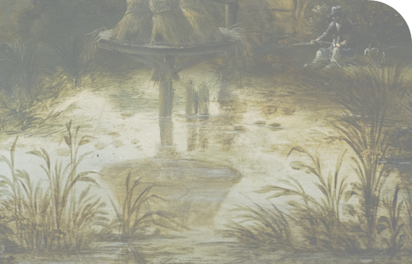
Tommaso Campanella 1568-1639
1592: manuscripts confiscated by the Inquisition
1594: arrested on suspicion of heresy
1598: involved in an attempted coup
1626: leaves the prison of Castel Nuovo for Naples
1634: exile in France

Slide 25
The City of the Sun
Genovese. Sorge nell’ampia campagna un colle, sopra il quale sta la maggior parte della città; ma arrivano i suoi giri molto spazio fuor delle radici del monte, il quale è tanto, che la città fa due miglia di diametro e più, e viene ad essere sette miglia di circolo; ma, per la levatura, più abitazioni ha, che si fosse in piano. È la città distinta in sette gironi grandissimi, nominati dalli sette pianeti, e s’entra dall’uno all’altro per quattro strade e per quattro porte, alli quattro angoli del mondo spettanti; ma sta in modo che, se fosse espugnato il primo girone, bisogna più travaglio al secondo e poi più; talché sette fiate bisogna espugnarla per vincerla.
La città del Sole, ed. L. Firpo, Laterza 1997 (reprinted 2008)

Slide 26
The City of the Sun
Genovese. A hill rises in the wide countryside, on which the greater part of the city is situated; but its circuits reach a great space beyond the roots of the mountain, which is so much, that the city is two miles in diameter and more, and comes to be seven miles in circle; but, because of its elevation, it has more dwellings, than if it were on a plain. The city is divided into seven very large circles, named after the seven planets, and one enters from one to the other by four roads and four gates, facing the four corners of the world; but it is so that, if the first circle were conquered, more effort would be needed for the second and then even more; so that seven times it must be conquered to conquer it.
La città del Sole, ed. L. Firpo, Laterza 1997 (reprinted 2008)

Slide 27
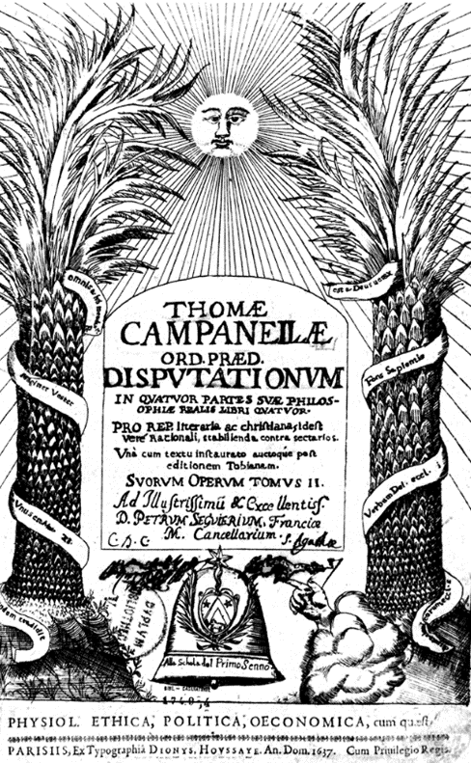
The City of the Sun: written in 1602, published for the first time in 1623 in Germany (appendix to the Politics)
Characters:
Ospitalario: knight of the order of San Giovanni in Jerusalem (Order of Malta)
Genovese: sailor with Columbus
The Genoese tells the story of his encounter with the Solarians, having reached their island just below the Equinox

Slide 28
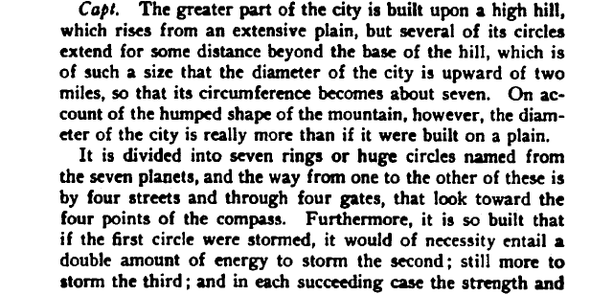
The natural environment

Slide 29
A Dynamic Community
Genovese. Il tempio è tondo perfettamente, e non ha muraglia che lo circonda; ma sta situato sopra colonne grosse e belle assai. La cupola grande ha in mezzo una cupoletta con uno spiraglio, che pende sopra l’altare, ch’è un solo e sta nel mezzo del tempio. Girano le colonne trecento passi e più, e fuor delle colonne della cupola vi sono per otto passi li chiostri con mura poco elevate sopra le sedie, che stan d’intorno al concavo dell’esterior muro, benché in tutte le colonne interiori, che senza muro fraposto tengono il tempio insieme, non manchino sedili portatili assai. Sopra l’altare non vi è altro ch’un mappamondo assai grande, dove tutto il cielo è dipinto, e un altro dove è la terra. Poi sul cielo della cupola vi stanno tutte le stelle maggiori del cielo, notate coi nomi loro e virtù, c’hanno sopra le cose terrene […].
Ospitalario: Quella [cosa] delle donne communi pare dura e ardua” – s’intende da un punto di vista cristiano. Genovese: “si difendono con Socrate, Catone, Platone e altri. Potria stare che lasciassero quest’uso un giorno, perché nelle città soggette a loro non accomunano se non le robbe, e le donne quanto all’ossequio e all’arti, ma non al letto; e questo l’ascrivono all’imperfezione di quelli che non han filosofato. Però vanno spiando di tutte nazioni l’usanze, e sempre migliorano; e quando sapranno le ragioni vive del Cristianesmo, provate con miracoli, consentiranno, perché son dolcissimi. Ma fin mo trattano naturalmente senza fede rivelata.”

Slide 30
A Dynamic Community
Genovese. The temple is perfectly round, and has no wall surrounding it; but it is placed on very large and beautiful columns. The large dome has in the middle a small dome with a small opening, which hangs over the altar, which is only one and is in the middle of the temple. The columns go around three hundred paces or more, and outside the columns of the dome there are for eight paces the cloisters with walls slightly raised above the seats, which are around the concave of the external wall, although in all the internal columns, which without a wall in between hold the temple together, there is no lack of very portable seats. Above the altar there is nothing but a very large globe, where the whole sky is painted, and another where the earth is. Then on the sky of the dome there are all the major stars of the sky, noted with their names and virtues, which they have over earthly things […].
Ospitalario: That [thing] that women are in common seems hard and arduous” – meaning from a Christian point of view.
Genovese: “they defend themselves with Socrates, Cato, Plato and others. It could be that they would abandon this custom one day, because in the cities subject to them they only share property, and women with regard to respectful attitude and the arts, but not to the bed; and they attribute this to the imperfection of those who have not philosophized. However, they go spying on the customs of all nations, and they always improve; and when they know the living reasons of Christianity, proven by miracles, they will consent, because they are very meek. But up to now they act according to nature without revealed faith; nor can they overcome it any longer.”

Slide 31
Diet in the Ideal City
Ospitalario: Che e come mangiano? e quanto è lunga la vita loro?
Genovese. Essi dicono che prima bisogna mirar la vita del tutto e poi delle parti
Genovese: Or essi mangiano carne, butiri, mèle, cascio, dattili, erbe diverse, e prima non volean uccidere gli animali, parendo crudeltà; ma poi, vedendo che era pur crudeltà ammazzar l’erbe, che han senso, onde bisognava morire, considerâro che le cose ignobili son fatte per le nobili, e magnano ogni cosa.

Slide 32
Diet in the Ideal City
Ospitalario:What and how do they eat? And how long is their life?
Genovese. They say that first one must look at the life of the whole and then of the parts.
Genovese: Now they eat meat, butter, honey, cheese, dates, various herbs, and at first they did not want to kill the animals, considering it cruelty; but then, seeing that it was also cruelty to kill the plants, which have sense, so that it was necessary to die of hunger], they considered that ignoble things are made for noble ones, and they eat everything.

Slide 33
Eating by Rotation

Slide 34
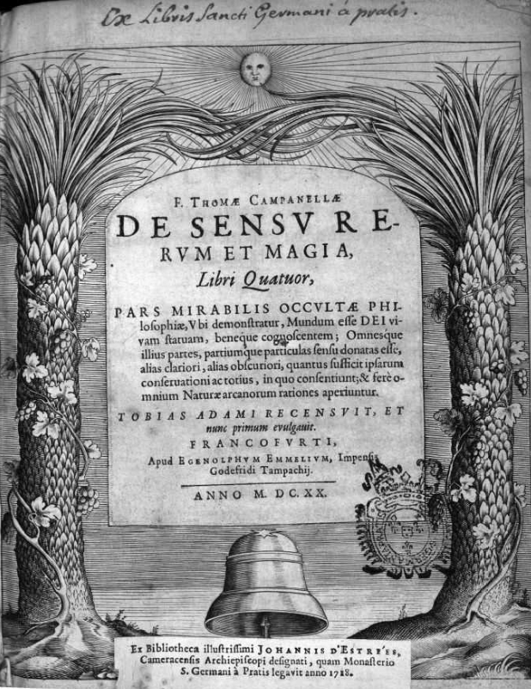
Nature Feels
Del senso delle cose e della magia (1604)
De sensu rerum et magia (1620)
Book I.1: “Or se gli animali, per consenso universale, hanno sentimento, e da niente il senso non nasce, è forza dire che sentano gli elementi, lor cause, e tutte, perché quel che ha l’uno all’altro convenire si mostrarà. Sente dunque il cielo e la terra e il mondo, e stan gli animali dentro a loro come i vermi dentro il ventre umano, che ignorano il senso dell’uomo, perché è sproporzionato alla loro conoscenza picciola”. (Del senso delle cose e della magia, ed. G. Ernst, Laterza 2007)

Slide 35
Nature Feels
Del senso delle cose e della magia (1604)
De sensu rerum et magia (1620)
Book I.1: “Now if animals, by universal consent, have feeling, and sense does not arise from nothing, it is necessary to say that the elements feel, which are their causes, and all, because it will be shown that what one possesses will also apply to another. Therefore, heaven and earth and the world feel, and animals are inside them like worms inside the human belly, which ignore the human sensation, because it is disproportionate to their small knowledge”. (Del senso delle cose e della magia, ed. G. Ernst, Laterza 2007)

Slide 36
Cornelis Snellinck (1605-1669)
Landscape with figures passing by a cottage and a pond

