Slide 1
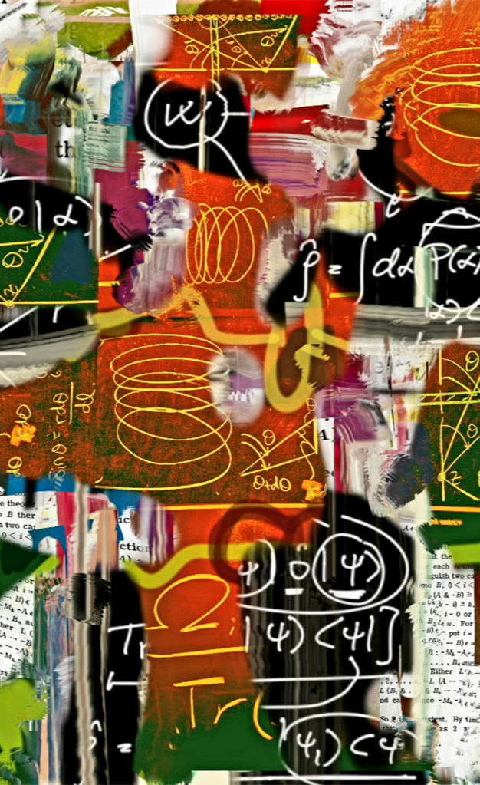
Knowledge and Rationality – A.Y. 2024-2025
Ignorance
and irrationality
Selene Arfini – selene.arfini@unipv.it

Slide 2
Ecological rationality can be conceptualized as the study of how individuals and species are adapted to identify and take advantage of opportunities in which past behavior can be exploited to achieve their goals in present contexts, including cases in which the exploited behavior is a strategic approach to exploration.
But... what remains of irrationality?
THE STRATEGY SELECTION PROBLEM
& ERROR TENDENCIES
Sour grapes
(underestimating the value of a positive-but-unlikely scenario)
Fear-driven inferences
(overstimating the probability of an unlikely-but-costly scenario)

Slide 3
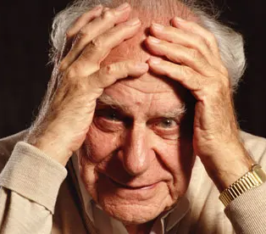
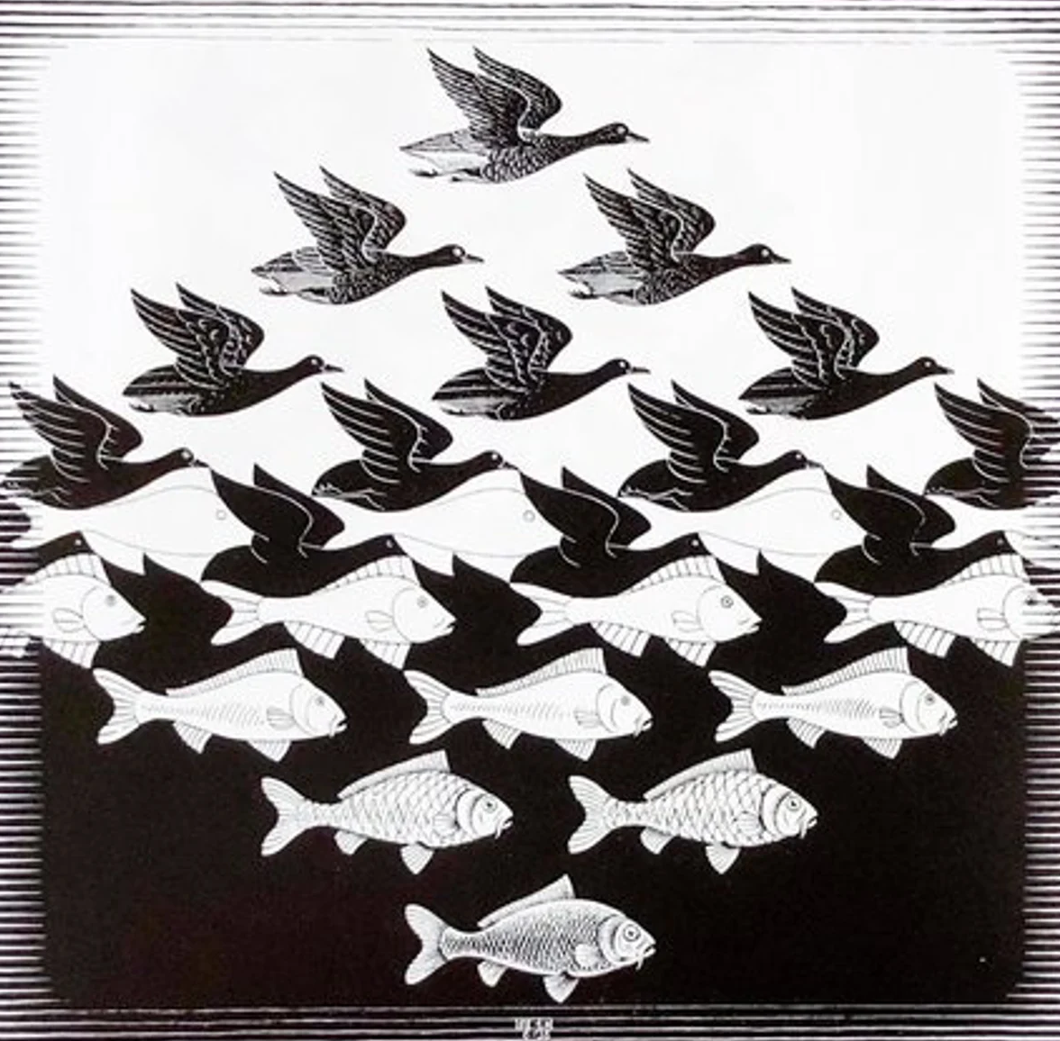
IGNORANCE
IRRATIONALITY
Un'ipotesi è falsificabile
se esiste almeno una proposizione osservativa logicamente possibile incompatibile con essa, ossia che, se vera,
la possa falsificare.
FALSIFICABILE
Karl Popper
(1902-1994)

Slide 4
IGNORANCE
KNOWLEDGE
RATIONALITY
IRRATIONALITY
Un'ipotesi è falsificabile
se esiste almeno una proposizione osservativa logicamente possibile incompatibile con essa, ossia che, se vera,
la possa falsificare.
FALSIFICABILE
Karl Popper
(1902-1994)

Slide 5
IGNORANCE
KNOWLEDGE
RATIONALITY
IRRATIONALITY

Slide 6
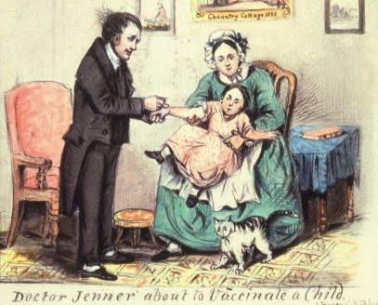
IGNORANCE
hypothetical reasoning
uncertainty
KNOWLEDGE
Magnani, L. (2013). Is abduction ignorance-preserving? Logic Journal of IGPL, 21, 882–914.
Chiffi, D., & Chiodo, S. (2020). Risk and Uncertainty: Foundational Issues. In A. Balducci, D. Chiffi, & F. Curci (Eds.), Risk and Resilience (pp. 1–13). Springer, Cham.
Copeland, S. (2019). On serendipity in science: Discovery at the intersection of chance and wisdom. Synthese, 196(6), 2385–2406.
RATIONALITY
IRRATIONALITY

Slide 7
IGNORANCE
hypothetical reasoning
uncertainty
Magnani, L. (2013). Is abduction ignorance-preserving? Logic Journal of IGPL, 21, 882–914.

Slide 8
IGNORANCE
hypothetical reasoning
uncertainty
risk
serendipity
Magnani, L. (2013). Is abduction ignorance-preserving? Logic Journal of IGPL, 21, 882–914.
Chiffi, D., & Chiodo, S. (2020). Risk and Uncertainty: Foundational Issues. In A. Balducci, D. Chiffi, & F. Curci (Eds.), Risk and Resilience (pp. 1–13). Springer, Cham.

Slide 9
IGNORANCE
hypothetical reasoning
uncertainty
risk
serendipity
Magnani, L. (2013). Is abduction ignorance-preserving? Logic Journal of IGPL, 21, 882–914.
Chiffi, D., & Chiodo, S. (2020). Risk and Uncertainty: Foundational Issues. In A. Balducci, D. Chiffi, & F. Curci (Eds.), Risk and Resilience (pp. 1–13). Springer, Cham.
Copeland, S. (2019). On serendipity in science: Discovery at the intersection of chance and wisdom. Synthese, 196(6), 2385–2406.

Slide 10
IGNORANCE
hypothetical reasoning
uncertainty
risk
socially distributed
ignorance
serendipity
Magnani, L. (2013). Is abduction ignorance-preserving? Logic Journal of IGPL, 21, 882–914.
Chiffi, D., & Chiodo, S. (2020). Risk and Uncertainty: Foundational Issues. In A. Balducci, D. Chiffi, & F. Curci (Eds.), Risk and Resilience (pp. 1–13). Springer, Cham.
epistemic trust/
relational ignorance
Copeland, S. (2019). On serendipity in science: Discovery at the intersection of chance and wisdom. Synthese, 196(6), 2385–2406.
Copeland, S. (2022). Relational Ignorance. In S. Arfini & L. Magnani (Eds.), Embodied, Extended, Ignorant Minds (pp. 15–35). Springer, Cham.
Irzik, G., & Kurtulmus, F. (r019). What Is Epistemic Public Trust in Science? The British Journal for the Philosophy of Science, 70(4), 1145–1166.

Slide 11
IGNORANCE
hypothetical reasoning
uncertainty
risk
socially distributed
ignorance
serendipity
interdisciplinarity
Darbellay, F., Moody, Z., Sedooka, A. & Steffen, G. (2014) Interdisciplinary Research Boosted by Serendipity, Creativity Research Journal, 26:1, 1-10.
epistemic trust/
relational ignorance
Copeland, S. (2022). Relational Ignorance. In S. Arfini & L. Magnani (Eds.), Embodied, Extended, Ignorant Minds (pp. 15–35). Springer, Cham.
Irzik, G., & Kurtulmus, F. (r019). What Is Epistemic Public Trust in Science? The British Journal for the Philosophy of Science, 70(4), 1145–1166.

Slide 12
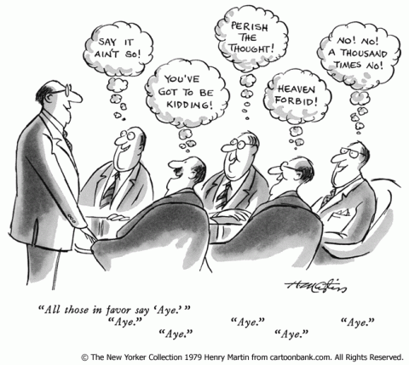
IGNORANCE
hypothetical reasoning
uncertainty
risk
socially distributed
ignorance
serendipity
interdisciplinarity
Darbellay, F., Moody, Z., Sedooka, A. & Steffen, G. (2014) Interdisciplinary Research Boosted by Serendipity, Creativity Research Journal, 26:1, 1-10.
pluralistic ignorance
epistemic trust/
relational ignorance
Copeland, S. (2022). Relational Ignorance. In S. Arfini & L. Magnani (Eds.), Embodied, Extended, Ignorant Minds (pp. 15–35). Springer, Cham.
Irzik, G., & Kurtulmus, F. (r019). What Is Epistemic Public Trust in Science? The British Journal for the Philosophy of Science, 70(4), 1145–1166.
Joven-Romero, M. A. (2018). On the Nature of Belief in Pluralistic Ignorance. Contemporary Pragmatism, 15(1), 23–45.

Slide 13
IGNORANCE
hypothetical reasoning
uncertainty
pluralistic ignorance
risk
socially distributed
ignorance
serendipity
interdisciplinarity
interdisciplinarity
epistemic trust/
relational ignorance
Darbellay, F., Moody, Z., Sedooka, A. & Steffen, G. (2014) Interdisciplinary Research Boosted by Serendipity, Creativity Research Journal, 26:1, 1-10.
Joven-Romero, M. A. (2018). On the Nature of Belief in Pluralistic Ignorance. Contemporary Pragmatism, 15(1), 23–45.
When different individuals conform to a group norm that they do not share simply because they are mistakenly convinced that everyone else accepts it.
epistemic trust/
relational ignorance
Copeland, S. (2022). Relational Ignorance. In S. Arfini & L. Magnani (Eds.), Embodied, Extended, Ignorant Minds (pp. 15–35). Springer, Cham.
Irzik, G., & Kurtulmus, F. (r019). What Is Epistemic Public Trust in Science? The British Journal for the Philosophy of Science, 70(4), 1145–1166.

Slide 14
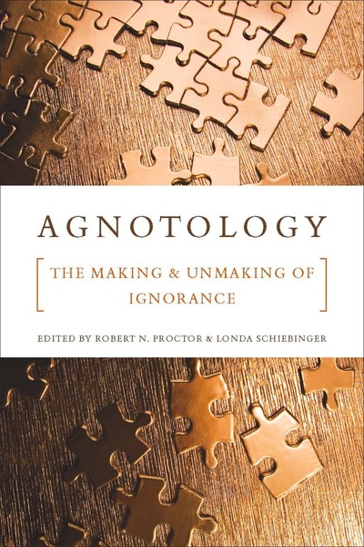
fake news
IGNORANCE
agnotology
hypothetical reasoning
conspiracy
theories
uncertainty
distributed
ignorance
pluralistic ignorance
risk
interdisciplinarity
serendipity
epistemic trust/relational ignorance
agnotology:
ignorance as a product
of socio-cultural strategies
e.g.: doubtmongering
When different individuals conform to a group norm that they do not share simply because they are mistakenly convinced that everyone else accepts it.
(Franklin, 2017)
Joven-Romero, M. A. (2018). On the Nature of Belief in Pluralistic Ignorance. Contemporary Pragmatism, 15(1), 23–45.

Slide 15
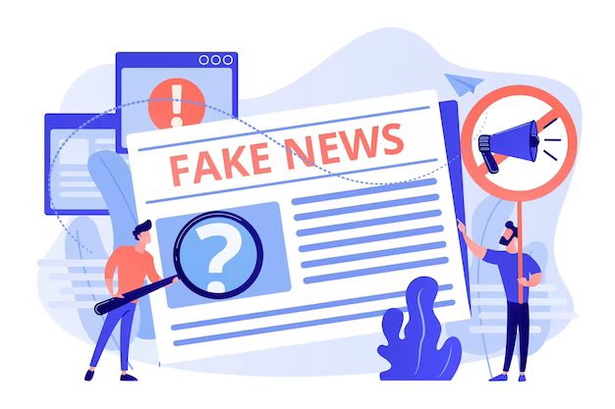
fake news
IGNORANCE
agnotology
hypothetical reasoning
conspiracy
theories
uncertainty
distributed
ignorance
pluralistic ignorance
risk
Gelfert, A. (2021). Fake News, False Beliefs, and the Fallible Art of Knowledge Maintenance. In A. Gelfert, The Epistemology of Fake News (pp. 310–333). Oxford University Press.
interdisciplinarity
serendipity
epistemic trust/relational ignorance
agnotology:
ignorance as a product
of socio-cultural strategies
e.g.: doubtmongering
When different individuals conform to a group norm that they do not share simply because they are mistakenly convinced that everyone else accepts it.
(Franklin, 2017)

Slide 16
fake news
IGNORANCE
agnotology
hypothetical reasoning
conspiracy
theories
uncertainty
distributed
ignorance
pluralistic ignorance
risk
Gelfert, A. (2021). Fake News, False Beliefs, and the Fallible Art of Knowledge Maintenance. In A. Gelfert, The Epistemology of Fake News (pp. 310–333). Oxford University Press.
interdisciplinarity
serendipity
epistemic trust/relational ignorance
agnotology:
ignorance as a product
of socio-cultural strategies
e.g.: doubtmongering
Basham, L. (2019). Malevolent global conspiracy. In D. Coady (Ed.), Conspiracy Theories (pp. 93–105). Routledge.

Slide 17
fake news
IGNORANCE
agnotology
hypothetical reasoning
conspiracy
theories
uncertainty
distributed
ignorance
pluralistic ignorance
risk
Gelfert, A. (2021). Fake News, False Beliefs, and the Fallible Art of Knowledge Maintenance. In A. Gelfert, The Epistemology of Fake News (pp. 310–333). Oxford University Press.
interdisciplinarity
serendipity
epistemic trust/relational ignorance
Basham, L. (2019). Malevolent global conspiracy. In D. Coady (Ed.), Conspiracy Theories (pp. 93–105). Routledge.

Slide 18
bias
fallibilism
impasse
fake news
IGNORANCE
Gelfert, A. (2021). Fake News, False Beliefs, and the Fallible Art of Knowledge Maintenance. In A. Gelfert, The Epistemology of Fake News (pp. 310–333). Oxford University Press.
agnotology
hypothetical reasoning
conspiracy
theories
uncertainty
distributed
ignorance
pluralistic ignorance
risk
interdisciplinarity
serendipity
epistemic trust/relational ignorance
Basham, L. (2019). Malevolent global conspiracy. In D. Coady (Ed.), Conspiracy Theories (pp. 93–105). Routledge.

Slide 19
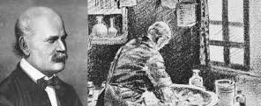
passive
Ignaz Semmelweis, 1818 - 1865
Kourany, J., & Carrier, M. (Eds.). (2020). Science and the production of ignorance: When the quest for knowledge is thwarted. The MIT Press.
active
epistemologies
of ignorance
bias
fallibilism
fake news
IGNORANCE
agnotology
hypothetical reasoning
conspiracy
theories
uncertainty
distributed
ignorance
pluralistic ignorance
risk
interdisciplinarity
serendipity
epistemic trust/relational ignorance

Slide 20
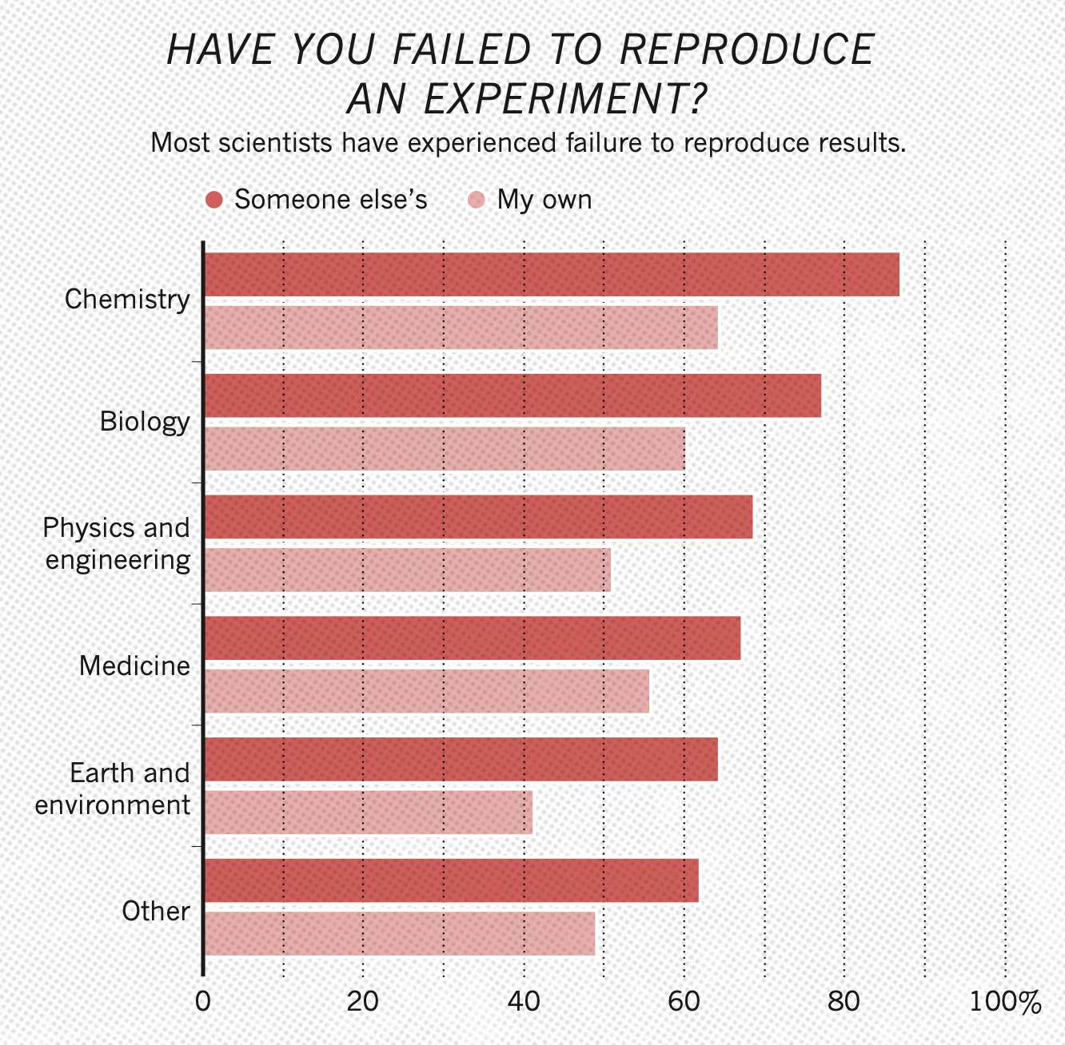
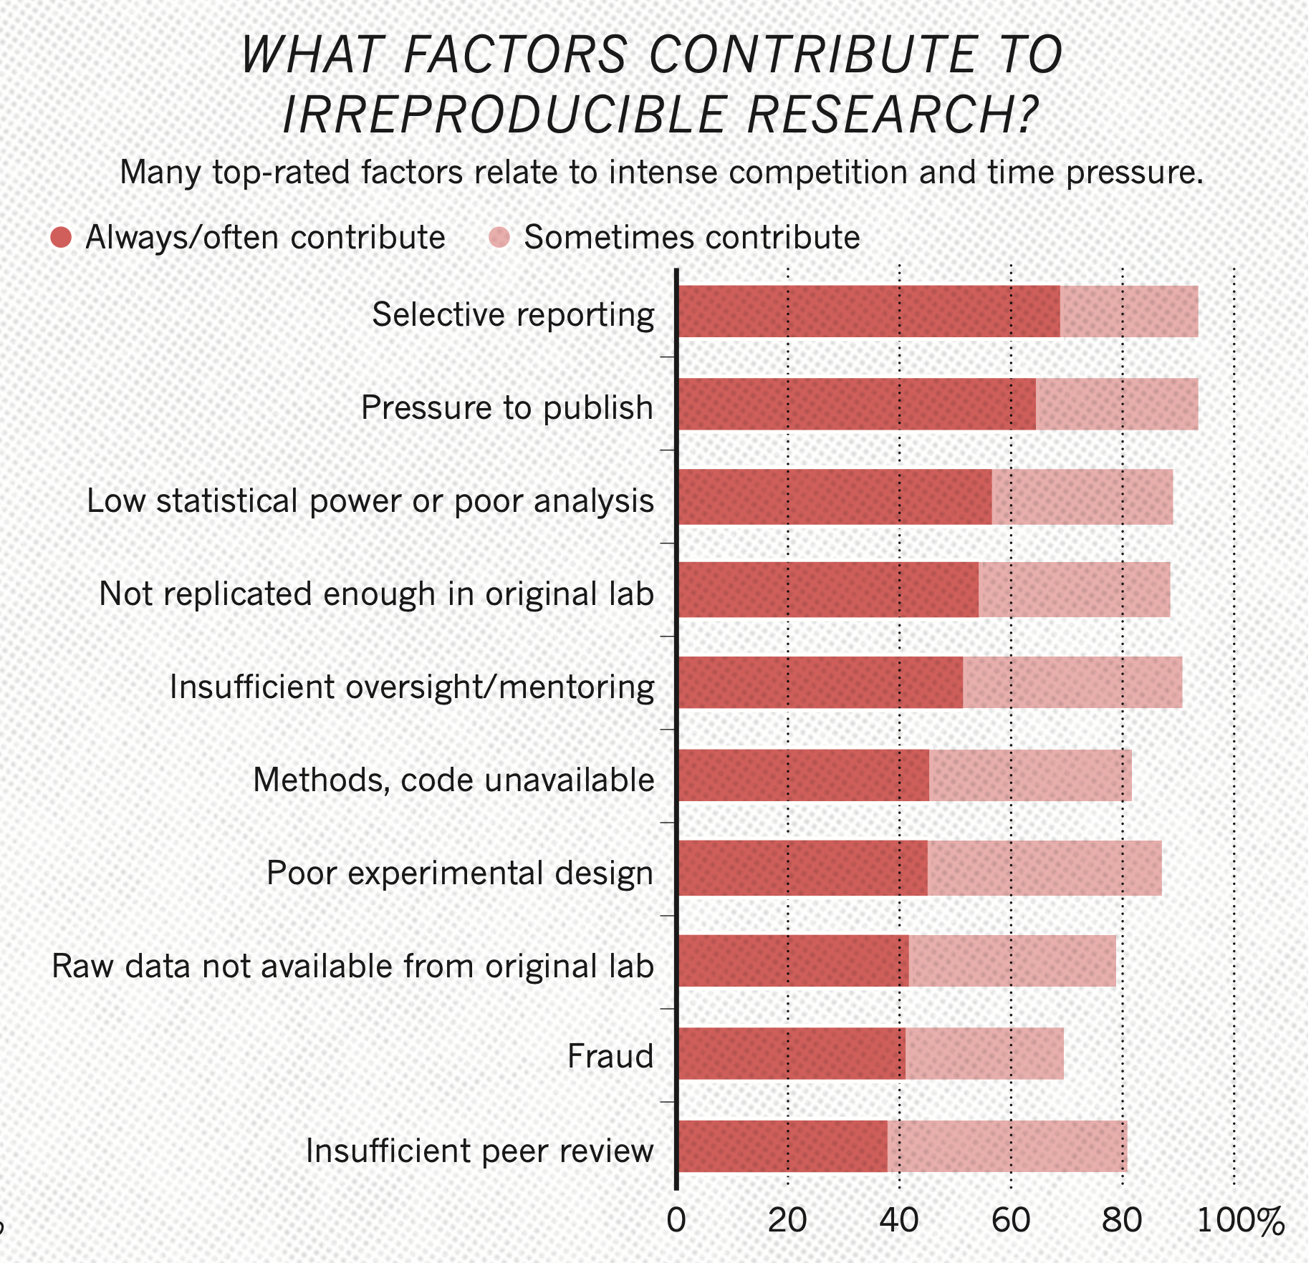
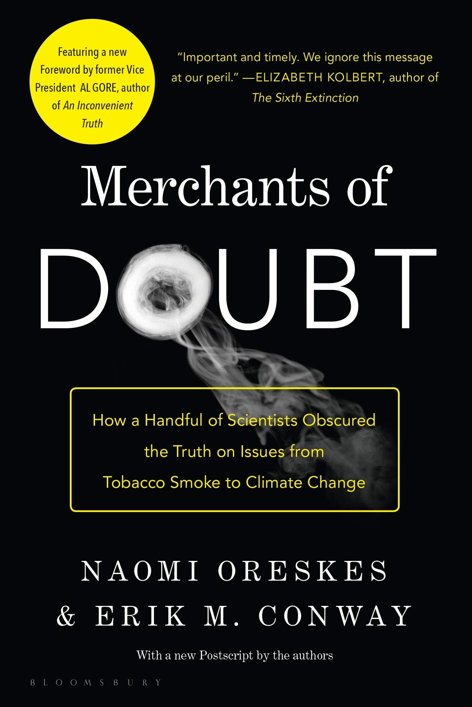
Kourany, J., & Carrier, M. (Eds.). (2020). Science and the production of ignorance: When the quest for knowledge is thwarted. The MIT Press.
passive
active
virtuous
Ignaz Semmelweis, 1818 - 1865
epistemologies
of ignorance
bias
fallibilism
fake news
IGNORANCE
agnotology
hypothetical reasoning
conspiracy
theories
uncertainty
distributed
ignorance
pluralistic ignorance
risk
interdisciplinarity
serendipity
epistemic trust/relational ignorance

Slide 21
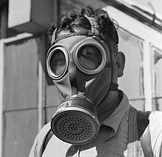
Ignaz Semmelweis, 1818 - 1865
Kourany, J., & Carrier, M. (Eds.). (2020). Science and the production of ignorance: When the quest for knowledge is thwarted. The MIT Press.
passive
active
virtuous
epistemologies
of ignorance
Are there things we shouldn’t know?
bias
fallibilism
fake news
IGNORANCE
agnotology
hypothetical reasoning
conspiracy
theories
uncertainty
distributed
ignorance
pluralistic ignorance
risk
interdisciplinarity
serendipity
epistemic trust/relational ignorance

Slide 22
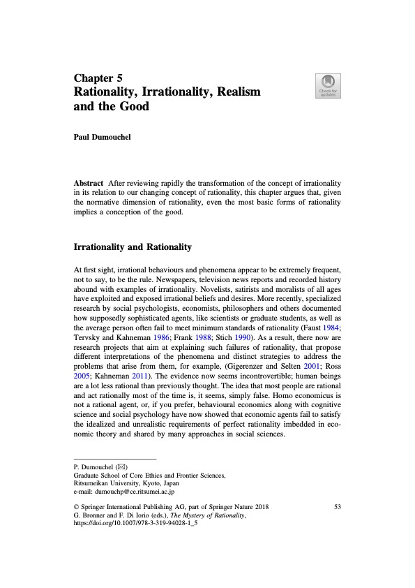

Slide 23
Next time: Self-defeating rationality
Arfini, S., & Magnani, L. (2021). Embodied Irrationality? Knowledge Avoidance, Willful Ignorance, and the Paradox of Autonomy. Frontiers in Psychology, 12, 769591. https://doi.org/10.3389/fpsyg.2021.769591
Dumouchel, P. (2018). Rationality, Irrationality, Realism and the Good. In G. Bronner & F. Di Iorio (Eds.), The Mystery of Rationality: Mind, Beliefs and the Social Sciences (pp. 53–65). Springer International Publishing. https://doi.org/10.1007/978-3-319-94028-1_5

