Slide 1
History of North America
Primary and secondary sources-
References during the course

Slide 2
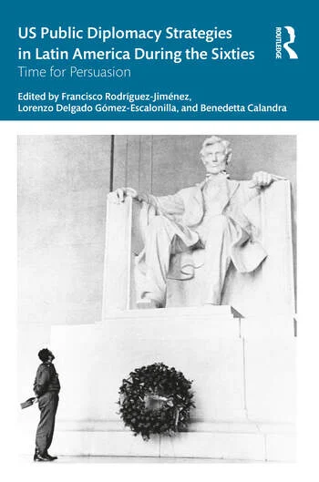
Publications include
*with Francisco Rodríguez and Lorenzo Delgado (eds.), U.S. Public
Diplomacy Strategies in Latin America During the Sixties. Time for Persuasion,
NY, Routledge, 2024.
Cultural Philantropy And Political Exile. The Ford Foundation Between Argentina And The United States (1959-1979). Revista Tempo, Universidad San Paolo, Brasil, summer 2019.

Slide 3
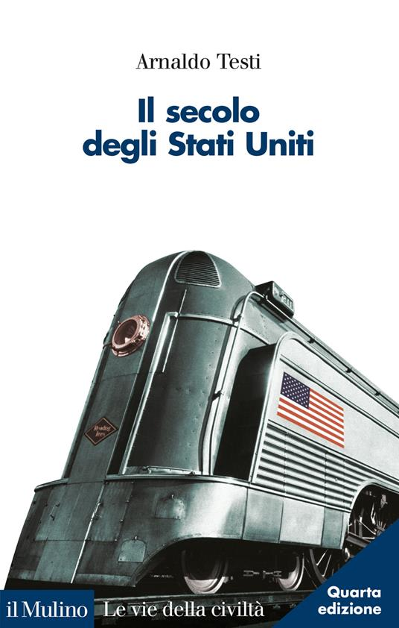
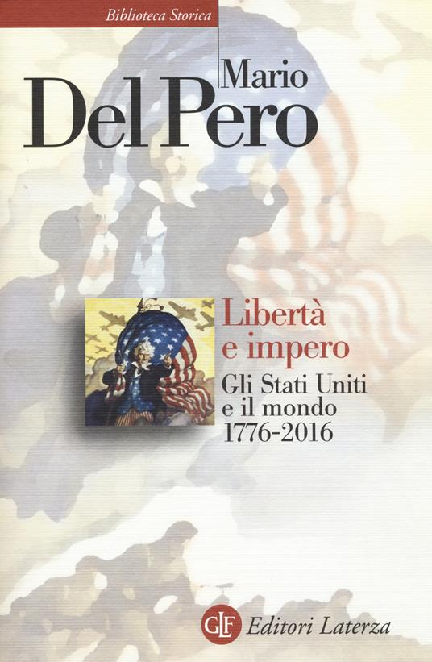
History of North America- the course
Prerequisites
General knowledge of US history. Students are expected to
have read an outline of US history. A recomended reading
is Arnaldo Testi, Il secolo degli Stati Uniti, Il Mulino, 2017.
As an alternative, students can read the introduction (pp. vi-xii) and pp. 159-367 of Mario Del Pero, Libertà e Impero Gli Stati Uniti e il mondo (1776-2011), Laterza, 2017.

Slide 4
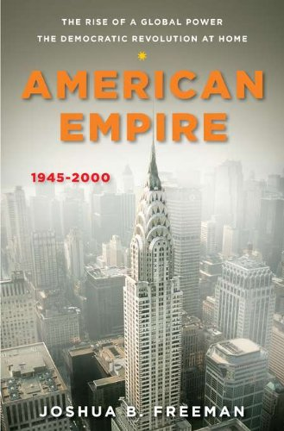
History of North America- the course
Textbooks
Joshua Freeman, American Empire. The Rise of A Global Power, The Democratic Revolution At Home, 1945-2000, The Penguin History of the United States (Series edited by Eric Foner) New York, 2013;
For class discussions and presentations
students can choose one among these recommended
readings: (Leganto page)

Slide 5
For class discussions and presentations students can choose one among these readings:
Thomas F. O'Brien, Making the Americas : the United States and Latin America from the age of revolutions to the era of globalization University of New Mexico press , 2007
Victoria De Grazia , Irresistible empire : America's advance through twentieth-century Europe / Harvard University press, 2006
MARIANO MARCO (ed), Defining the Atlantic Community. Culture, Intellectuals, and Policies in the Mid-Twentieth Century, Routledge, 2015.
Daniel Immerwahr . How to Hide an Empire: A History of the Greater United States, Starus and Giroux 2019.

Slide 6
For class discussions and presentations students can choose one among these readings:
G. Hopkins, American Empire: A Global History, Princeton University Press 2018.
David W. Ellwood Una sfida per la modernità. Europa e America nel lungo Novecento , Carocci, 2021.
Benedetta Calandra, Il corpo del Caribe. Le politiche sulla riproduzione tra Puerto Rico e Stati Uniti (1898-1993). Ombe corte 2020.
Jennifer Nelson, Sterilization, birth control and abortion, “American Women’s history,”, 2020.
Johanna Schoen, Choice and coercion: women and the politics of sterilization in North Carolina, 1929-75, “Journal of Women’s history”, 2001.

Slide 7
Other reference books in the syllabus. Mario Del Pero Libertà e impero. Gli Stati Uniti e il mondo 1776-2016, Laterza 2017.

Slide 8
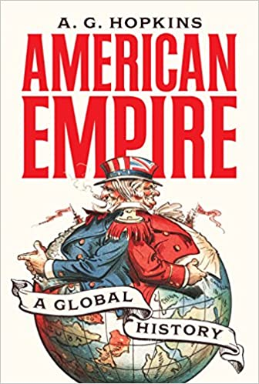
Other reference books in the syllabus
A.G. Hopkins. American Empire. A Global History, Princeton,
Princeton UP, 2018.
Daniel Immerwahr, How to Hide an Empire. A History of the
Greater United States, New York Farrar Straus & Giroux 2019.

Slide 9
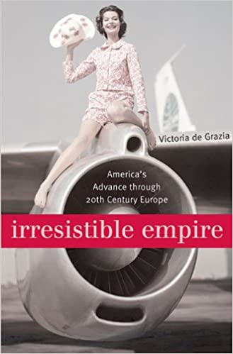
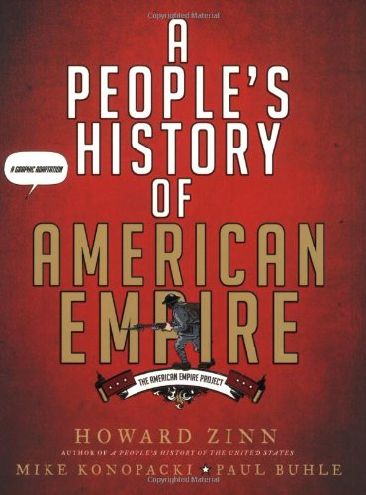
Other reference books in the syllabus
de Grazia, Victoria, Irresistible Empire: America's Advance Through Twentieth-Century Europe, Cambridge: Harvard University Press, 2005)
Howard Zinn, A People's History of American Empire.
A graphic adaptation, 2008
.

Slide 10
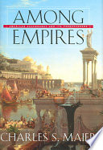
Charles S. Maier, Among empires : American ascendancy and its predecessors, Cambridge ; London : Harvard University Press, 2006.

Slide 11
Enduring Empire : Ancient Lessons for Global Politics Toivo Koivukoski, David Tabachnick, eds, University of Toronto Press, 2016

Slide 12
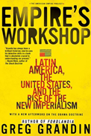
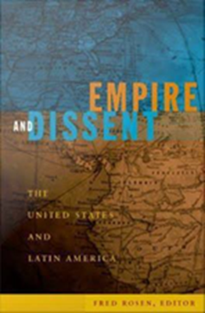
Why Latin America? Greg Grandin, Empire's Workshop: Latin America, the United States, and the Rise of the New Imperialism, New York: Metropolitan. 2006
The British and Roman empires are often invoked as precedents to the US aggressive foreign policy. But America's imperial identity was actually shaped much closer to home.
Empire's Workshop shows how Latin America has functioned as a proving ground for American strategies and tactics overseas.

Slide 13
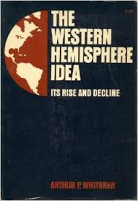
According to historian Arthur Whitaker ( Cornell University press, 1954)
«The Western Hemisphere Idea»: The New World was (Cold War)
Culturally unified
Ideologically unique
Politically superior to other realms of the globe

Slide 14
Marco Mariano, Identity, Alterity and the "Growing Plant" of Monroeism in U.S. Foreign Policy Ideology, in Michael P. Cullinane and David Ryan eds., U.S. Foreign Policy and the Other, Berghahn Books, 2015.
Enduring legacy of the Monroe Doctrine as an ideological tool providing domestic cohesion and forging national identity by opposition, and defining
the natural place and
historical mission
of the United States as one against a perceived other in the international arena.

Slide 15
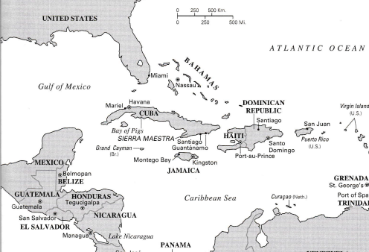
Louis Pérez, The War of 1898, U.S. and Cuba in history and historiography, North Carolina Press, 1998).
.. It all began with US interest in Cuba, «the pearl of the Antilles», since the second half of XIX century.

Slide 16
Frederick Jackson Turner, “The Signficance of Frontier in American History” (1893)
“the frontier is productive of individualism. Complex society is precipitated by the wilderness into a kind of primitive organization based on the family. The tendency is anti-social. It produces antipathy to control, and particularly to any direct control … The frontier individualism has from the beginning promoted democracy …. the frontier of settlement advanced and carried with it individualism, democracy, and nationalism, and powerfully affected the East and the Old World …..

Slide 17
Marixa Lasso Erased. The Untold Story of the Panama Canal

Slide 18
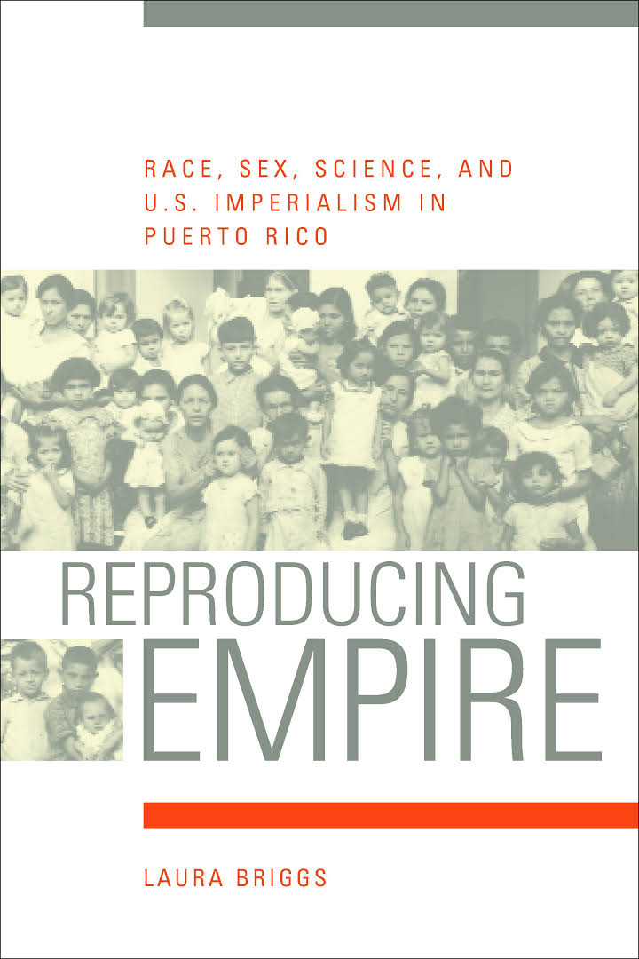
Why Puerto Rico?
According to Laura Briggs, Reproducing Empire. Race, Sex, Science, and US Imperialism in Puerto Rico (2002)..

Slide 19
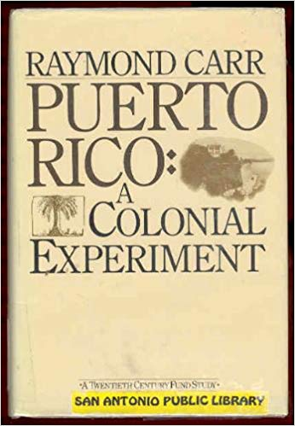
Since 1898 – Spanish-American War
From a political point of view, constant ambiguity
Latino/Anglo-Saxon identity
Carr, Puerto Rico: a Colonial Experiment, 1984
«Unincorporated Territory of the US»
Lack of statehood , second class citizens
No voting representation in the Congress

Slide 20
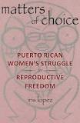
Scholars like Iris Lopez from City College of New York
are still arguing if sterilization falls within the category of
Coercion
or
personal choice

Slide 21
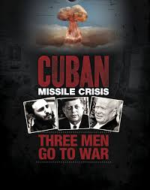
Cuban Missile Crisis: Three Men Go to War
https://www.youtube.com/watch?v=1UbVuTXg4CQ (21 min)

Slide 22
Elizabeth Cobbs Hoffman, All You Need Is Love: The Peace Corps and the Spirit of the 1960s, Harvard University Press, 1998.

Slide 23
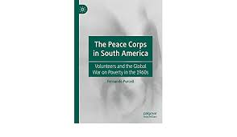
Fernando Purcell, Connecting Realities: Peace Corps Volunteers in South America and the Global War on Poverty during the 1960s
Purcell examines the work of Peace Corps volunteers in South America during the 1960s. He argues that through their training in impoverished communities in the United States and their intervention in similar contexts in South America, these volunteers connected diverse visions of community action aimed at eradicating poverty. This allows an inclusion of a historical comprehension of the Peace Corps within the scenario of a Global War on Poverty.

Slide 24
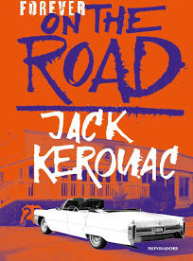
The Beat Movement
The Beat sensibility soon permeated Bohemian neighborhoods like Greenwich Village and the Lower Est Side of New York and North Beach in San Francisco. It could be found, too, in the student quarters near large college campuses, in places like Berkeley, California, Austin, Texas.
But the Beat influence went beyond enclaves of hipness and
student life. Ginsberg's 1955 poem Howl, initially deemed obscene by government authorities, sold 100,000 copies during its first decade in print, while Kerouac's novel On the Road was a 1957 best seller.

Slide 25
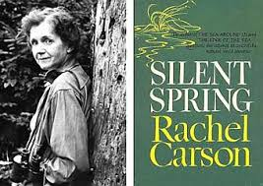
Environmentalism
The 1962 publication of Rachel Carson's Silent Spring , documenting the effects of pesticides on the environment, sparked against industrial pollution and the loss of open space and wilderness.

Slide 26
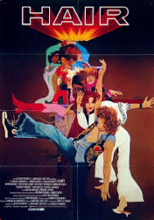
https://www.youtube.com/watch?v=BTZArvbmG_o

Slide 27
Peter Kornbluh, 2004. The Pinochet File. A Declassified Dossier on Atrocity and Accountability. Nueva York : National Security Archive, New Press

Slide 28
John Dinges, 2004. The Condor Years. How Pinochet and His Allies Brought Terrorism to Three Continents. Nueva York: New Press.

Slide 29
Interview with with Joyce Horman
Interview with Joyce Horman, Charles’ widow
Joyce Horman on the Chilean Military Coup of 1973 | Bob Herbert's Op-Ed.TV
https://www.youtube.com/watch?v=C4-7-WqtN24 (26 min.)

Slide 31
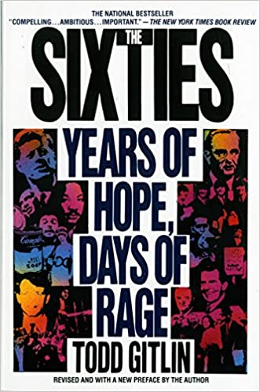
U.S. CIVIL SOCIETY ORGANIZATIONS
Probably, the roots of these ‘non governmental actors’ can be found in the ‘humus’ of ‘civil disobedience’ represented by what was called ‘The Movement’ in the Sixties.
NACLA (North American Congress on Latin America) was without doubts a child of what Todd Gitlin would call the ‘Days of rage, years of Hope’ represented by the Sixties.

Slide 32
The Full Scale of the Tragedy in Chile is Just Now Coming into Focus, October 8, 1973 . Richard Fagen to: William Fulbright,

