Slide 1
The world becoming global – the invention of global tases Wars and people movement: USA and Hawaii and South Pacific, Europe and the Med. Touristic discovery of the exotic. - Global cultural industries – movies and books and popular culture - Free time and disposable income - Universalization of the beach experience (sand, sea, sun)

Slide 2
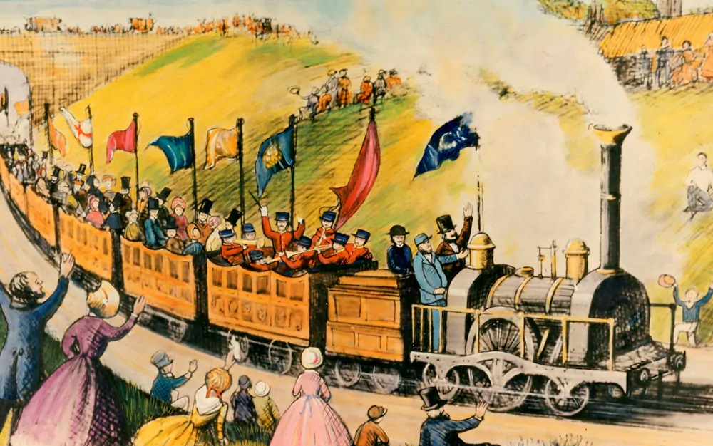
Thomas Cook – First package tour, 1841.

Slide 3
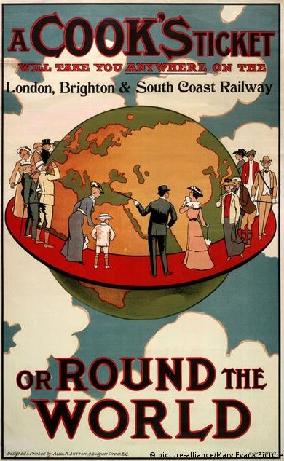

Slide 4
The world becoming global – the invention of global tases Wars and people movement: USA and Hawaii and South Pacific, Europe and the Med. Touristic discovery of the exotic. - Global cultural industries – movies and books and popular culture - Free time and disposable income - Universalization of the beach experience (sand, sea, sun)

Slide 5
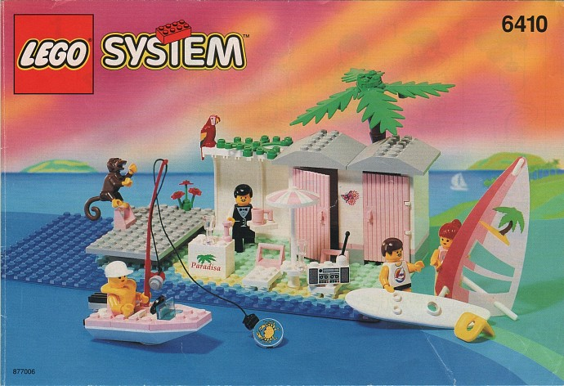

Slide 6
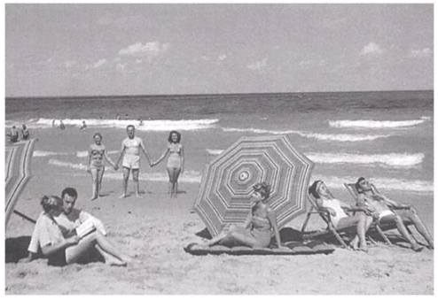

Slide 7
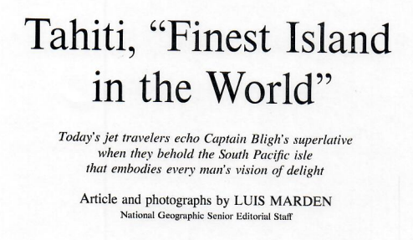

Slide 8
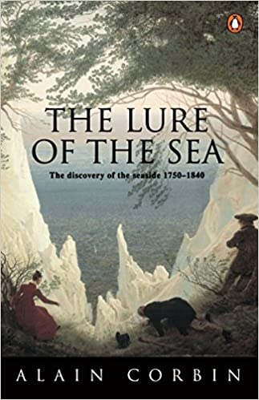

Slide 9
The world becoming global – the invention of global tases Wars and people movement – USA and Hawaii and South Pacific, Europe and the Med. Touristic discovery of the exotic. - Global cultural industries – movies and books and popular culture - Free time and disposable income - Universalization of the beach experience (sand, sea, sun) - Hotels turned into destinations (Las Vegas, London, etc.) - Changing tourists – away from the (new) mundane. - New regimes, new tourists – obligatory seaside travels

Slide 10
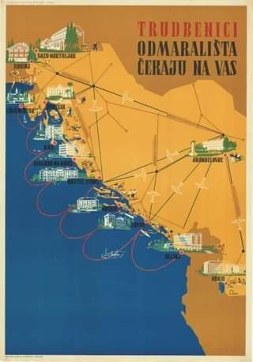
The president of the workers' council of the Varaždin textile industry "Varteks" regretted the non-acceptance of travel culture by some workers: "Most of the workers are from the countryside. Many of them simply do not feel the need to go somewhere away from home during the summer. For some an annual vacation at the seaside is a 'luxury', something that belongs to a 'gentleman', not a worker. [...] Old understandings and habits, which the trade union should fight against, are to blame. Our worker lacks industrial culture." (Socialist Yugoslavia, 1958)

Slide 11
The transport revolution and the globalized world Travel & Tourism in 2019: US$8.9 trillion contribution to the world’s GDP 10.3% of global GDP 330 million jobs, 1 in 10 jobs around the world US$1.7 trillion visitor exports (6.8% of total exports, 28.3% of global services exports) US$948 billion capital investment (4.3% of total investment) - All dependent on the transport revolution and democratization of transport - Connects supply (production) and demand (market) directly; without it, tourism simply cannot take place.

Slide 12
The transport revolution and the globalized world - Trains laid foundation for modern tourism, movements in large numbers, - Car revolutionized the style of regional and inter-regional tourism, - Airplanes made long haul possible and parts of the world accessible for the first time, - Ships (cruise and ferries) became destinations in their own right. - World became connected as never before and only then it actually became global. 21st century - unprecedented move of people. It is not the privilege of the few!

Slide 13
The transport revolution and the globalized world - Cheap flights and buses revolutionarized travel and tourism: Invention of short brakes as a form of traveling Blurred borders and expanded horizonts (Dinner in Amsterdan, breakfast in London). Distance became relative as prices dropped. Introduced AirBnB and similar platforms that changed local communities profoundly Evolution on transport brought destinations maturity (raised numbers of inbound tourists, chaged places (cities, landscapes, etc.) into consumable destinations, brings investments in both tourism and non tourism infrastructures and activities, enables locals to become tourists themselfs

Slide 14
The digital revolution: traveling with/in the Web. - Digital and postdigital world (no analog/digital divide anymore) - Web 2.0 enabled sharing economies – airbnb, tripadvisor, couchsurfing, etc. - Made actors in travel more exposed to global audiences, made quality go up - One step shop. Knowing what to expect and arrange everything before you leave. The sense of surprise and the unexpected is reduced more and more. Social networking with circulating idealized images. - Google maps and streetview - a virtual reflection of the real world to enable armchair exploration. Irish Minister of Tourism: „ ‘Street View will showcase the real beauty of Ireland’s towns and countryside to millions of Internet users around the world and has the potential to deliver a welcome boost to visitor numbers to Ireland“. Problems with stigmatized neighbourhoods.

Slide 15
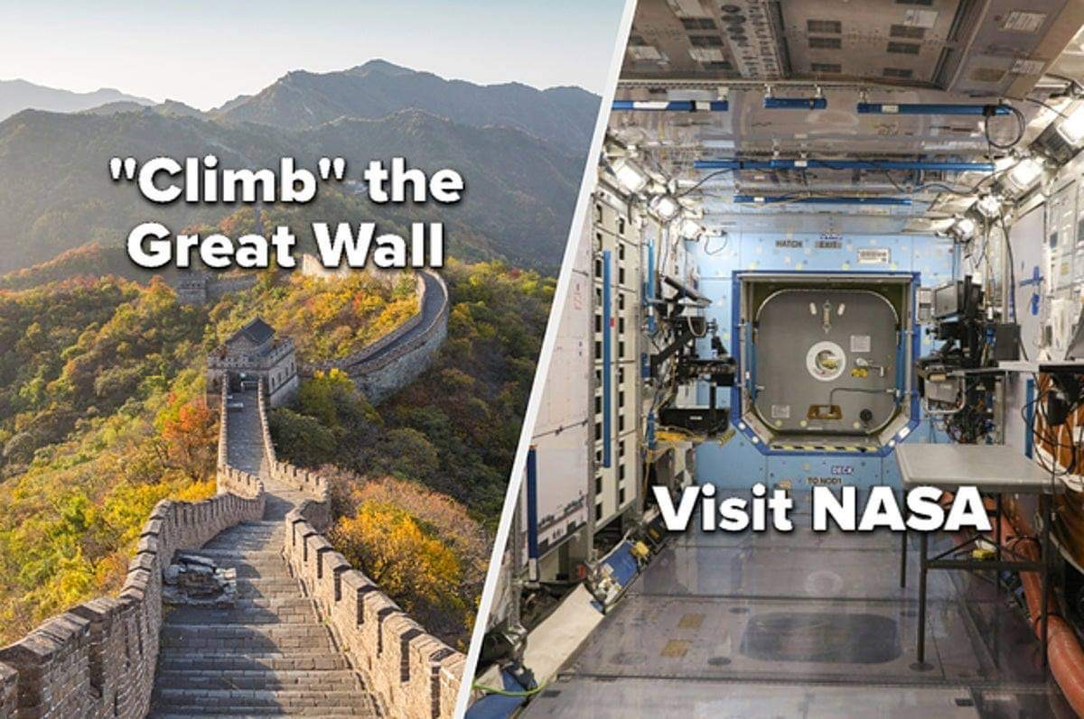
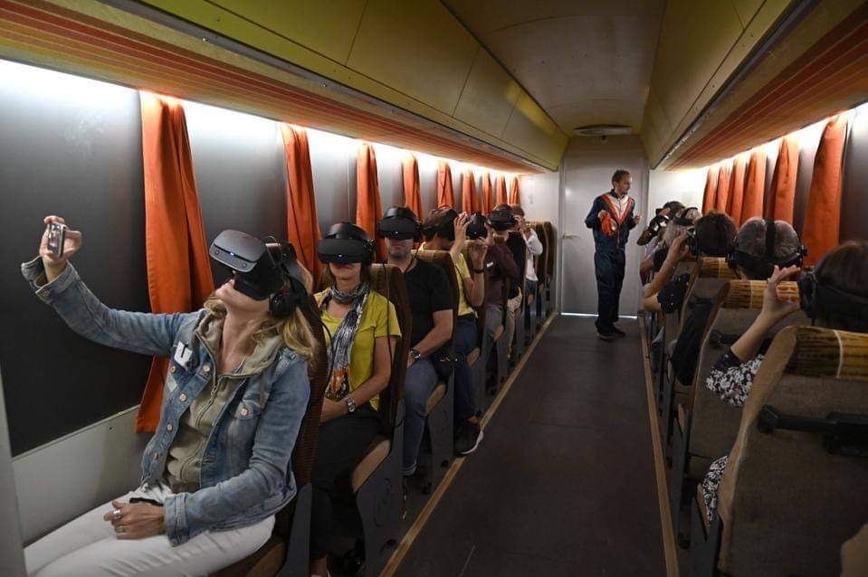
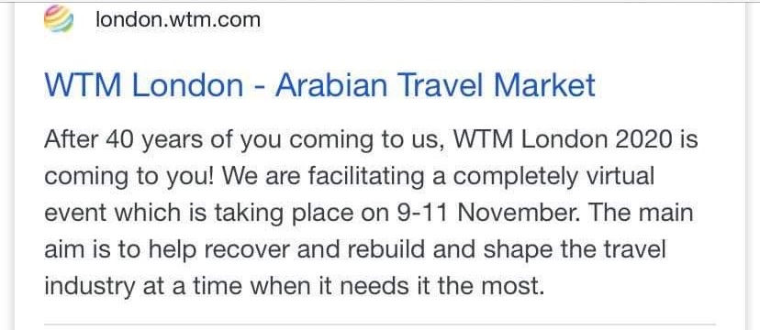
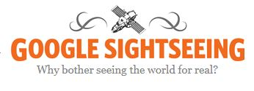
The digital revolution: traveling with/in the Web. Travel without mobility

Slide 16
The digital revolution: traveling with/in the Web. - Souvenir 3D printing - e-Agents (digital travel friends) - digital keys, etc. (avoiding the contact) - Unique entertainment experiences (VR in the pyramids of Giza) - Smart tourists use Apps and other services to acquire, but also to share, information, photos, videos, and other content which is then used in their interactions with friends, relatives, and wider communities to which they belong. This all takes place during the trip, turning the tourism experience into an occasion to engage the traveler’s entire social network in his/her personal adventure in real time, through comments and reactions to the narrative being shared. - After the trip, the digital tourist finds another occasion to affirm his/her identity and to give more meaning to the just-completed experience. Like they did during the trip, smart tourists turn to blogs or websites where they can share photos and videos with friends and the public afterwards; however, once they return to their everyday lives, they can take time to go back and relive the travel experience through a more thoughtful retelling of it.

Slide 17
The multicultural turn - Promotes different cultures and a specific orientation toward a culturally different population. - Inclusion of distinct cultural, ethnic, and religious groups, with equal status, rights, and opportunities. - In tourism – examples? Local history heritage museums. Minority group walks. Inclusion of cultural and ethnic diversity into „core“ of the destination.

