Slide 1
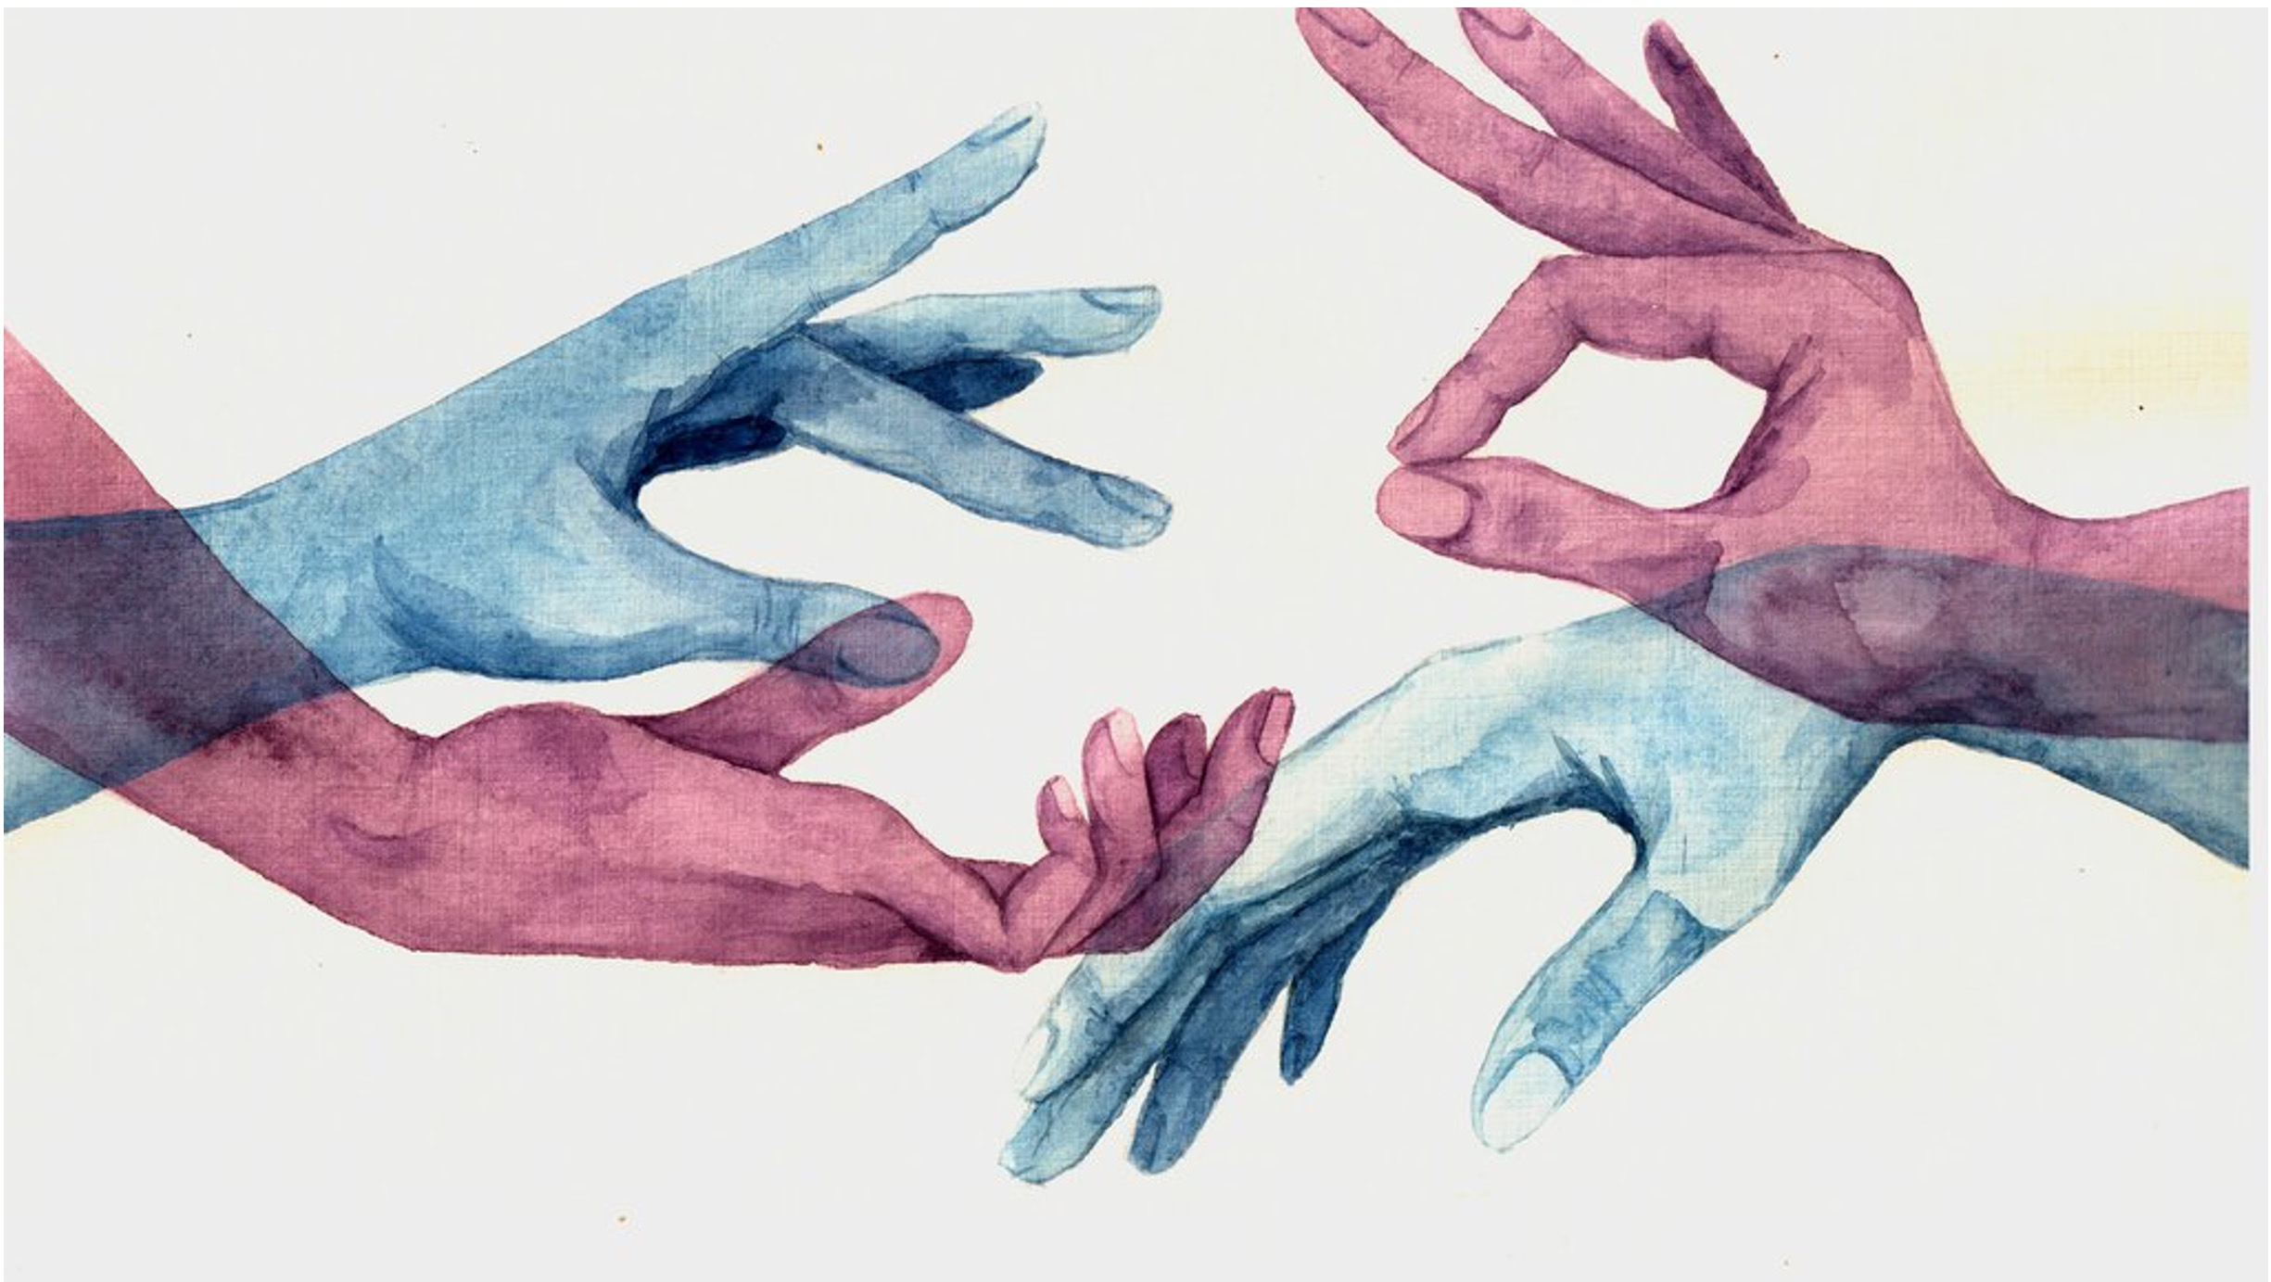
Knowledge and Rationality – A.Y. 2024-2025
Embodying
rationality
Selene Arfini – selene.arfini@unipv.it

Slide 2
Self-deception
HOW IS THE BODY INVOLVED IN RATIONAL BEHAVIOR?
It’s a cognitive and metacognitive limitation of human agents

Slide 3
Ideal rationality
The bounded/
ecological views
The rationality of self-deception
The war on rationality
The problem of irrationality

Slide 4
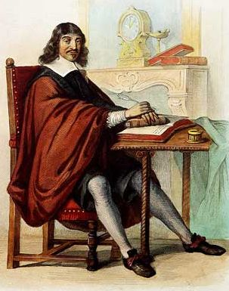
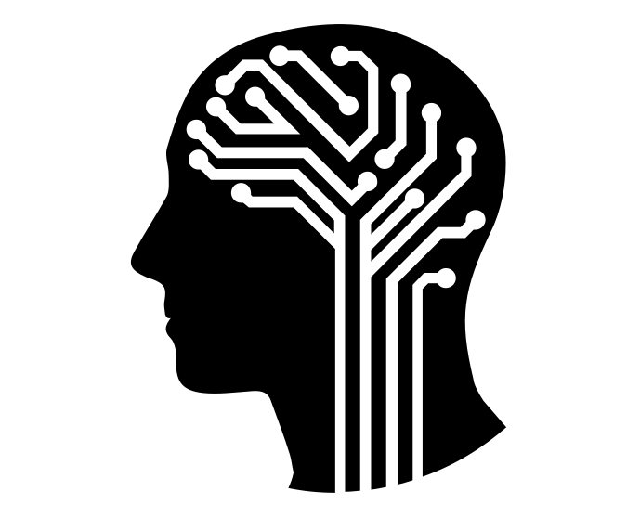
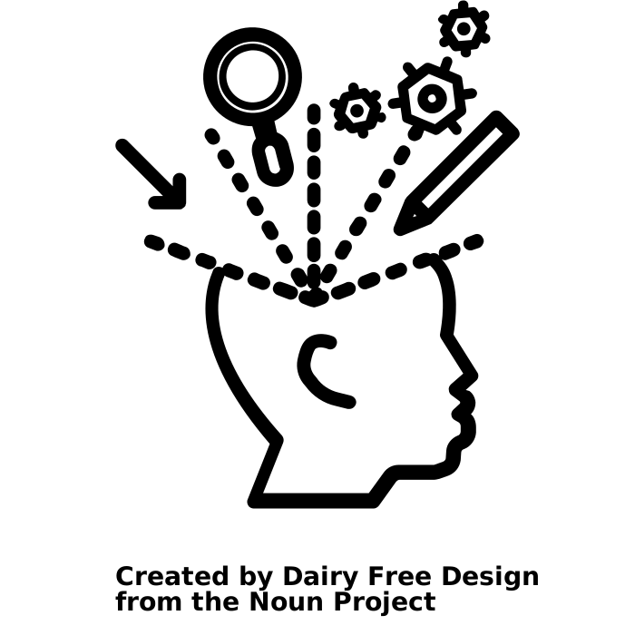
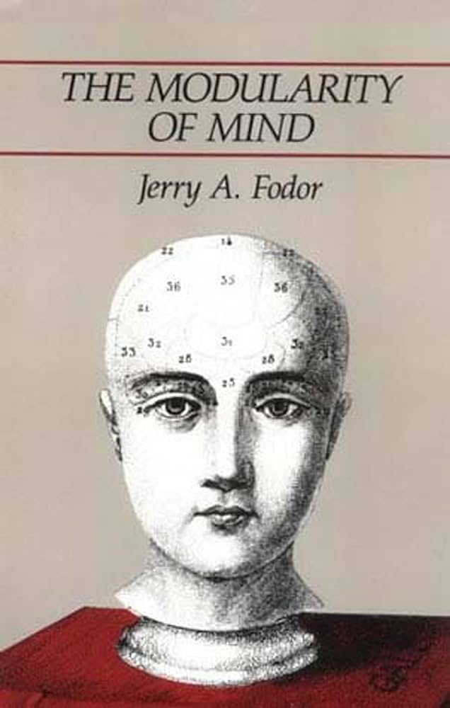
cognitive science
PROBLEMS
human cognition as radically different from animal cognition
ontogenetic continuity
metaphorical thinking
perceptual exploration
artificial intelligence
philosophy of mind
cognitive psychology

Slide 5
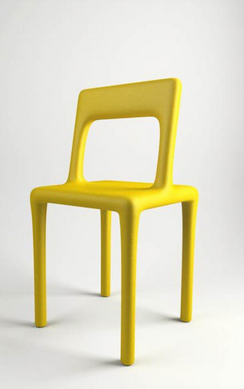
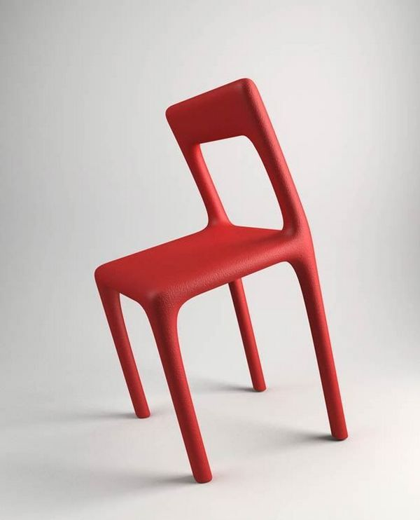
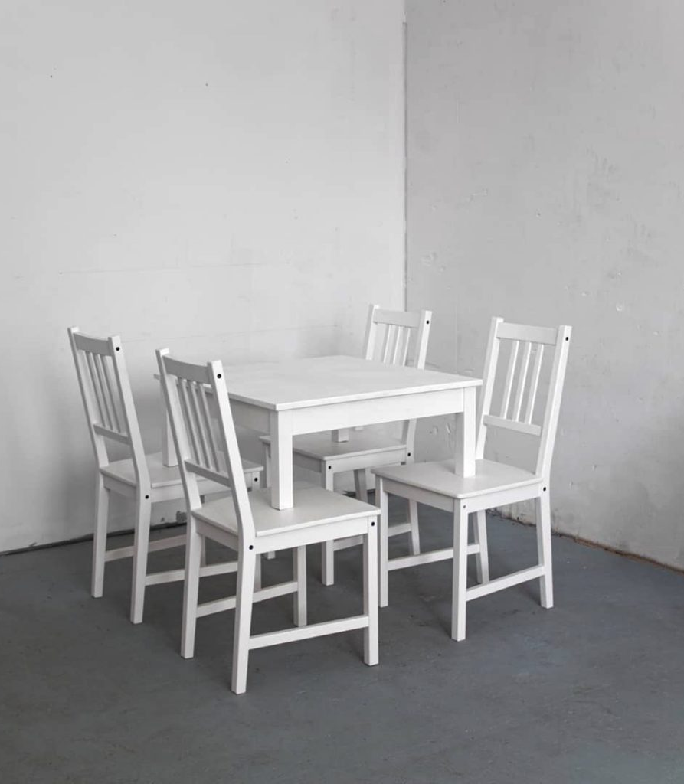
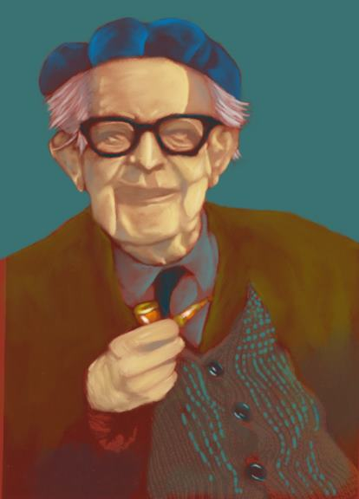
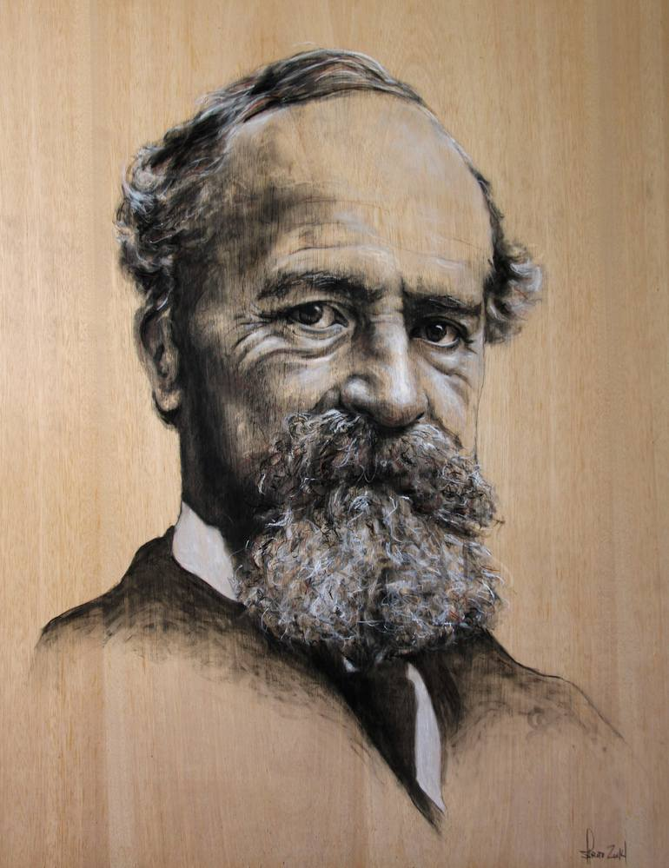
Abstract concepts are based on metaphors for bodily and physical concepts
George Lakoff
Mark Johnson
Jean Piaget
The affordance theory of perception, which claims that it is action-oriented
Developmental psychology that emphasizes the emergence of cognitive abilities out of a groundwork of sensorimotor abilities
James Gibson
Motor theories of perception
William James

Slide 6
4E COGNITION
Embodied
Extended
Enacted
Embedded

Slide 7
4E COGNITION
Off-line cognition is bodily based
Embodied
We off-load cognitive work onto the environment
Extended
The environment is part of the cognitive system
Enacted
Cognition is for action
Embedded
Cognition is time pressured
Cognition is situated

Slide 8
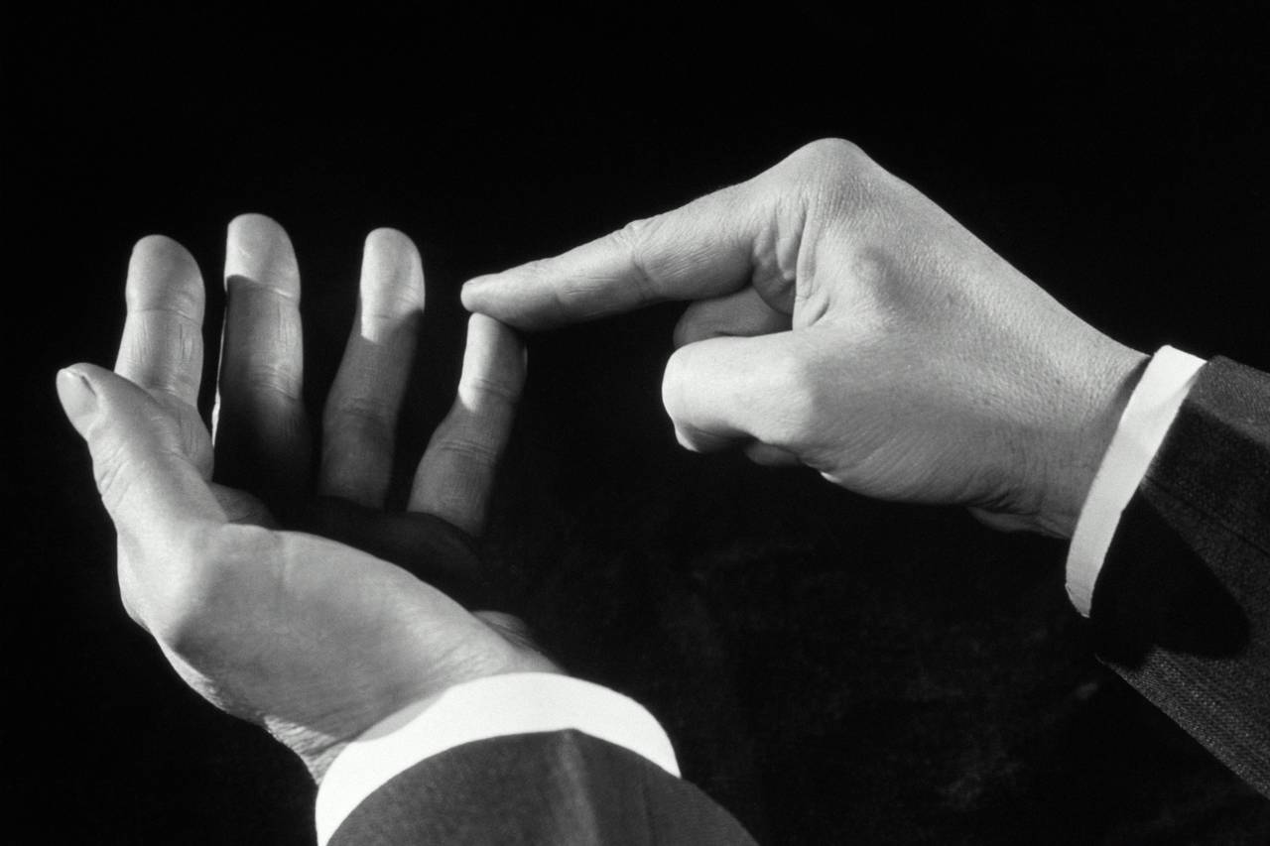
Embodied cognitive actions
4E COGNITION
Embodied
We off-load cognitive work onto the environment
Off-line cognition is bodily based
Extended
The environment is part of the cognitive system
Cognition is for action
Cognitive
metaphor theory
Enacted
Cognition is time pressured
Embedded
Cognition is situated
Affective cognition – epistemic feelings
Foglia, L., & Wilson, R. (2013). Embodied Cognition. Wiley Interdisciplinary Reviews: Cognitive Science, 4(3), 319–325. https://doi.org/10.1002/wcs.1226
Loev, S. (2022). Epistemic Feelings are Affective Experiences. Emotion Review, 14(3), 206–216. https://doi.org/10.1177/17540739221104464
Lakoff, G. (2012). Explaining Embodied Cognition Results. Topics in Cognitive Science, 4(4), 773–785. https://doi.org/10.1111/j.1756-8765.2012.01222.x

Slide 9
4E COGNITION
Off-line cognition is bodily based
Embodied
We off-load cognitive work onto the environment
Extended
The environment is part of the cognitive system
Enacted
Cognition is for action
Embedded
Cognition is time pressured
Cognition is situated

Slide 10
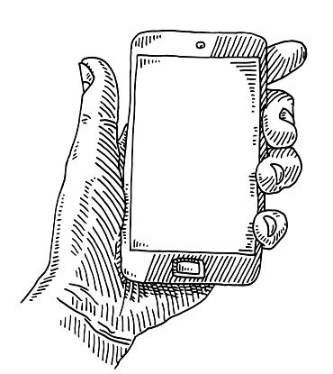
Extended
cognitive process
4E COGNITION
Off-line cognition is bodily based
Extended
Embodied
We off-load cognitive work onto the environment
The environment is part of the cognitive system
Epistemic actions
Extended
cognitive states
Enacted
Cognition is time pressured
Cognition is for action
Embedded
Cognition is situated
Kirsh, D., & Maglio, P. (1994). On distinguishing epistemic from pragmatic action. Cognitive Science, 18, 513–549.
Ludwig, D. (2015). Extended cognition and the explosion of knowledge. Philosophical Psychology, 28(3), 355–368.
Clark, A., & Chalmers, D. J. (1998). The extended mind. Analysis, 58(1), 7–19.

Slide 11
4E COGNITION
Off-line cognition is bodily based
Embodied
We off-load cognitive work onto the environment
Extended
The environment is part of the cognitive system
Enacted
Cognition is for action
Embedded
Cognition is time pressured
Cognition is situated

Slide 12
Affordances
Cooperative learning and tuning
4E COGNITION
Off-line cognition is bodily based
Enacted
Embodied
We off-load cognitive work onto the environment
Cognition is for action
Extended
Cognition is time pressured
The environment is part of the cognitive system
Embedded
Cognition is situated
Mirror neurons
Gibson, J. J. (1977). The concept of affordances. In R. Shaw & J. Bransford (Eds.), Perceiving, acting, and knowing (Vol. 1). Routledge.
Gallagher, S. (2008). Direct perception in the intersubjective context. Consciousness and Cognition, 17(2), 535–543.
Feiten, T. E., Peck, Z., Holland, K., & Chemero, A. (2023). Constructive constraints: On the role of chance and complexity in artistic creativity. Possibility Studies & Society, 1(3), 311–323. https://doi.org/10.1177/27538699231193539

Slide 13
4E COGNITION
Off-line cognition is bodily based
Embodied
We off-load cognitive work onto the environment
Extended
The environment is part of the cognitive system
Enacted
Cognition is for action
Embedded
Cognition is time pressured
Cognition is situated

Slide 14
Habit formation
4E COGNITION
Embedded
Off-line cognition is bodily based
Embodied
We off-load cognitive work onto the environment
Cognitive niches theory
Extended
The environment is part of the cognitive system
Enacted
Cognition is for action
Cognition is time pressured
Mindshaping and effects
Maiese, M. (2022). Mindshaping, Racist Habits, and White Ignorance. In S. Arfini & L. Magnani (Eds.), Embodied, Extended, Ignorant Minds. Springer
Ongaro, G., & Ward, D. (2017). An enactive account of placebo effects. Biology & Philosophy, 32(4), 507–533.
Cognition is situated
Bertolotti, T., & Magnani, L. (2017). Theoretical considerations on cognitive niche construction. Synthese, 194(12), 4757–4779.

Slide 15
Next time: Embodied Bounded Rationality
Maiese, M. (2018). Can the mind be embodied, enactive, affective, and extended? Phenomenology and the Cognitive Sciences, 17(2), 343–361. https://doi.org/10.1007/s11097-017-9510-6
Wilson, M. (2002). Six views of embodied cognition. Psychonomic Bulletin & Review, 9(4), 625–636. https://doi.org/10.3758/BF03196322

