Slide 1
Knowledge and Rationality – A.Y. 2024-2025
Self-defeating
rationality
Selene Arfini – selene.arfini@unipv.it

Slide 2
Kourany, J., & Carrier, M. (Eds.). (2020). Science and the production of ignorance: When the quest for knowledge is thwarted. The MIT Press.
active
epistemologies
of ignorance
bias
fallibilism
impasse
fake news
IGNORANCE
agnotology
hypothetical reasoning
conspiracy
theories
uncertainty
distributed
ignorance
pluralistic ignorance
risk
interdisciplinarity
serendipity
epistemic trust/relational ignorance

Slide 3
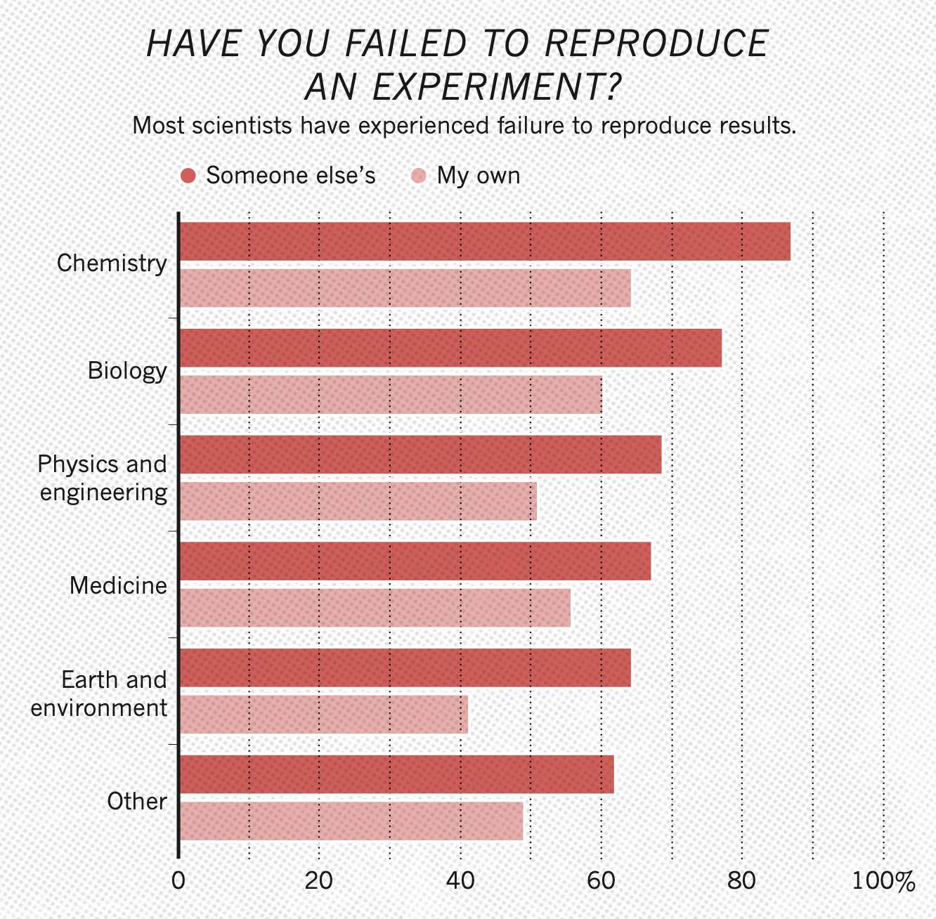
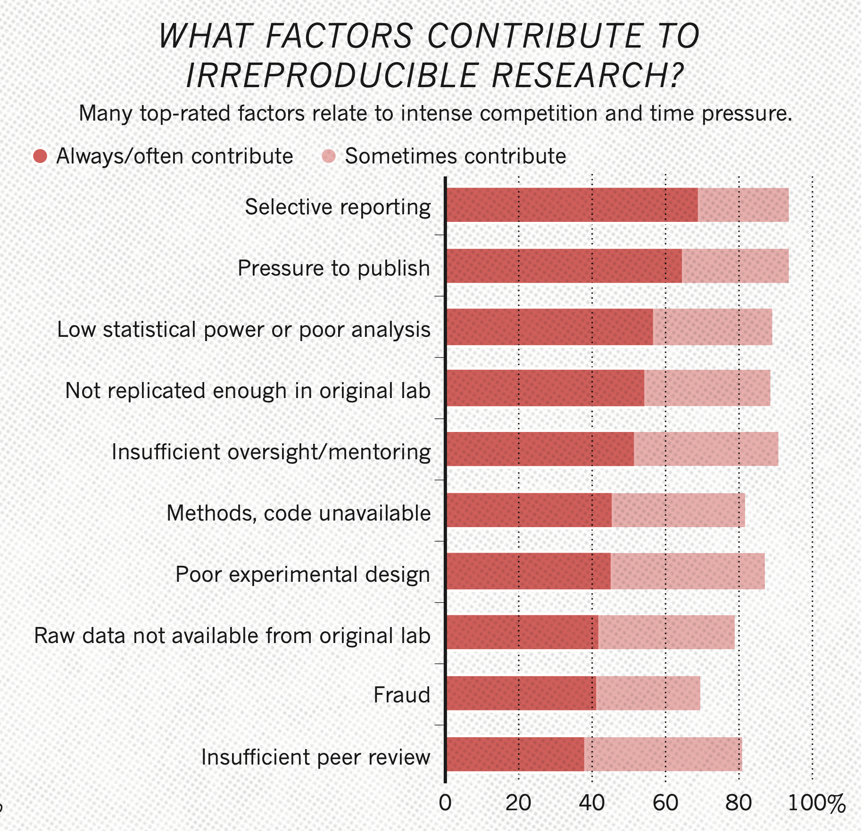
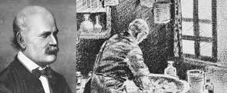
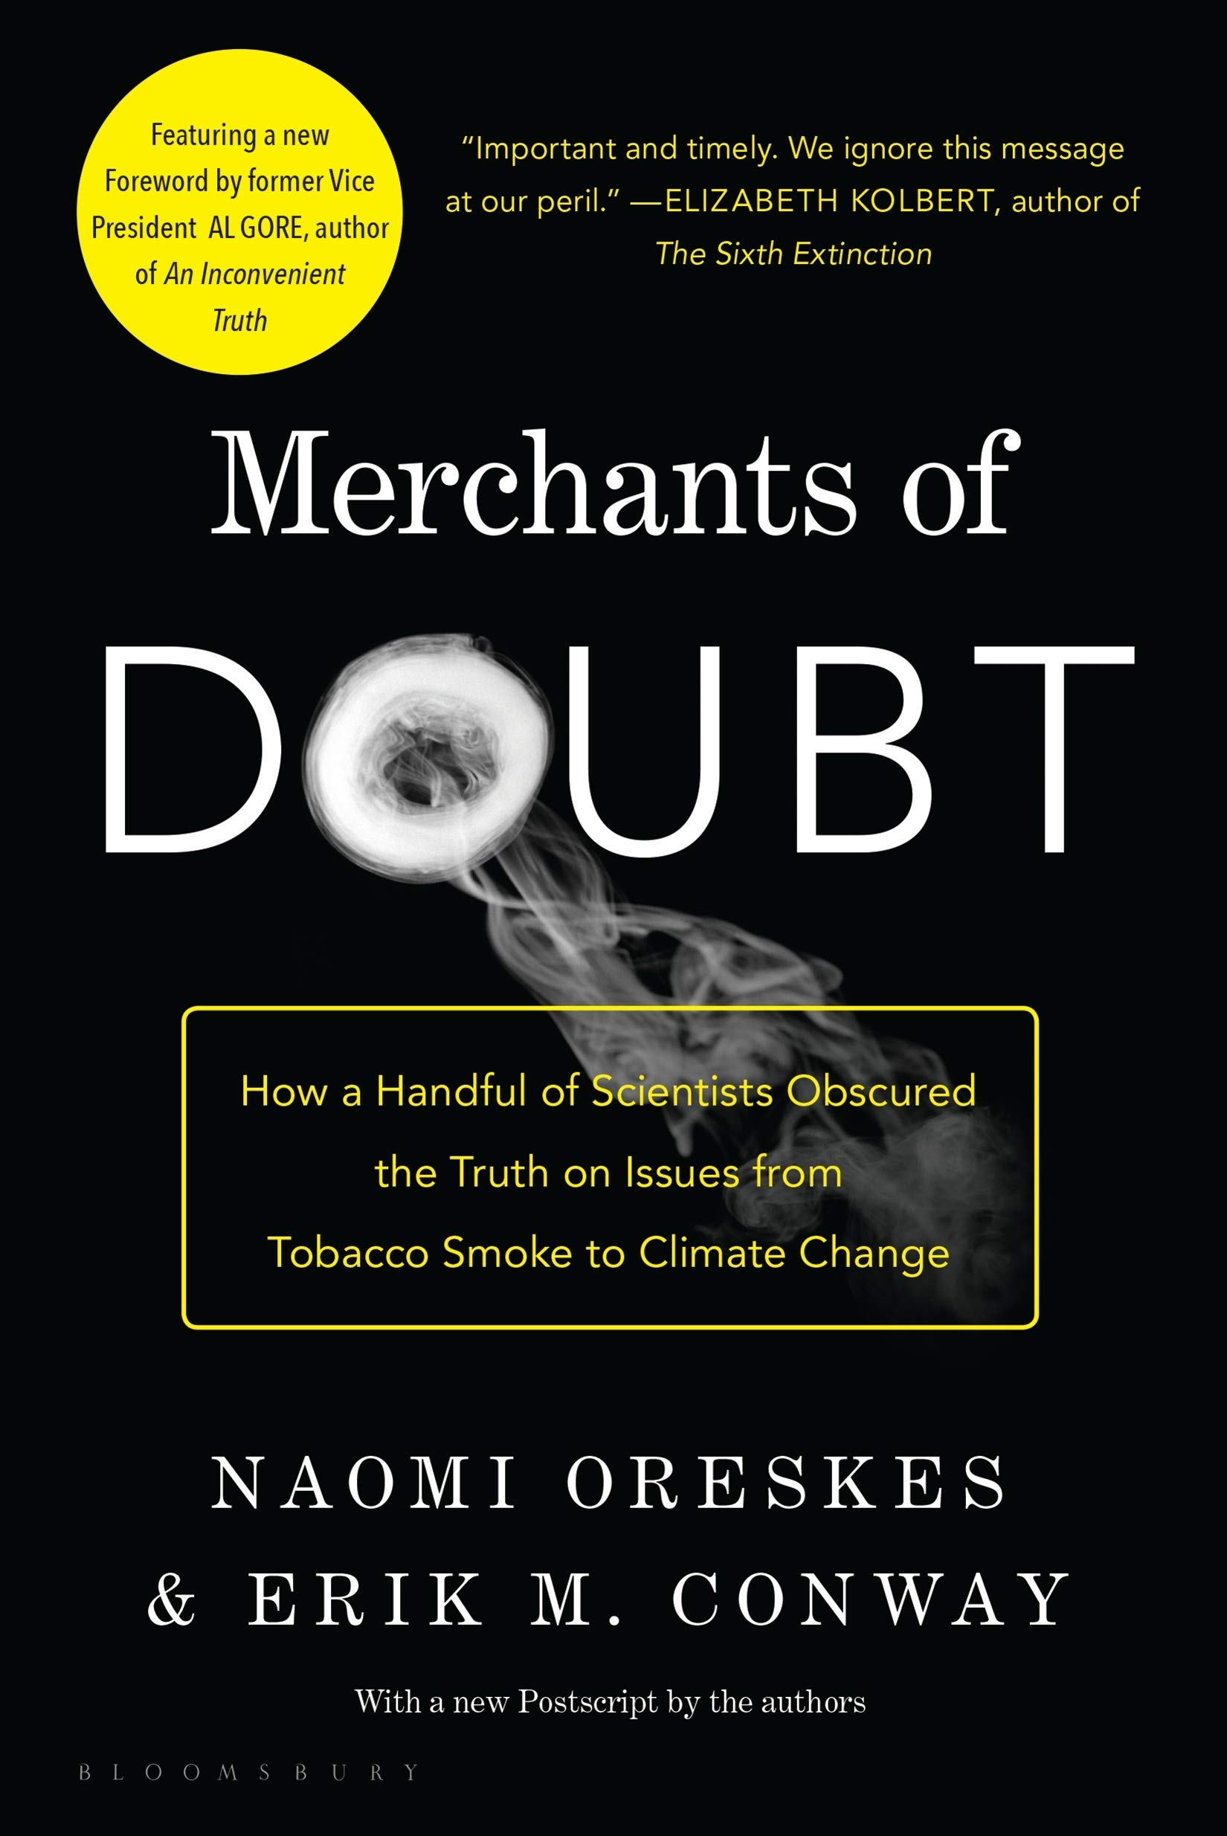
Ignaz Semmelweis, 1818 - 1865
Kourany, J., & Carrier, M. (Eds.). (2020). Science and the production of ignorance: When the quest for knowledge is thwarted. The MIT Press.
passive
active
virtuous
epistemologies
of ignorance
Are there things we shouldn’t know?
bias
fallibilism
fake news
IGNORANCE
agnotology
hypothetical reasoning
conspiracy
theories
uncertainty
distributed
ignorance
pluralistic ignorance
risk
interdisciplinarity
serendipity
epistemic trust/relational ignorance

Slide 4
A person is rationally ignorant whenever he or she has decided not to learn some body of knowledge because the costs of doing so exceed the benefits, based on the decision-maker’s own objectives
passive
active
virtuous
epistemologies
of ignorance
bias
Somin, I. (2015). Rational ignorance. In M. Gross & L. McGoey (Eds.), Routledge International Handbook of Ignorance Studies (pp. 274–281). Routledge.
rational
fallibilism
fake news
IGNORANCE
agnotology
hypothetical reasoning
conspiracy
theories
uncertainty
distributed
ignorance
pluralistic ignorance
risk
interdisciplinarity
serendipity
epistemic trust/relational ignorance

Slide 5
Kourany, J., & Carrier, M. (Eds.). (2020). Science and the production of ignorance: When the quest for knowledge is thwarted. The MIT Press.
active
passive
bias
active
virtuous
epistemologies
of ignorance
fallibilism
rational
impasse
fake news
IGNORANCE
agnotology
hypothetical reasoning
conspiracy
theories
uncertainty
distributed
ignorance
pluralistic ignorance
risk
interdisciplinarity
serendipity
epistemic trust/relational ignorance

Slide 6
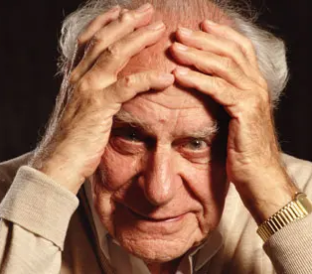
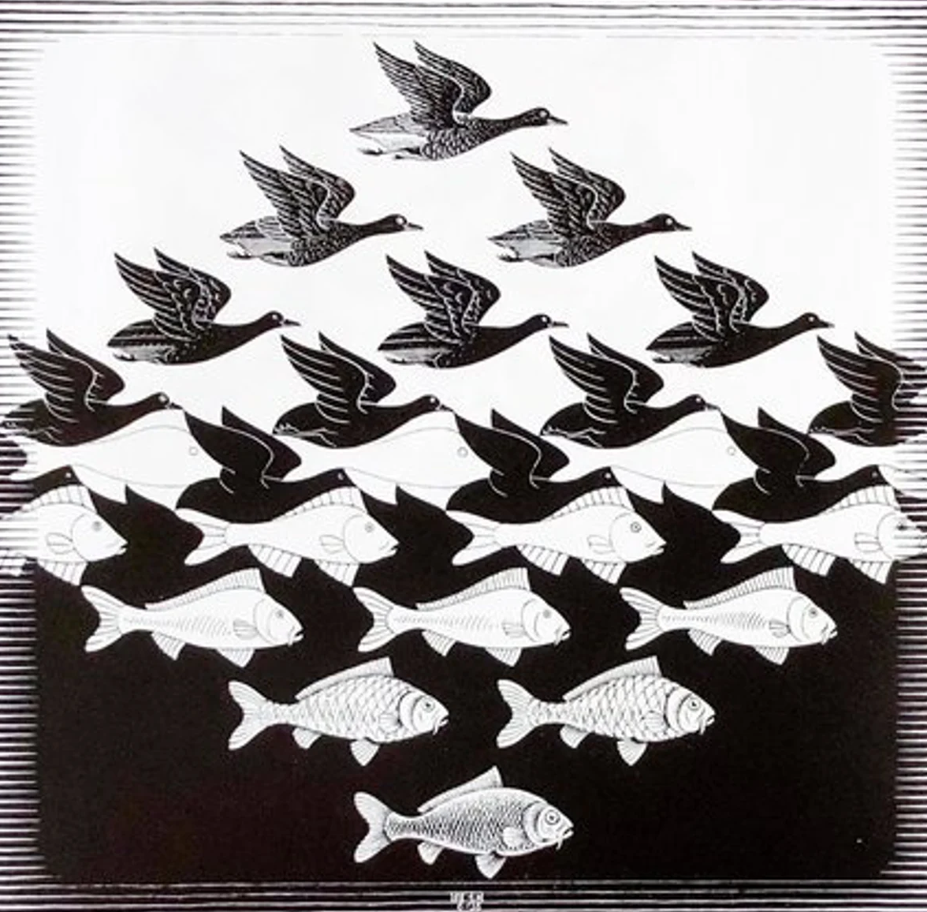
A person is rationally ignorant whenever he or she has decided not to learn some body of knowledge because the costs of doing so exceed the benefits, based on the decision-maker’s own objectives..
Somin, I. (2015). Rational ignorance. In M. Gross & L. McGoey (Eds.), Routledge International Handbook of Ignorance Studies (pp. 274–281). Routledge.
irrational ignorance?
IGNORANCE
IRRATIONALITY
uncertainty
rational ignorance
willful ignorance?
knowledge avoidance?
fallibilism
agnotology
epistemologies
of ignorance
distributed
ignorance
Un'ipotesi è falsificabile
se esiste almeno una proposizione osservativa logicamente possibile incompatibile con essa, ossia che, se vera,
la possa falsificare.
FALSIFICABILE
Karl Popper
(1902-1994)

Slide 7
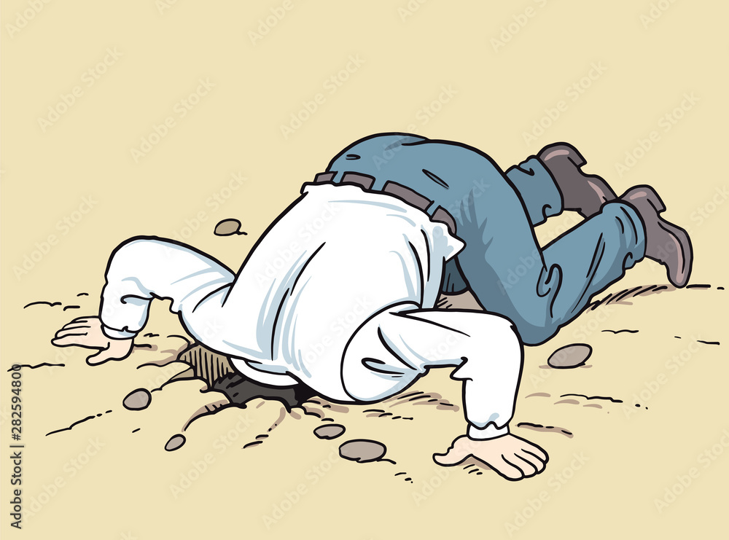
IGNORANCE
IRRATIONALITY
Risk of disease
uncertainty
rational ignorance
willful ignorance
knowledge avoidance
Peer review
fallibilism
agnotology
epistemologies
of ignorance
distributed
ignorance
Spoiler
the general avoidance of situations that make someone aware of certain information, evidence, or knowledge.
The choice of not getting specific pieces of information for particular reasons
Are they both irrational?

Slide 8
IRRATIONALITY
willful ignorance
knowledge avoidance
IGNORANCE
uncertainty
rational ignorance
the general avoidance of situations that make someone aware of certain information, evidence, or knowledge.
The choice of not getting specific pieces of information for particular reasons
fallibilism
agnotology
Are they both irrational?
epistemologies
of ignorance
distributed
ignorance
Epistemic akrasia
Wishful thinking
Self-deception
a person’s first-order beliefs diverge from her/his higher-order judgments about what it would be reasonable for her/him to believe and
these divergent beliefs are freely and deliberately formed

Slide 9
IRRATIONALITY
willful ignorance
knowledge avoidance
IGNORANCE
uncertainty
rational ignorance
the general avoidance of situations that make someone aware of certain information, evidence, or knowledge.
The choice of not getting specific pieces of information for particular reasons
fallibilism
agnotology
Are they both irrational?
epistemologies
of ignorance
distributed
ignorance
a person’s first-order beliefs diverge from her/his higher-order judgments about what it would be reasonable for her/him to believe and
these divergent beliefs are freely and deliberately formed
Epistemic akrasia
Wishful thinking
Self-deception

Slide 10
IRRATIONALITY
willful ignorance
knowledge avoidance
IGNORANCE
uncertainty
rational ignorance
the general avoidance of situations that make someone aware of certain information, evidence, or knowledge.
The choice of not getting specific pieces of information for particular reasons
fallibilism
agnotology
Are they both irrational?
epistemologies
of ignorance
distributed
ignorance
Epistemic akrasia
Wishful thinking
Self-deception
a person’s first-order beliefs diverge from her/his higher-order judgments about what it would be reasonable for her/him to believe and
these divergent first-order beliefs are freely and deliberately formed
a positive illusion which generally moves the agents to believe in statements corresponding to their wishes and to avoid believing ones that are inconsistent with their motivations

Slide 11
IRRATIONALITY
willful ignorance
knowledge avoidance
IGNORANCE
uncertainty
rational ignorance
the general avoidance of situations that make someone aware of certain information, evidence, or knowledge.
The choice of not getting specific pieces of information for particular reasons
fallibilism
agnotology
Are they both irrational?
epistemologies
of ignorance
distributed
ignorance
a positive illusion which generally moves the agents to believe in statements corresponding to their wishes and to avoid believing ones that are inconsistent with their motivations
Epistemic akrasia
Wishful thinking
Self-deception

Slide 12
IRRATIONALITY
willful ignorance
knowledge avoidance
IGNORANCE
uncertainty
rational ignorance
the general avoidance of situations that make someone aware of certain information, evidence, or knowledge.
The choice of not getting specific pieces of information for particular reasons
fallibilism
agnotology
Are they both irrational?
epistemologies
of ignorance
distributed
ignorance
Epistemic akrasia
Wishful thinking
Self-deception
a positive illusion which generally moves the agents to believe in statements corresponding to their wishes and to avoid believing ones that are inconsistent with their motivations

Slide 13
Self-deception
Self-deception and wishful thinking typically involve holding a belief that is motivated by reasons other than appropriate epistemic warrant, like a desire, wish, or other conative impetus that it be so.
(Baghramian e Nicholson, 2013, p. 1019)

Slide 14
Self-deception
THE PARADOX
The principal problem is to explain how it is possible for me
to believe one thing and yet intentionally cause myself to concurrently believe the contrary.
(Baghramian e Nicholson, 2013, p. 1018)
Self-deception and wishful thinking typically involve holding a belief that is motivated by reasons other than appropriate epistemic warrant, like a desire, wish, or other conative impetus that it be so.
(Baghramian e Nicholson, 2013, p. 1019)

Slide 15
Self-deception
THE PARADOX
The principal problem is to explain how it is possible for me
to believe one thing and yet intentionally cause myself to concurrently believe the contrary.
(Baghramian e Nicholson, 2013, p. 1018)
Self-deception and wishful thinking typically involve holding a belief that is motivated by reasons other than appropriate epistemic warrant, like a desire, wish, or other conative impetus that it be so.
(Baghramian e Nicholson, 2013, p. 1019)

Slide 16
Self-deception
THE PARADOX
The principal problem is to explain how it is possible for me
to believe one thing and yet intentionally cause myself to concurrently believe the contrary.
(Baghramian e Nicholson, 2013, p. 1018)
AVOIDABLE
Self-deception and wishful thinking typically involve holding a belief that is motivated by reasons other than appropriate epistemic warrant, like a desire, wish, or other conative impetus that it be so.
(Baghramian e Nicholson, 2013, p. 1019)
It’s a cognitive and metacognitive limitation of human agents
It’s a cognitive and metacognitive limit of human agents
UNAVOIDABLE

Slide 17
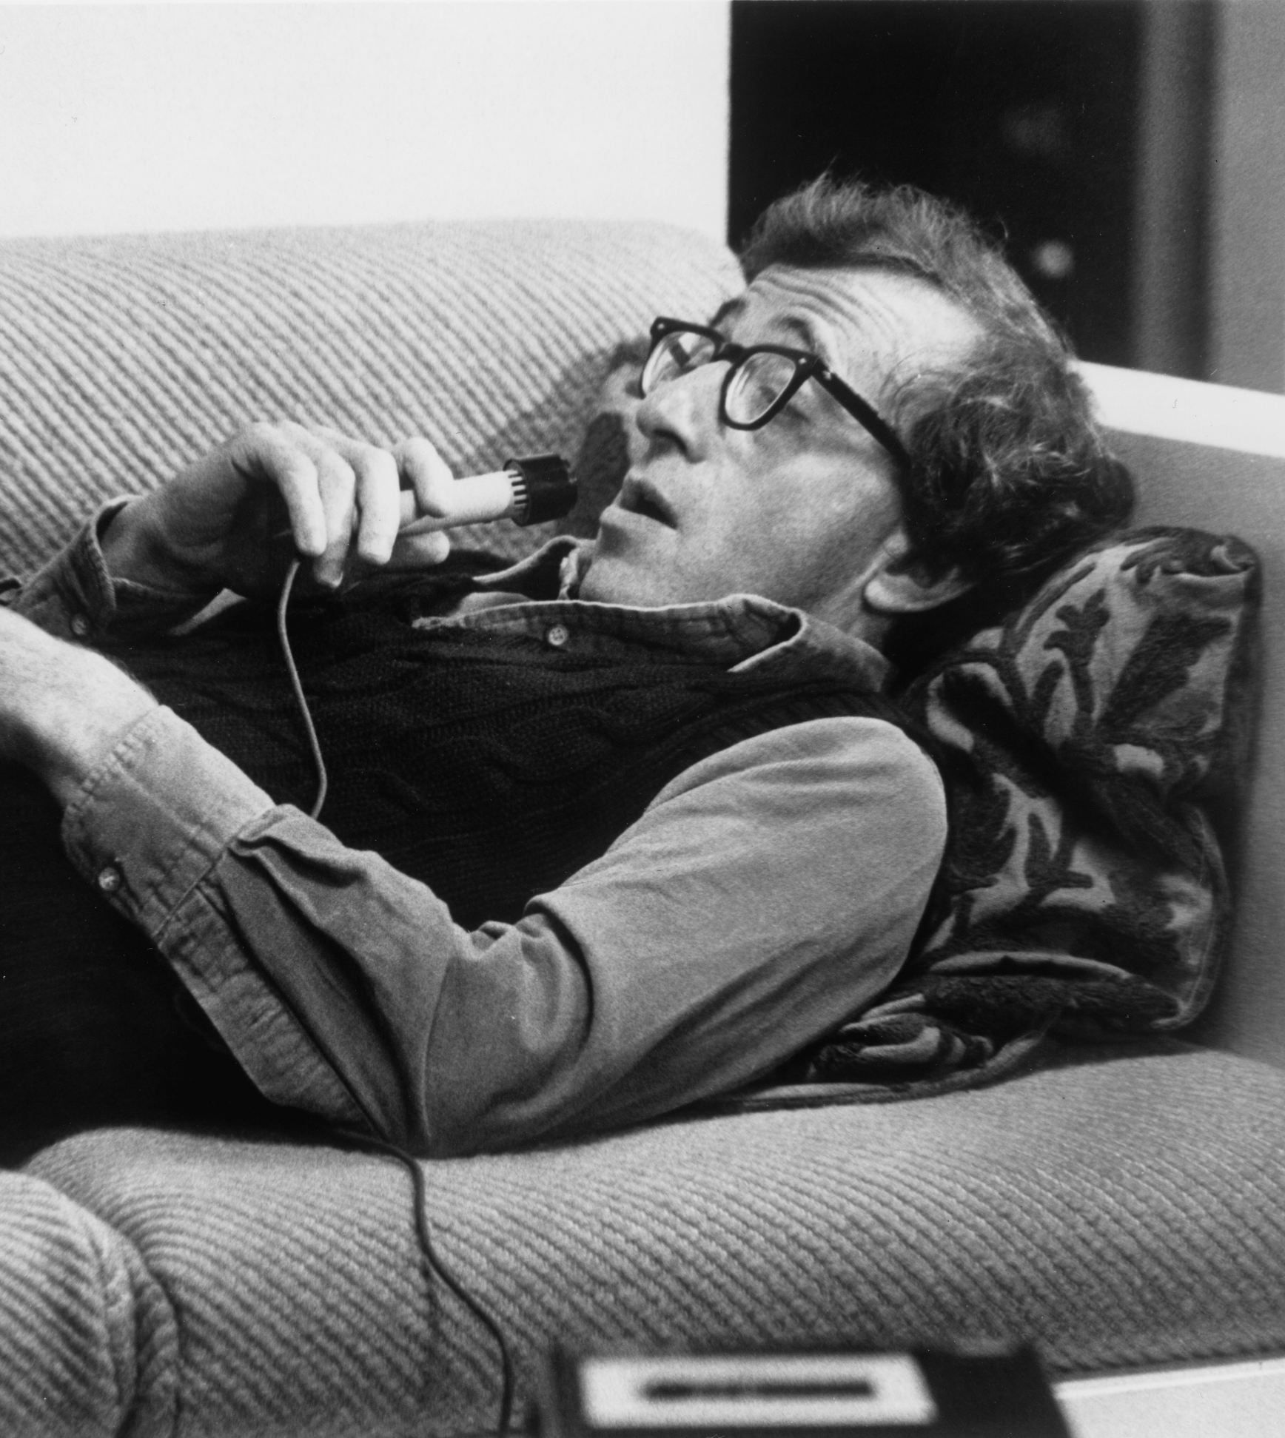
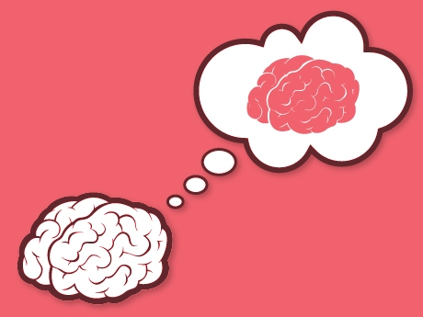
Ha a che fare con le limitazioni cognitive e metacognitive degli agenti umani
Evitabile
Autoinganno
Cognition
Metacognitive processes of monitoring and control
Meta-Cognition
Metacognitive knowledge
Autoinganno
Inevitabile
Ha a che fare con i limiti cognitivi e metacognitivi degli agenti umani

Slide 18
Ha a che fare con le limitazioni cognitive e metacognitive degli agenti umani
Evitabile
Autoinganno
Cognition
Metacognitive processes of monitoring and control
Meta-Cognition
Metacognitive knowledge
Autoinganno
Inevitabile
Ha a che fare con i limiti cognitivi e metacognitivi degli agenti umani

Slide 19
Self-deception
THE PARADOX
The principal problem is to explain how it is possible for me
to believe one thing and yet intentionally cause myself to concurrently believe the contrary.
(Baghramian e Nicholson, 2013, p. 1018)
AVOIDABLE
Self-deception and wishful thinking typically involve holding a belief that is motivated by reasons other than appropriate epistemic warrant, like a desire, wish, or other conative impetus that it be so.
(Baghramian e Nicholson, 2013, p. 1019)
It’s a cognitive and metacognitive limitation of human agents
It’s a cognitive and metacognitive limit of human agents
UNAVOIDABLE

Slide 20
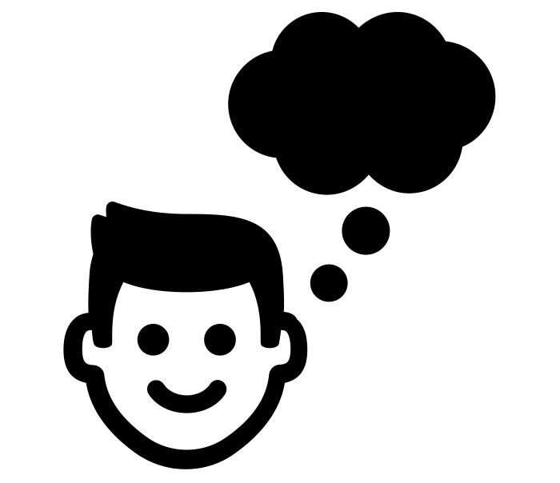
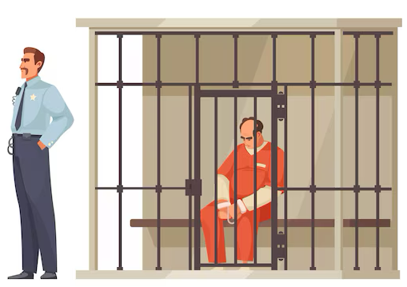
Main elements:
Self-deception
The subject believes the false but desirable proposition P
The subject holds that belief "in the teeth" of available evidence
THE PARADOX
The principal problem is to explain how it is possible for me
to believe one thing and yet intentionally cause myself to concurrently believe the contrary.
(Baghramian e Nicholson, 2013, p. 1018)
Do self-deceivers want to deceive themselves?
Self-deception and wishful thinking typically involve holding a belief that is motivated by reasons other than appropriate epistemic warrant, like a desire, wish, or other conative impetus that it be so.
(Baghramian e Nicholson, 2013, p. 1019)
It affects the cognitive and metacognitive limits of human agents
It’s a cognitive and metacognitive limitation of human agents
The subject is competent and cannot be blamed for intellectual sloppiness
The subject’s metacognitive abilities are sound but not their epistemic standards in that case
UNAVOIDABLE
The subject gives reasons (but not norms) to explain their beliefs
A few examples

Slide 21
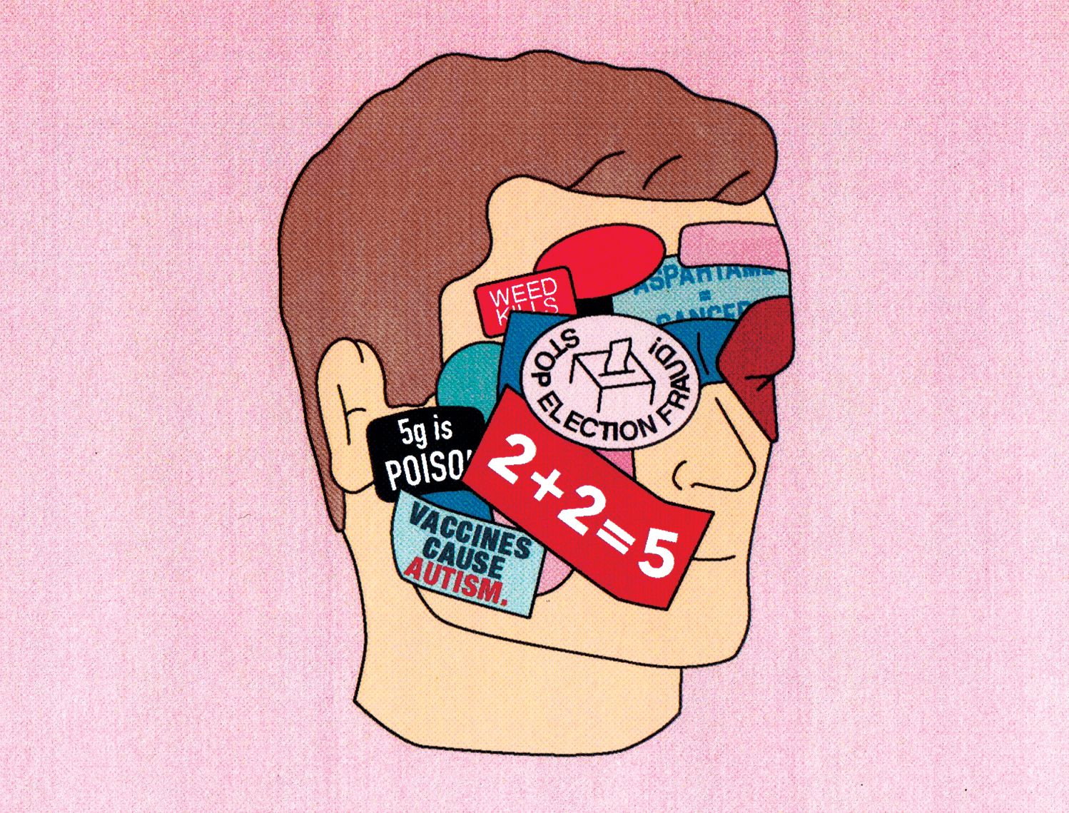
Different from:
Main elements:
Self-deception
Dual-belief
condition
The subject believes the false but desirable proposition P
How can a self-deceiver simultaneously believe and disbelieve p?
The subject holds that belief "in the teeth" of available evidence
Wishful thinking
Do self-deceivers want to deceive themselves?
AVOIDABLE
The subject is competent and cannot be blamed for intellectual sloppiness
It affects the cognitive and metacognitive limitations of human agents
The subject’s metacognitive abilities are sound but not their epistemic standards in that case
Intention
condition
How can people intentionally cause themselves to believe p, while believing that p is false?
Akrasia
The subject gives reasons (but not norms) to explain their beliefs
A few examples

Slide 22
Solutions:
Different from:
Main elements:
Self-deception
Dual-belief
condition
The subject believes the false but desirable proposition P
How can a self-deceiver simultaneously believe and disbelieve p?
The subject holds that belief "in the teeth" of available evidence
Wishful thinking
Do self-deceivers want to deceive themselves?
AVOIDABLE
The subject is competent and cannot be blamed for intellectual sloppiness
It affects the cognitive and metacognitive limitations of human agents
The subject’s metacognitive abilities are sound but not their epistemic standards
Intention
condition
How can people intentionally cause themselves to believe p, while believing that p is false?
Akrasia
The subject gives reasons (but not norms) to explain their beliefs
A few examples

Slide 23
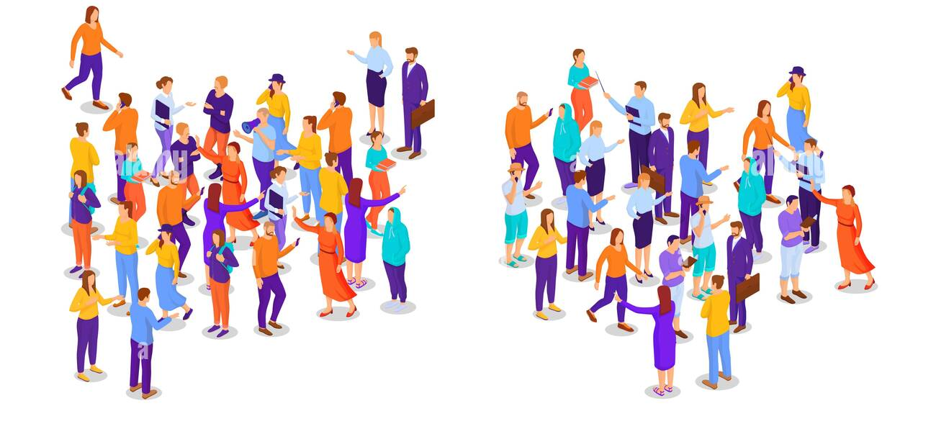
Solutions:
Main elements:
Self-deception
Dual-belief
condition
Deniers:
The subject believes the false but desirable proposition P
How can a self-deceiver simultaneously believe and disbelieve p?
The subject holds that belief "in the teeth" of available evidence
Denying the phenomenon
Do self-deceivers want to deceive themselves?
AVOIDABLE
The subject is competent and cannot be blamed for intellectual sloppiness
It affects the cognitive and metacognitive limitations of human agents
Partitioning strategies
The subject’s metacognitive abilities are sound but not their epistemic standards
Intention
condition
How can people intentionally cause themselves to believe p, while believing that p is false?
The subject gives reasons (but not norms) to explain their beliefs
A few examples
Reformulation strategies
Different from:
Wishful thinking
Akrasia

Slide 24
Solutions:
Main elements:
Self-deception
Dual-belief
condition
Deniers:
The subject believes the false but desirable proposition P
Mary Haight: self-deception is merely other-deception
David Kipp: it’s impossible to consider something true and false at the same time
Steffan Borge: what we mistakenly refer to as self-deception is actually a failure to comprehend our emotions and their influence on our lives
How can a self-deceiver simultaneously believe and disbelieve p?
The subject holds that belief "in the teeth" of available evidence
Denying the phenomenon
Do self-deceivers want to deceive themselves?
AVOIDABLE
The subject is competent and cannot be blamed for intellectual sloppiness
It affects the cognitive and metacognitive limitations of human agents
The subject’s metacognitive abilities are sound but not their epistemic standards
Intention
condition
How can people intentionally cause themselves to believe p, while believing that p is false?
The subject gives reasons (but not norms) to explain their beliefs
A few examples

Slide 25
Solutions:
(problem of regression)
(absence of reflexivity)
Main elements:
Self-deception
Two or more selves
Dual-belief
condition
The subject believes the false but desirable proposition P
How can a self-deceiver simultaneously believe and disbelieve p?
The subject holds that belief "in the teeth" of available evidence
Denying the phenomenon
The self-deceivers want to deceive themselves?
AVOIDABLE
Cognitive partitioning
The subject is competent and cannot be blamed for intellectual sloppiness
It affects the cognitive and metacognitive limitations of human agents
Doxastic segregation
Partitioning strategies
The subject’s metacognitive abilities are sound but not their epistemic standards
Intention
condition
How can people intentionally cause themselves to believe p, while believing that p is false?
The subject gives reasons (but not norms) to explain their beliefs
A few examples
Deniers:
Mary Haight: self-deception is merely other-deception
David Kipp: it’s impossible to consider something true and false at the same time
Steffan Borge: what we mistakenly refer to as self-deception is actually a failure to comprehend our emotions and their influence on our lives

Slide 26
(problem of regression)
(absence of reflexivity)
Two or more selves
(twisted self-deception)
(separated but interacting?!)
Solutions:
Main elements:
Self-deception
Davidson: Intentionalism
Dual-belief
condition
Separation between beliefs
The subject believes the false but desirable proposition P
How can a self-deceiver simultaneously believe and disbelieve p?
The subject holds that belief "in the teeth" of available evidence
Denying the phenomenon
The self-deceivers want to deceive themselves?
AVOIDABLE
Doxastic segregation
The subject is competent and cannot be blamed for intellectual sloppiness
It affects the cognitive and metacognitive limitations of human agents
Cognitive partitioning
Partitioning strategies
The subject’s metacognitive abilities are sound but not their epistemic standards
Intention
condition
How can people intentionally cause themselves to believe p, while believing that p is false?
The subject gives reasons (but not norms) to explain their beliefs
A few examples
Deniers:
Mary Haight: self-deception is merely other-deception
David Kipp: it’s impossible to consider something true and false at the same time
Steffan Borge: what we mistakenly refer to as self-deception is actually a failure to comprehend our emotions and their influence on our lives
Reformulation strategies

Slide 27
Solutions:
Main elements:
Self-deception
Dual-belief
condition
The subject believes the false but desirable proposition P
How can a self-deceiver simultaneously believe and disbelieve p?
The subject holds that belief "in the teeth" of available evidence
(is it really self-deception?)
Denying the phenomenon
The self-deceivers want to deceive themselves?
AVOIDABLE
Can we help
a self-deceiver?
And If so, how?
Mele: Explaining self-deception with everyday heuristics
The subject is competent and cannot be blamed for intellectual sloppiness
It affects the cognitive and metacognitive limitations of human agents
Partitioning strategies
The subject’s metacognitive abilities are sound but not their epistemic standards
Intention
condition
How can people intentionally cause themselves to believe p, while believing that p is false?
The subject gives reasons (but not norms) to explain their beliefs
Deflationary account
A few examples
Reformulation strategies

Slide 28
Solutions:
Main elements:
Self-deception
Self-deception
Dual-belief
condition
The subject believes the false but desirable proposition P
How can a self-deceiver simultaneously believe and disbelieve p?
The subject holds that belief "in the teeth" of available evidence
Denying the phenomenon
The self-deceivers want to deceive themselves?
AVOIDABLE
It affects the cognitive and metacognitive limits of human agents
Can we help
a self-deceiver?
And If so, how?
The subject is competent and cannot be blamed for intellectual sloppiness
It affects the cognitive and metacognitive limitations of human agents
Partitioning strategies
The subject’s metacognitive abilities are sound but not their epistemic standards
Intention
condition
How can people intentionally cause themselves to believe p, while believing that p is false?
UNAVOIDABLE
The subject gives reasons (but not norms) to explain their beliefs
A few examples
Reformulation strategies
(is it really self-deception?)
Explaining self-deception with everyday heuristics
Deflationary account

Slide 29
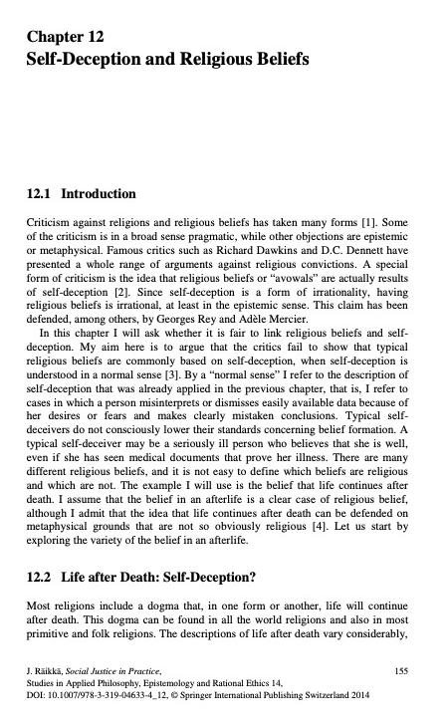

Slide 30
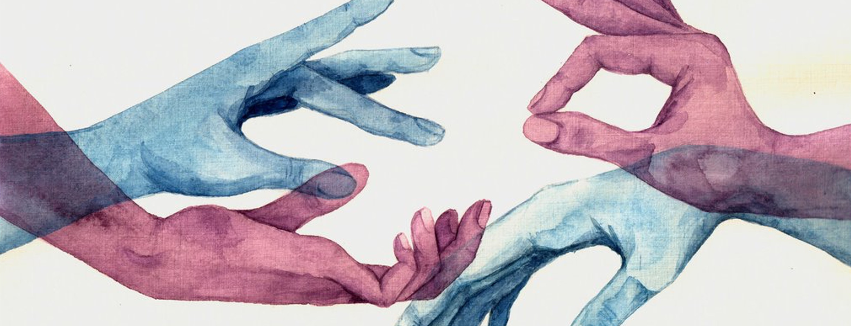
Next time: Embodying Rationality
Baghramian, M., & Nicholson, A. (2013). The Puzzle of Self‐Deception. Philosophy Compass, 8(11), 1018–1029. https://doi.org/10.1111/phc3.12083
Räikkä, J. (2007). Self-Deception and Religious Beliefs. The Heythrop Journal, 48(4), 513–526. https://doi.org/10.1111/j.1468-2265.2007.00327.x

